Slide 1
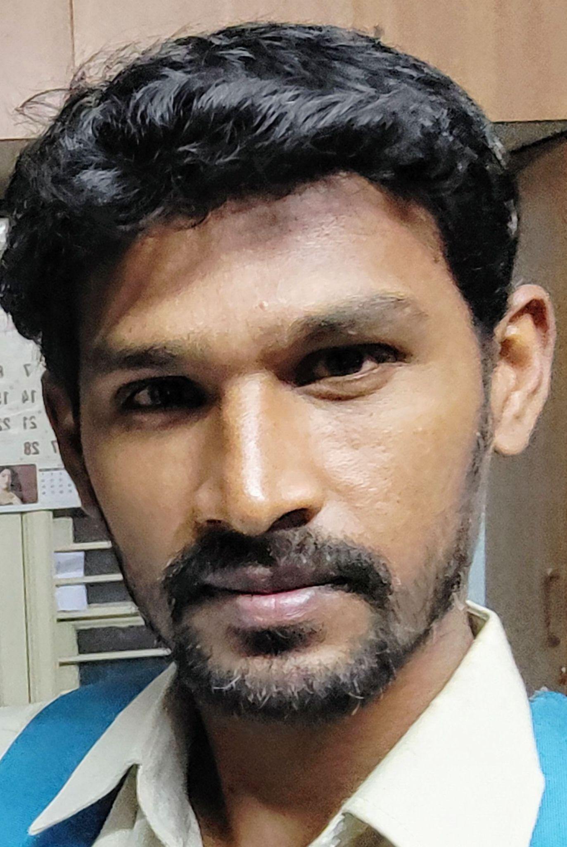
Name: Arya
Category: All Rounder
Age: 30 years Ph: 9611999614

Slide 2
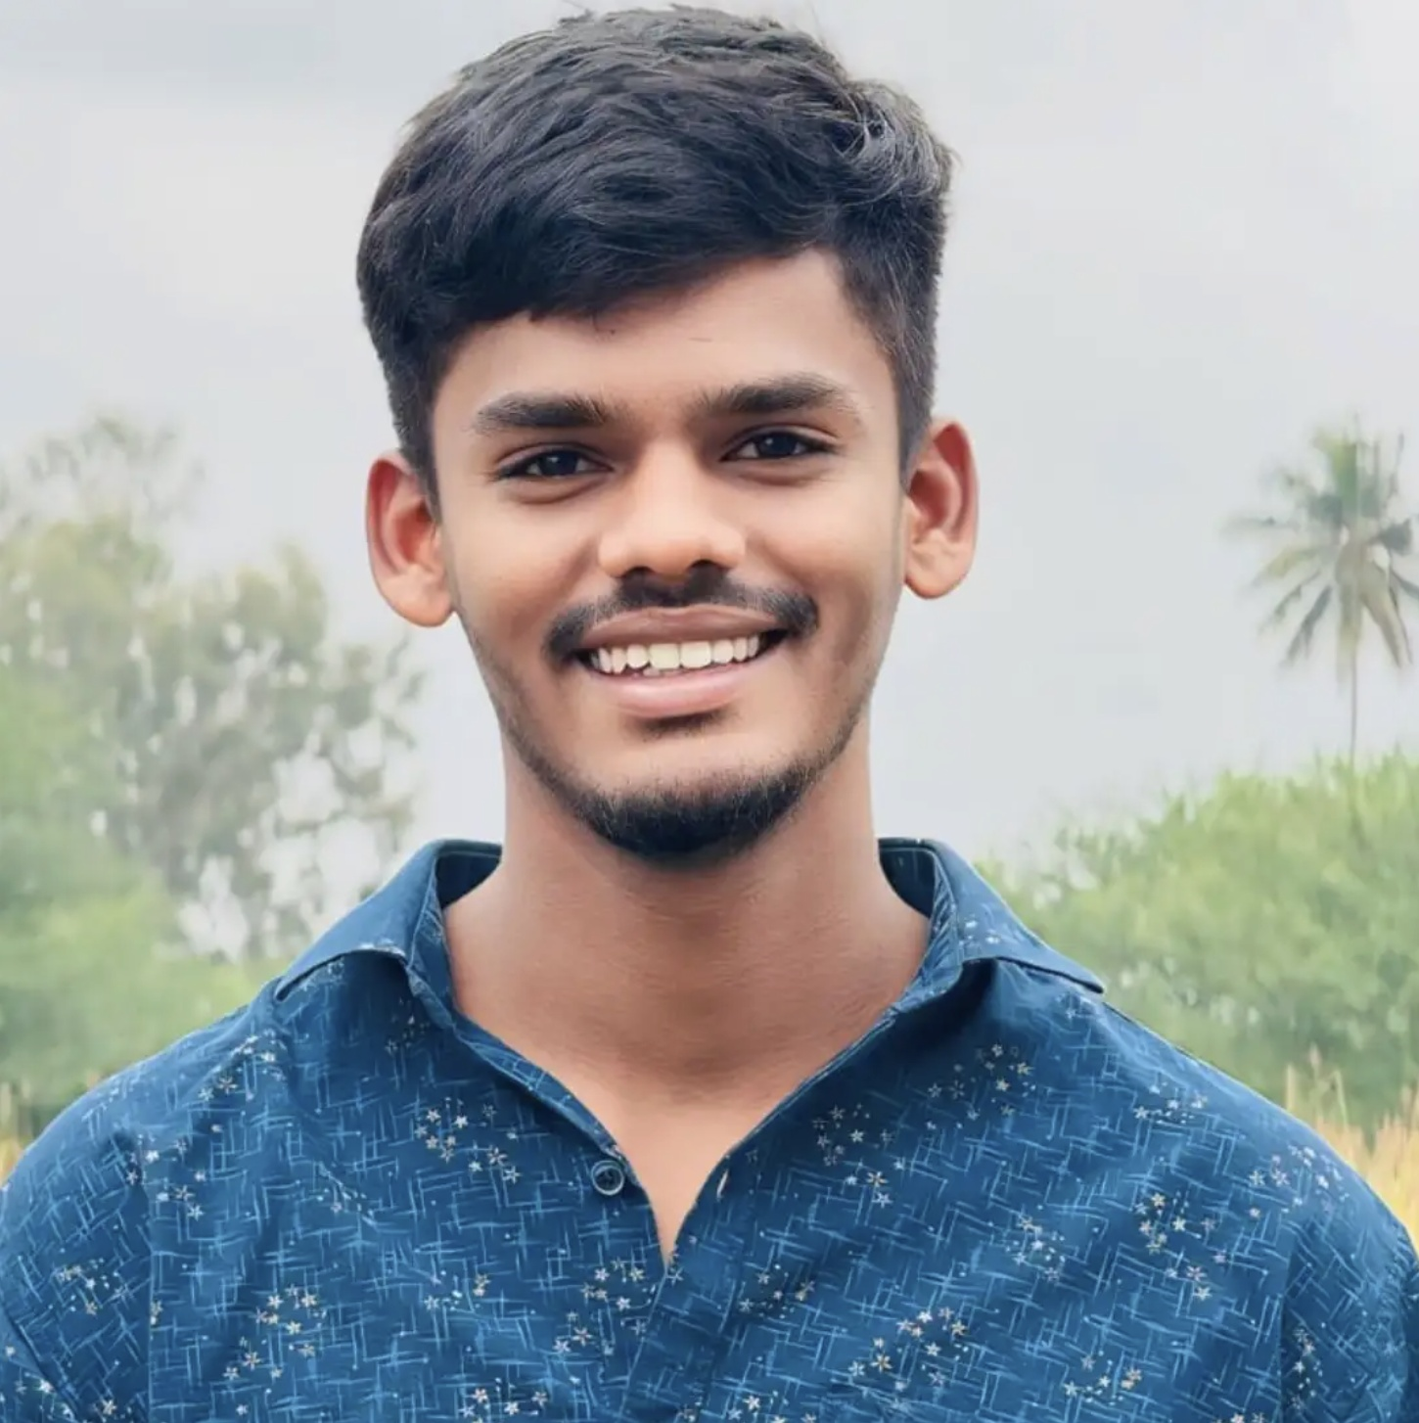
Name: Punith V
Category: All Rounder
Age: 21 years
Ph: 6360452535
Age: 21 years Ph: 6360452535
Category: All Rounder

Slide 3
Name: Subramani
Category: Batsman
Age: 27 years
Ph: 6360937589
Age: 27 years Ph: 6360937589
Category: Batsman

Slide 4
Name: Manjunatha BG
Category: All Rounder
Age: 32 years
Ph: 6362049445
Age: 32 years Ph: 6362049445
Category: All Rounder

Slide 5
Name: Mohan Rao
Category: All Rounder
Age: 27 years
Ph: 7014841335
Age: 27 years Ph: 7014841335
Category: All Rounder

Slide 6
Name: Lokesh J
Category: Batsman
Age: 22 years
Ph: 7022190895
Age: 22 years Ph: 7022190895
Category: Batsman

Slide 7
Name: Kiran M
Category: Batsman
Age: 23 years
Ph: 7022550833
Age: 23 years Ph: 7022550833
Category: Batsman

Slide 8
Name: Sharanu V
Category: All Rounder
Age: 21 years
Ph: 7022731680
Age: 21 years Ph: 7022731680
Category: All Rounder

Slide 9
Name: Shivanand
Category: All Rounder
Age: 31 years
Ph: 7204691096
Age: 31 years Ph: 7204691096
Category: All Rounder

Slide 10
Name: Kailash
Category: All Rounder
Age: 32 years
Ph: 7259693680
Age: 32 years Ph: 7259693680
Category: All Rounder

Slide 11
Name: Kumar
Category: All Rounder
Age: 26 years
Ph: 7338632438
Age: 26 years Ph: 7338632438
Category: All Rounder

Slide 12
Name: Lingraj
Category: Batsman
Age: 20 years
Ph: 7349651319
Age: 20 years Ph: 7349651319
Category: Batsman

Slide 13
Name: Dhanush R
Category: Batsman
Age: 20 years
Ph: 7411352556
Age: 20 years Ph: 7411352556
Category: Batsman

Slide 14
Name: Goutham
Category: Batsman
Age: 23 years
Ph: 7411721373
Age: 23 years Ph: 7411721373
Category: Batsman

Slide 15
Name: Ambrish
Category: All Rounder
Age: 32 years
Ph: 7619379377
Age: 32 years Ph: 7619379377
Category: All Rounder

Slide 16
Name: Vikas
Category: Batsman
Age: 24 years
Ph: 7619518400
Age: 24 years Ph: 7619518400
Category: Batsman

Slide 17
Name: Tarun Reddy
Category: Batsman
Age: 26 years
Ph: 7676761221
Age: 26 years Ph: 7676761221
Category: Batsman

Slide 18
Name: Vishwas R
Category: All Rounder
Age: 26 years
Ph: 7676762367
Age: 26 years Ph: 7676762367
Category: All Rounder

Slide 19
Name: Bharath S
Category: Batsman
Age: 29 years
Ph: 7676765445
Age: 29 years Ph: 7676765445
Category: Batsman

Slide 20
Name: Shiva Prasad
Category: Batsman
Age: 25 years
Ph: 7760218518
Age: 25 years Ph: 7760218518
Category: Batsman

Slide 21
Name: Govardhan
Category: Batsman
Age: 22 years
Ph: 7760993459
Age: 22 years Ph: 7760993459
Category: Batsman

Slide 22
Name: Afthab
Category: Batsman
Age: 23 years
Ph: 7795259224
Age: 23 years Ph: 7795259224
Category: Batsman

Slide 23
Name: Shashank
Category: Batsman
Age: 21 years
Ph: 7795582288
Age: 21 years Ph: 7795582288
Category: Batsman

Slide 24
Name: Uday Kiran
Category: Batsman
Age: 25 years
Ph: 7899049568
Age: 25 years Ph: 7899049568
Category: Batsman

Slide 25
Name: Kishan
Category: All Rounder
Age: 14 years
Ph: 7899392188
Age: 14 years Ph: 7899392188
Category: All Rounder

Slide 26
Name: Madhu Prasad
Category: Batsman
Age: 26 years
Ph: 8050867265
Age: 26 years Ph: 8050867265
Category: Batsman

Slide 27
Name: Yeshwanth B S
Category: Batsman
Age: 25 years
Ph: 8073713026
Age: 25 years Ph: 8073713026
Category: Batsman

Slide 28
Name: Sachin N
Category: Batsman
Age: 26 years
Ph: 8073943636
Age: 26 years Ph: 8073943636
Category: Batsman

Slide 29
Name: Bhargav K
Category: Batsman
Age: 17 years
Ph: 8123054335
Age: 17 years Ph: 8123054335
Category: Batsman

Slide 30
Name: Bharath
Category: All Rounder
Age: 26 years
Ph: 8123263208
Age: 26 years Ph: 8123263208
Category: All Rounder

Slide 31
Name: Vinay G
Category: Batsman
Age: 23 years
Ph: 8123265156
ICON Player
Age: 23 years Ph: 8123265156
Category: Batsman
ICON Player

Slide 32
Name: Anil Reddy
Category: All Rounder
Age: 26 years
Ph: 8123388804
Age: 26 years Ph: 8123388804
Category: All Rounder

Slide 33
Name: Avinash
Category: Batsman
Age: 29 years
Ph: 8123744990
Age: 29 years Ph: 8123744990
Category: Batsman

Slide 34
Name: Sanjay Kumar
Category: Batsman
Age: 26 years
Ph: 8147011437
Age: 26 years Ph: 8147011437
Category: Batsman

Slide 35
Name: Manjunatha
Category: All Rounder
Age: 31 years
Ph: 8147429118
Age: 31 years Ph: 8147429118
Category: All Rounder

Slide 36
Name: Nagavendra M
Category: All Rounder
Age: 35 years
Ph: 8197661719
Age: 35 years Ph: 8197661719
Category: All Rounder

Slide 37
Name: Sachin G
Category: Batsman
Age: 27 years
Ph: 8217347563
Age: 27 years Ph: 8217347563
Category: Batsman

Slide 38
Name: Sanjay BK
Category: All Rounder
Age: 27 years
Ph: 8217853871
Age: 27 years Ph: 8217853871
Category: All Rounder

Slide 39
Name: Suman Reddy
Category: Batsman, Wicket Keeper
Age: 28 years
Ph: 8296151789
Age: 28 years Ph: 8296151789
Category: Batsman, Wicket Keeper

Slide 40
Name: Manoj Reddy
Category: All Rounder
Age: 21 years
Ph: 8310511078
Age: 21 years Ph: 8310511078
Category: All Rounder

Slide 41
Name: Anil Kumar B K
Category: All Rounder
Age: 35 years
Ph: 8310714306
Age: 35 years Ph: 8310714306
Category: All Rounder

Slide 42
Name: Sunil Diesel
Category: Wicket Keeper
Age: 43 years
Ph: 8317448327
Age: 43 years Ph: 8317448327
Category: Wicket Keeper

Slide 43
Name: Azhar Khan
Category: Batsman
Age: 39 years
Ph: 8693908342
Age: 39 years Ph: 8693908342
Category: Batsman

Slide 44
Name: Naveen Kumar
Category: All Rounder
Age: 29 years
Ph: 8867282226
Age: 29 years Ph: 8867282226
Category: All Rounder

Slide 45
Name: Karthik P
Category: Batsman
Age: 26 years
Ph: 8880388889
Age: 26 years Ph: 8880388889
Category: Batsman

Slide 46
Name: Nithin Kumar
Category: All Rounder
Age: 27 years
Ph: 8904774933
Age: 27 years Ph: 8904774933
Category: All Rounder

Slide 47
Name: Kashif
Category: All Rounder
Age: 20 years
Ph: 8971110413
Age: 20 years Ph: 8971110413
Category: All Rounder

Slide 48
Name: Dishank
Category: All Rounder
Age: 35 years
Ph: 9008481848
Age: 35 years Ph: 9008481848
Category: All Rounder

Slide 49
Name: Yash
Category: Batsman
Age: 24 years
Ph: 9008659880
Age: 24 years Ph: 9008659880
Category: Batsman

Slide 50
Name: Chethan
Category: Batsman
Age: 31 years
Ph: 9008796333
ICON Player
Age: 31 years Ph: 9008796333
Category: Batsman
ICON Player

Slide 51
Name: Sanjay Kumar Appi
Category: All Rounder
Ph: 9019913566
Age: 30 years Ph: 9019913566

Slide 52
Name: Indresh Kumar
Category: All Rounder
Age: 34 years
Ph: 9035751115
Age: 34 years Ph: 9035751115
Category: All Rounder

Slide 53
Name: Ravindra
Category: Batsman
Age: 40 years
Ph: 9036110064
Age: 40 years Ph: 9036110064
Category: Batsman

Slide 54
Name: Anil
Category: Batsman
Age: 38 years
Ph: 9108444706
ICON Player
Age: 38 years Ph: 9108444706
Category: Batsman
ICON Player

Slide 55
Name: Vinay Kumar
Category: All Rounder
Age: 27 years
Ph: 9113941421
Age: 27 years Ph: 9113941421
Category: All Rounder

Slide 56
Name: Shashidhar
Category: Batsman
Age: 30 years
Ph: 9148046396
Age: 30 years Ph: 9148046396
Category: Batsman

Slide 57
Name: Basavaraj
Category: Batsman
Age: 23 years
Ph: 9148634810
Age: 23 years Ph: 9148634810
Category: Batsman

Slide 58
Name: Shashi Kumar
Category: Batsman
Age: 34 years
Ph: 9148849740
Age: 34 years Ph: 9148849740
Category: Batsman

Slide 59
Name: Mohan M
Category: Batsman
Age: 22 years
Ph: 9148938382
Age: 22 years Ph: 9148938382
Category: Batsman

Slide 60
Name: Mohamad Ali
Category: All Rounder
Age: 26 years
Ph: 9353264372
Age: 26 years Ph: 9353264372
Category: All Rounder

Slide 61
Name: S Manish
Category: Batsman
Age: 20 years
Ph: 9380234874
Age: 20 years Ph: 9380234874
Category: Batsman

Slide 62
Name: Anil Kumar HR
Category: All Rounder
Age: 24 years
Ph: 9380619989
Age: 24 years Ph: 9380619989
Category: All Rounder

Slide 63
Name: Shiva C
Category: All Rounder
Age: 26 years
Ph: 9449777563
Age: 26 years Ph: 9449777563
Category: All Rounder

Slide 64
Name: Mallikarjun
Category: Bowler
Age: 34 years
Ph: 9513465666
Age: 34 years Ph: 9513465666
Category: Bowler

Slide 65
Name: Jaga
Category: All Rounder
Age: 35 years
Ph: 9513631219
Age: 35 years Ph: 9513631219
Category: All Rounder

Slide 66
Name: Srikanth
Category: Batsman
Age: 24 years
Ph: 9535053189
Age: 24 years Ph: 9535053189
Category: Batsman

Slide 67
Name: Yeshwanth V
Category: Batsman
Age: 27 years
Ph: 9535500446
Age: 27 years Ph: 9535500446
Category: Batsman

Slide 68
Name: Satyajit Reddy
Category: All Rounder
Age: 20 years
Ph: 9535533664
Age: 20 years Ph: 9535533664
Category: All Rounder

Slide 69
Name: Narayana Swamy
Category: Batsman
Age: 29 years
Ph: 9535689777
Age: 29 years Ph: 9535689777
Category: Batsman

Slide 70
Name: Kishore
Category: Batsman
Age: 31 years
Ph: 9535815098
Age: 31 years Ph: 9535815098
Category: Batsman

Slide 71
Name: Dhanush B
Category: All Rounder
Age: 28 years
Ph: 9535988176
Age: 28 years Ph: 9535988176
Category: All Rounder

Slide 72
Name: Nitesh S
Category: All Rounder
Age: 28 years
Ph: 9535991650
Age: 28 years Ph: 9535991650
Category: All Rounder

Slide 73
Name: Sandeep Kumar
Category: All Rounder
Age: 31 years
Ph: 9538076343
Age: 31 years Ph: 9538076343
Category: All Rounder

Slide 74
Name: Sridhar
Category: Batsman
Age: 29 years
Ph: 9538658262
Age: 29 years Ph: 9538658262
Category: Batsman

Slide 75
Name: Sudeep G
Category: All Rounder
Age: 20 years
Ph: 9538772943
Age: 20 years Ph: 9538772943
Category: All Rounder

Slide 76
Name: Nikhil Prabhakar
Category: All Rounder
Age: 28 years
Ph: 9591101802
Age: 28 years Ph: 9591101802
Category: All Rounder

Slide 77
Name: Vijay Kumar
Category: All Rounder
Age: 42 years
Ph: 9591383139
Age: 42 years Ph: 9591383139
Category: All Rounder

Slide 78
Name: Manjunth M
Category: All Rounder
Ph: 9591589009
Age: 30 years Ph: 9591589009

Slide 79
Name: Mithun M
Category: All Rounder
Age: 25 years
Ph: 9591755567
Age: 25 years Ph: 9591755567
Category: All Rounder

Slide 80
Name: Sridhar M
Category: Batsman
Age: 20 years
Ph: 9606575937
Age: 20 years Ph: 9606575937
Category: Batsman

Slide 81
Name: Ravi Kumar BK
Category: Batsman
Age: 37 years
Ph: 9611106928
Age: 37 years Ph: 9611106928
Category: Batsman

Slide 82
Name: Chetan N
Category: Batsman
Age: 33 years
Ph: 9611111666
Age: 33 years Ph: 9611111666
Category: Batsman

Slide 83
Name: Basavaraj
Category: All Rounder
Age: 18 years
Ph: 9611144490
Age: 18 years Ph: 9611144490
Category: All Rounder

Slide 84
Name: Varchas Reddy
Category: All Rounder
Age: 22 years
Ph: 9611360570
Age: 22 years Ph: 9611360570
Category: All Rounder

Slide 85
Name: Pradeep BG
Category: Bowler
Age: 35 years
Ph: 9611494999
Age: 35 years Ph: 9611494999
Category: Bowler

Slide 86
Name: Arya
Category: All Rounder
Age: 30 years
Ph: 9611999614
Age: 30 years Ph: 9611999614
Category: All Rounder

Slide 87
Name: Sanjay Kumar
Category: Batsman
Age: 26 years
Ph: 9620191414
Age: 26 years Ph: 9620191414
Category: Batsman

Slide 88
Name: Babu Prasad
Category: All Rounder
Age: 32 years
Ph: 9620206600
Age: 32 years Ph: 9620206600
Category: All Rounder

Slide 89
Name: Yuvaraj
Category: Batsman
Age: 25 years
Ph: 9620310245
Age: 25 years Ph: 9620310245
Category: Batsman

Slide 90
Name: VR Kshatriya
Category: All Rounder
Age: 32 years
Ph: 9632138055
Age: 32 years Ph: 9632138055
Category: All Rounder

Slide 91
Name: Saravana
Category: Batsman
Age: 24 years
Ph: 9632322485
Age: 24 years Ph: 9632322485
Category: Batsman

Slide 92
Name: Shashidhar
Category: Batsman
Age: 35 years
Ph: 9632541001
Age: 35 years Ph: 9632541001
Category: Batsman

Slide 93
Name: Bharath R
Category: All Rounder
Age: 32 years
Ph: 9632558777
Age: 32 years Ph: 9632558777
Category: All Rounder

Slide 94
Name: Chandrashekar
Category: Batsman
Age: 37 years
Ph: 9663510908
Age: 37 years Ph: 9663510908
Category: Batsman

Slide 95
Name: Mahesh
Category: All Rounder
Age: 45 years
Ph: 9663993399
Age: 45 years Ph: 9663993399
Category: All Rounder

Slide 96
Name: Ranjith
Category: All Rounder
Age: 25 years
Ph: 9686208176
Age: 25 years Ph: 9686208176
Category: All Rounder

Slide 97
Name: Siddalinga
Category: All Rounder
Ph: 9686229057
Age: 30 years Ph: 9686229057

Slide 98
Name: Krishnamurthy
Category: Bowler
Age: 32 years
Ph: 9686333928
Age: 32 years Ph: 9686333928
Category: Bowler

Slide 99
Name: M Vamshi
Category: All Rounder
Age: 16 years
Ph: 9686616327
Age: 16 years Ph: 9686616327
Category: All Rounder

Slide 100
Name: Guru Raghavendra
Category: All Rounder
Ph: 9686623625
Age: 30 years Ph: 9686623625

Slide 101
Name: Sandeep Kumar S
Category: All Rounder
Age: 33 years
Ph: 9738342349
Age: 33 years Ph: 9738342349
Category: All Rounder

Slide 102
Name: Dhanush N
Category: Batsman
Age: 27 years
Ph: 9738899414
Age: 27 years Ph: 9738899414
Category: Batsman

Slide 103
Name: Hitesh G
Category: All Rounder
Age: 24 years
Ph: 9739050679
Age: 24 years Ph: 9739050679
Category: All Rounder

Slide 104
Name: Kunal Bhargava
Category: All Rounder
Age: 38 years
Ph: 9739363656
Age: 38 years Ph: 9739363656
Category: All Rounder

Slide 105
Name: Munikrishna
Category: All Rounder
Age: 28 years
Ph: 9739586978
Age: 28 years Ph: 9739586978
Category: All Rounder

Slide 106
Name: Murugesh M
Category: Batsman
Age: 30 years
Ph: 9739721772
Age: 30 years Ph: 9739721772
Category: Batsman

Slide 107
Name: Arun Kumar
Category: Batsman
Age: 26 years
Ph: 9740489284
Age: 26 years Ph: 9740489284
Category: Batsman

Slide 108
Name: Kiran
Category: Batsman
Age: 29 years
Ph: 9740834449
Age: 29 years Ph: 9740834449
Category: Batsman

Slide 109
Name: Mithun Murthy
Category: All Rounder
Age: 20 years
Ph: 9741440817
Age: 20 years Ph: 9741440817
Category: All Rounder

Slide 110
Name: Vasanth Kumar
Category: Batsman
Age: 28 years
Ph: 9742060594
Age: 28 years Ph: 9742060594
Category: Batsman

Slide 111
Name: Kantha Kumar
Category: All Rounder
Age: 32 years
Ph: 9742315080
Age: 32 years Ph: 9742315080
Category: All Rounder

Slide 112
Name: Vinay
Category: Batsman
Age: 25 years
Ph: 9742321215
Age: 25 years Ph: 9742321215
Category: Batsman

Slide 113
Name: Mahadev
Category: Batsman
Age: 26 years
Ph: 9742355554
Age: 26 years Ph: 9742355554
Category: Batsman

Slide 114
Name: Arjun Ramesh Tendulkar
Category: All Rounder
Age: 12 years
Ph: 9742386644
Age: 12 years Ph: 9742386644
Category: All Rounder

Slide 115
Name: Shankar M
Category: Batsman
Age: 30 years
Ph: 9742589701
Age: 30 years Ph: 9742589701
Category: Batsman

Slide 116
Name: Prakash
Category: Batsman
Age: 32 years
Ph: 9742715666
Age: 32 years Ph: 9742715666
Category: Batsman

Slide 117
Name: Manjunath P
Category: All Rounder
Age: 35 years
Ph: 9743015567
Age: 35 years Ph: 9743015567
Category: All Rounder

Slide 118
Name: Girish
Category: Batsman
Age: 44 years
Ph: 9745347173
Age: 44 years Ph: 9745347173
Category: Batsman

Slide 119
Name: Shiva Kumar N
Category: All Rounder
Age: 41 years
Ph: 9845079668
Age: 41 years Ph: 9845079668
Category: All Rounder

Slide 120
Name: Santhosh Reddy
Category: All Rounder
Age: 39 years
Ph: 9845372233
Age: 39 years Ph: 9845372233
Category: All Rounder

Slide 121
Name: Pradeep
Category: Batsman
Age: 42 years
Ph: 9845554410
Age: 42 years Ph: 9845554410
Category: Batsman

Slide 122
Name: Vajresh
Category: Batsman
Age: 36 years
Ph: 9845573427
ICON Player
Age: 36 years Ph: 9845573427
Category: Batsman
ICON Player

Slide 123
Name: Karagappa
Category: Batsman
Age: 43 years
Ph: 9845798817
ICON Player
Age: 43 years Ph: 9845798817
Category: Batsman
ICON Player

Slide 124
Name: BC Harish Kumar
Category: All Rounder
Age: 40 years
Ph: 9845827989
Age: 40 years Ph: 9845827989
Category: All Rounder

Slide 125
Name: Chethan
Category: Batsman
Age: 37 years
Ph: 9845944474
Age: 37 years Ph: 9845944474
Category: Batsman

Slide 126
Name: Rama Chandra
Category: All Rounder
Age: 40 years
Ph: 9845976133
Age: 40 years Ph: 9845976133
Category: All Rounder

Slide 127
Name: Uday Kumar
Category: Batsman
Age: 37 years
Ph: 9880080119
Age: 37 years Ph: 9880080119
Category: Batsman

Slide 128
Name: Narayanaswamy
Category: All Rounder
Age: 40 years
Ph: 9880296843
Age: 40 years Ph: 9880296843
Category: All Rounder

Slide 129
Name: Likith Reddy
Category: Bowler
Age: 18 years
Ph: 9880616057
Age: 18 years Ph: 9880616057
Category: Bowler

Slide 130
Name: Rajesh V
Category: All Rounder
Age: 39 years
Ph: 9880669969
Age: 39 years Ph: 9880669969
Category: All Rounder

Slide 131
Name: Praveen Kumar N
Category: All Rounder
Age: 40 years
Ph: 9880739393
Age: 40 years Ph: 9880739393
Category: All Rounder

Slide 132
Name: Dharshan M
Category: All Rounder
Age: 23 years
Ph: 9886311767
Age: 23 years Ph: 9886311767
Category: All Rounder

Slide 133
Name: Sujan Reddy B S
Category: Batsman
Age: 24 years
Ph: 9886335511
Age: 24 years Ph: 9886335511
Category: Batsman

Slide 134
Name: Dhruva Kumar
Category: Batsman
Age: 37 years
Ph: 9886668883
Age: 37 years Ph: 9886668883
Category: Batsman

Slide 135
Name: Roshan
Category: All Rounder
Age: 48 years
Ph: 9886749342
Age: 48 years Ph: 9886749342
Category: All Rounder

Slide 136
Name: Umesh BK
Category: Batsman
Age: 37 years
Ph: 9900100178
Age: 37 years Ph: 9900100178
Category: Batsman

Slide 137
Name: Bharath
Category: All Rounder
Age: 27 years
Ph: 9900310361
Age: 27 years Ph: 9900310361
Category: All Rounder

Slide 138
Name: Mahadev
Category: Batsman
Age: 24 years
Ph: 9900478358
Age: 24 years Ph: 9900478358
Category: Batsman

Slide 139
Name: Gopinath V
Category: All Rounder
Age: 40 years
Ph: 9900676026
Age: 40 years Ph: 9900676026
Category: All Rounder

Slide 140
Name: Jitin S
Category: All Rounder
Age: 20 years
Ph: 9900900666
Age: 20 years Ph: 9900900666
Category: All Rounder

Slide 141
Name: Devendra
Category: All Rounder
Age: 38 years
Ph: 9900922363
Age: 38 years Ph: 9900922363
Category: All Rounder

Slide 142
Name: Naveen Reddy
Category: All Rounder
Age: 40 years
Ph: 9901096669
Age: 40 years Ph: 9901096669
Category: All Rounder

Slide 143
Name: Anil
Category: All Rounder
Age: 23 years
Ph: 9901115633
Age: 23 years Ph: 9901115633
Category: All Rounder

Slide 144
Name: Harish M
Category: All Rounder
Age: 38 years
Ph: 9902032229
Age: 38 years Ph: 9902032229
Category: All Rounder

Slide 145
Name: Subramani
Category: Batsman
Age: 28 years
Ph: 9902294137
Age: 28 years Ph: 9902294137
Category: Batsman

Slide 146
Name: Naveen M
Category: All Rounder
Age: 28 years
Ph: 9902785999
Age: 28 years Ph: 9902785999
Category: All Rounder

Slide 147
Name: Aditya M
Category: All Rounder
Age: 34 years
Ph: 9902890795
Age: 34 years Ph: 9902890795
Category: All Rounder

Slide 148
Name: Shivaraj K
Category: Batsman
Age: 38 years
Ph: 9916812444
Age: 38 years Ph: 9916812444
Category: Batsman

Slide 149
Name: Manjunath
Category: All Rounder
Age: 47 years
Ph: 9916976357
Age: 47 years Ph: 9916976357
Category: All Rounder

Slide 150
Name: Manjunath NM
Category: All Rounder
Ph: 9945194297
Age: 30 years Ph: 9945194297

Slide 151
Name: Chetan Kumar N
Category: Bowler
Age: 39 years
Ph: 9945621717
Age: 39 years Ph: 9945621717
Category: Bowler

Slide 152
Name: Chethan Kumar
Category: Batsman
Age: 36 years
Ph: 9945829499
Age: 36 years Ph: 9945829499
Category: Batsman

Slide 153
Name: Sunil
Category: Batsman
Age: 33 years
Ph: 9964122322
Age: 33 years Ph: 9964122322
Category: Batsman

Slide 154
Name: Manjunath P
Category: Batsman
Age: 42 years
Ph: 9964399249
ICON Player
Age: 42 years Ph: 9964399249
Category: Batsman
ICON Player

Slide 155
Name: Nandan Chaitanya
Category: Batsman
Age: 37 years
Ph: 9964500100
Age: 37 years Ph: 9964500100
Category: Batsman

Slide 156
Name: Manjunath M
Category: Bowler
Age: 44 years
Ph: 9964821055
Age: 44 years Ph: 9964821055
Category: Bowler

Slide 157
Name: Karthik
Category: All Rounder
Age: 36 years
Ph: 9972418999
Age: 36 years Ph: 9972418999
Category: All Rounder

Slide 158
Name: Rohit Reddy
Category: All Rounder
Age: 19 years
Ph: 9972629127
Age: 19 years Ph: 9972629127
Category: All Rounder

Slide 159
Name: Ramesh G
Category: All Rounder
Age: 37 years
Ph: 9972723408
Age: 37 years Ph: 9972723408
Category: All Rounder

Slide 160
Name: Ishthiyak
Category: Batsman
Age: 26 years
Ph: 9980181786
Age: 26 years Ph: 9980181786
Category: Batsman

Slide 161
Name: Sandeep Reddy
Category: All Rounder
Age: 34 years
Ph: 9980548880
Age: 34 years Ph: 9980548880
Category: All Rounder

Slide 162
Name: Dhanush R
Category: Batsman
Age: 20 years
Ph: 9980598523
Age: 20 years Ph: 9980598523
Category: Batsman

Slide 163
Name: R Prajwal
Category: Batsman
Age: 27 years
Ph: 9980804533
Age: 27 years Ph: 9980804533
Category: Batsman

Slide 164
Name: Sandeep Wadhawan
Category: All Rounder
Age: 43 years
Ph: 9986015073
Age: 43 years Ph: 9986015073
Category: All Rounder

Slide 165
Name: Noorulla
Category: Batsman
Age: 37 years
Ph: 9986188370
Age: 37 years Ph: 9986188370
Category: Batsman

Slide 166
Name: Rajesh R
Category: All Rounder
Age: 35 years
Ph: 9986634888
Age: 35 years Ph: 9986634888
Category: All Rounder

Slide 167
Name: Mithun Reddy
Category: All Rounder
Age: 35 years
Ph: 9986646222
Age: 35 years Ph: 9986646222
Category: All Rounder

Slide 168
Name: Shiva
Category: All Rounder
Age: 36 years
Ph: 9986675261
Age: 36 years Ph: 9986675261
Category: All Rounder

Slide 169
Name: A Ravindranath
Category: All Rounder
Age: 48 years
Ph: 9986998229
Age: 48 years Ph: 9986998229
Category: All Rounder

Slide 170
Name: Prajwal L
Category: All Rounder
Age: 27 years
Ph: 9071198321
Age: 27 years Ph: 9071198321
Category: All Rounder

Slide 171
Name: Punith V
Category: All Rounder
Age: 21 years
Ph: 6360452535
Age: 21 years Ph: 6360452535
Category: All Rounder

Slide 172
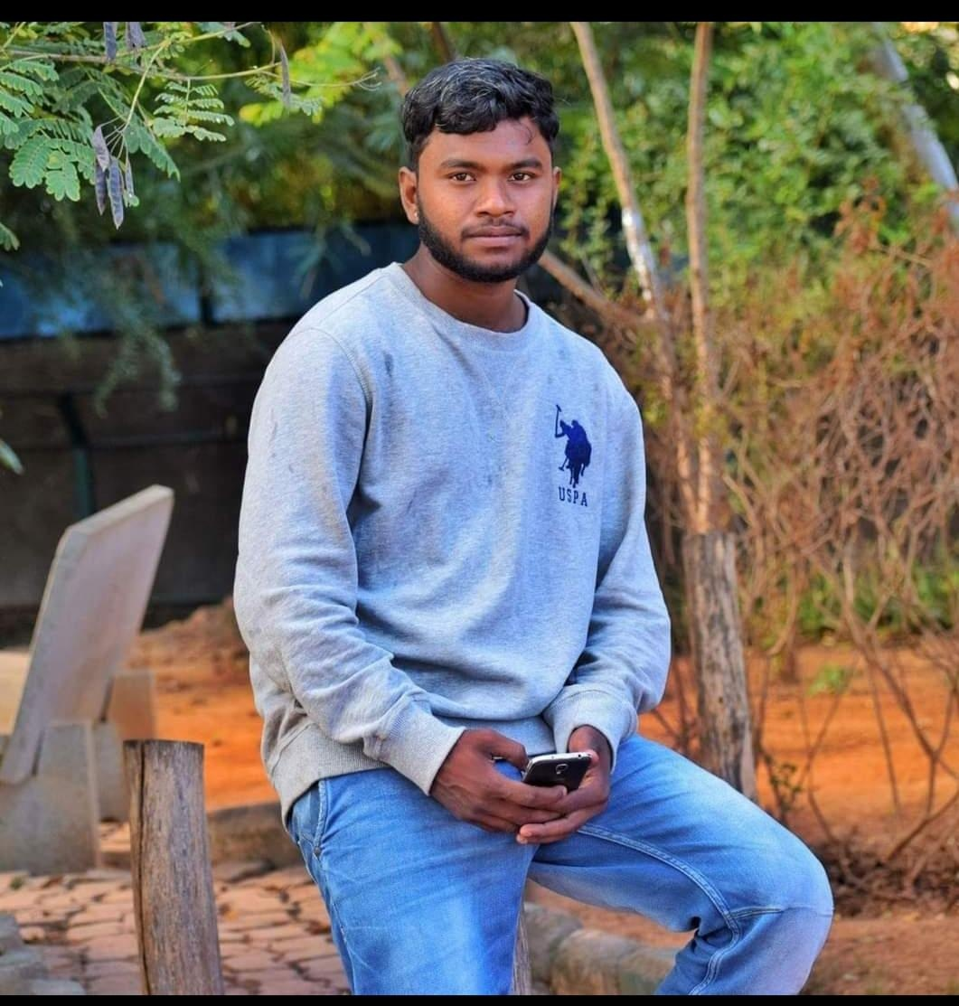
Name: Subramani
Category: Batsman
Age: 27 years
Ph: 6360937589
Age: 27 years Ph: 6360937589
Category: Batsman

Slide 173
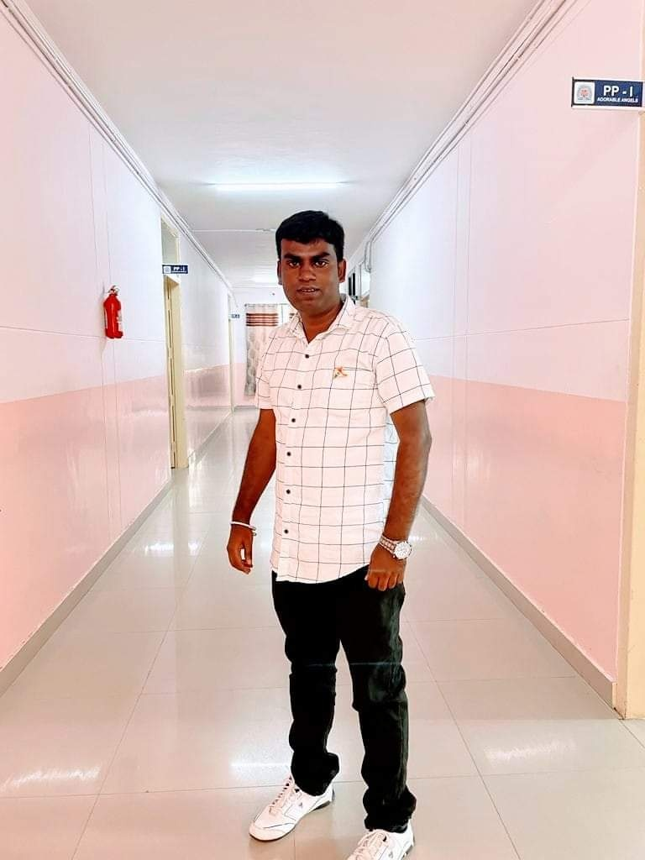
Name: Manjunatha BG
Category: All Rounder
Age: 32 years
Ph: 6362049445
Age: 32 years Ph: 6362049445
Category: All Rounder

Slide 174
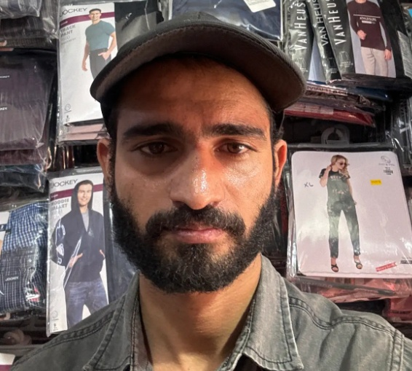
Name: Mohan Rao
Category: All Rounder
Age: 27 years
Ph: 7014841335
Age: 27 years Ph: 7014841335
Category: All Rounder

Slide 175
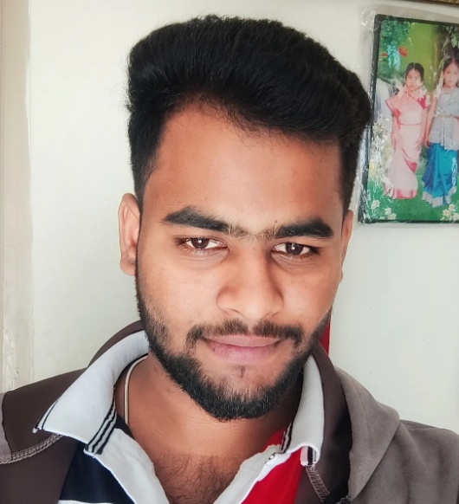
Name: Lokesh J
Category: Batsman
Age: 22 years
Ph: 7022190895
Age: 22 years Ph: 7022190895
Category: Batsman

Slide 176
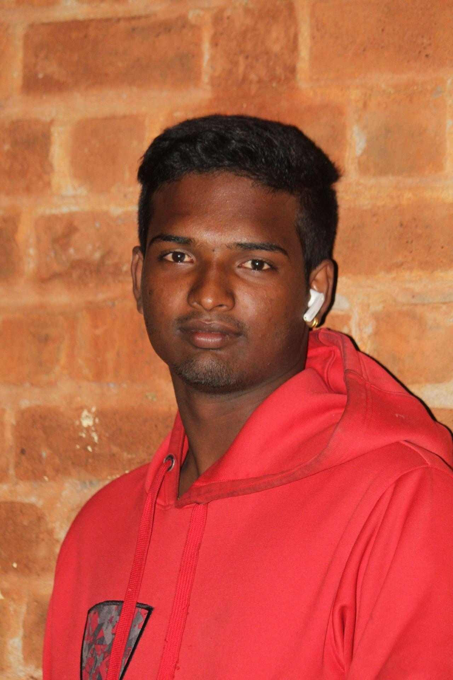
Name: Kiran M
Category: Batsman
Age: 23 years
Ph: 7022550833
Age: 23 years Ph: 7022550833
Category: Batsman

Slide 177
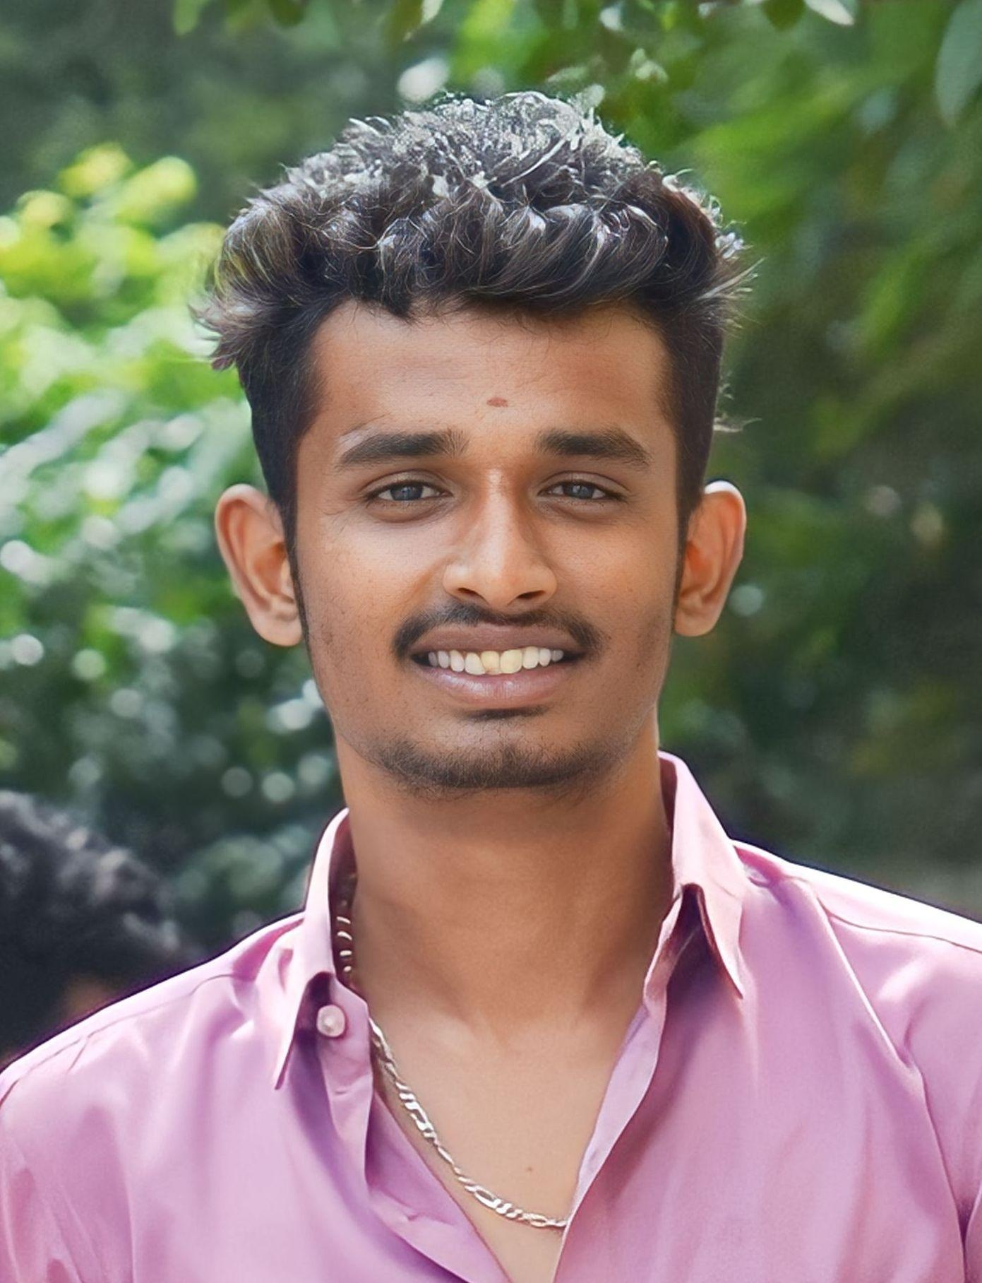
Name: Sharanu V
Category: All Rounder
Age: 21 years
Ph: 7022731680
Age: 21 years Ph: 7022731680
Category: All Rounder

Slide 178
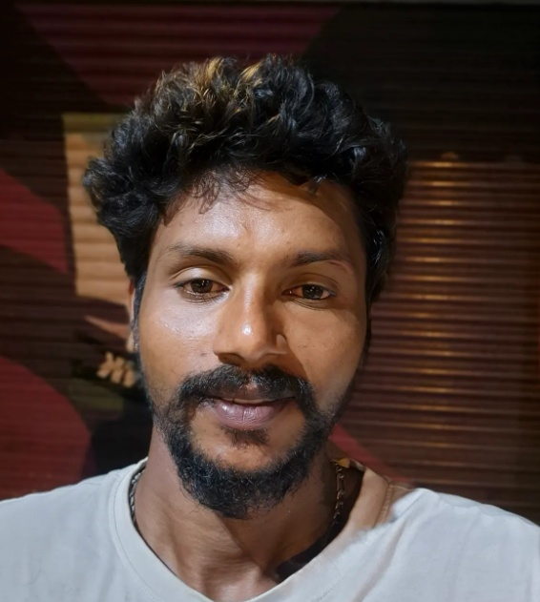
Name: Shivanand
Category: All Rounder
Age: 31 years
Ph: 7204691096
Age: 31 years Ph: 7204691096
Category: All Rounder

Slide 179
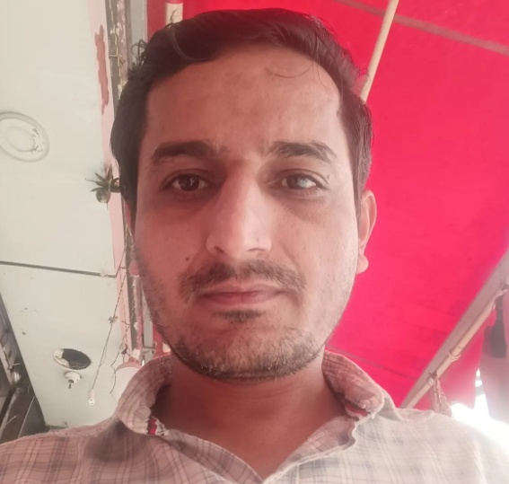
Name: Kailash
Category: All Rounder
Age: 32 years
Ph: 7259693680
Age: 32 years Ph: 7259693680
Category: All Rounder

Slide 180
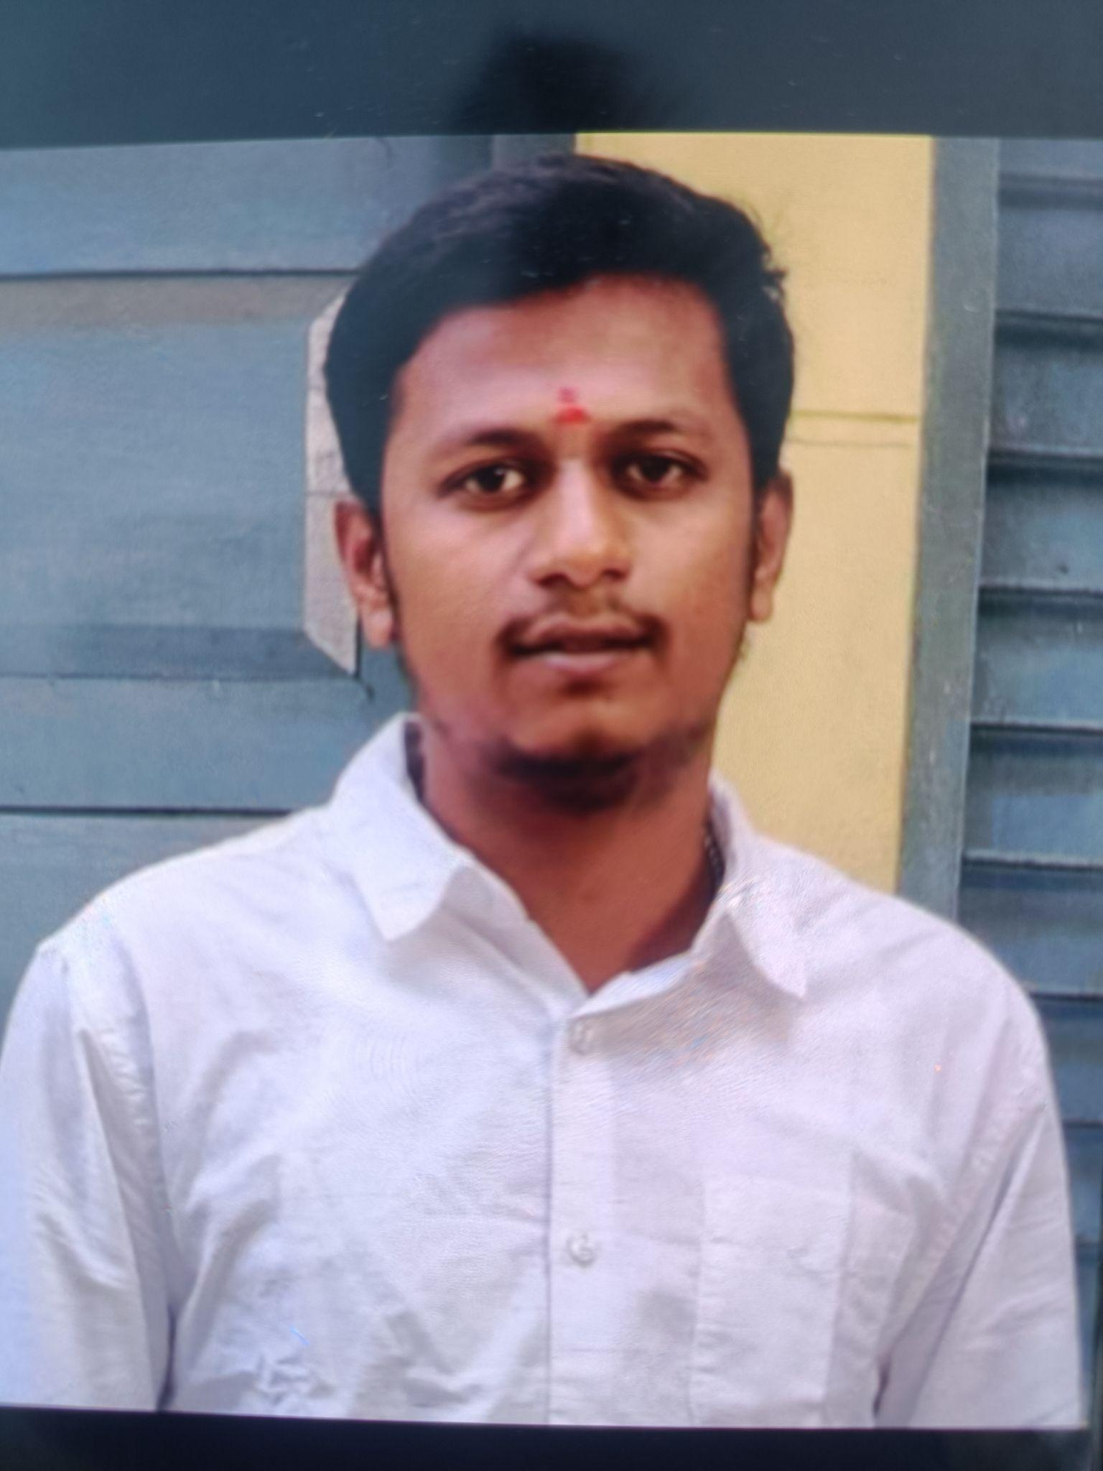
Name: Kumar
Category: All Rounder
Age: 26 years
Ph: 7338632438
Age: 26 years Ph: 7338632438
Category: All Rounder

Slide 181
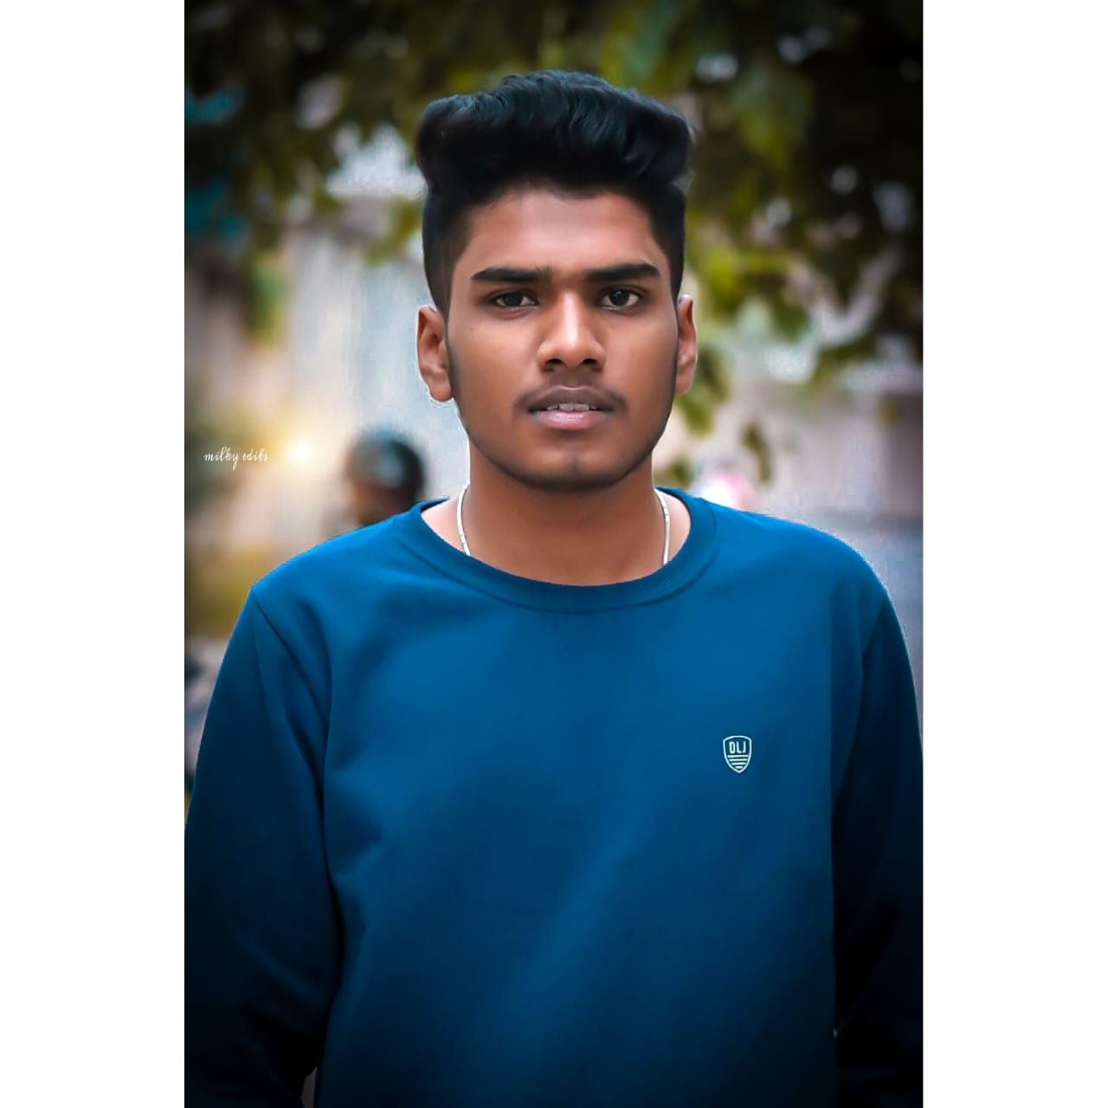
Name: Lingraj
Category: Batsman
Age: 20 years
Ph: 7349651319
Age: 20 years Ph: 7349651319
Category: Batsman

Slide 182
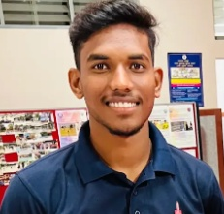
Name: Dhanush R
Category: Batsman
Age: 20 years
Ph: 7411352556
Age: 20 years Ph: 7411352556
Category: Batsman

Slide 183
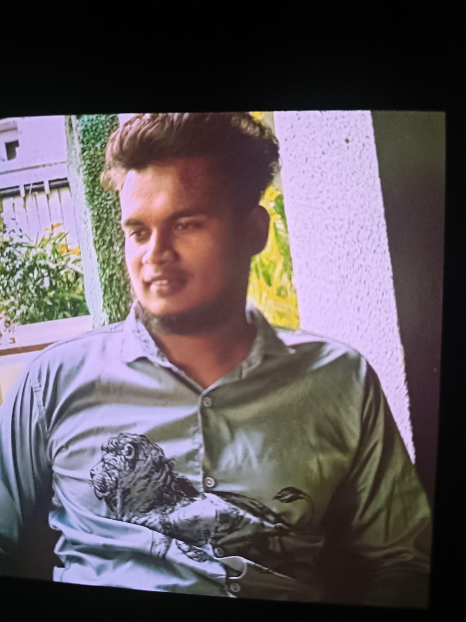
Name: Goutham
Category: Batsman
Age: 23 years
Ph: 7411721373
Age: 23 years Ph: 7411721373
Category: Batsman

Slide 184
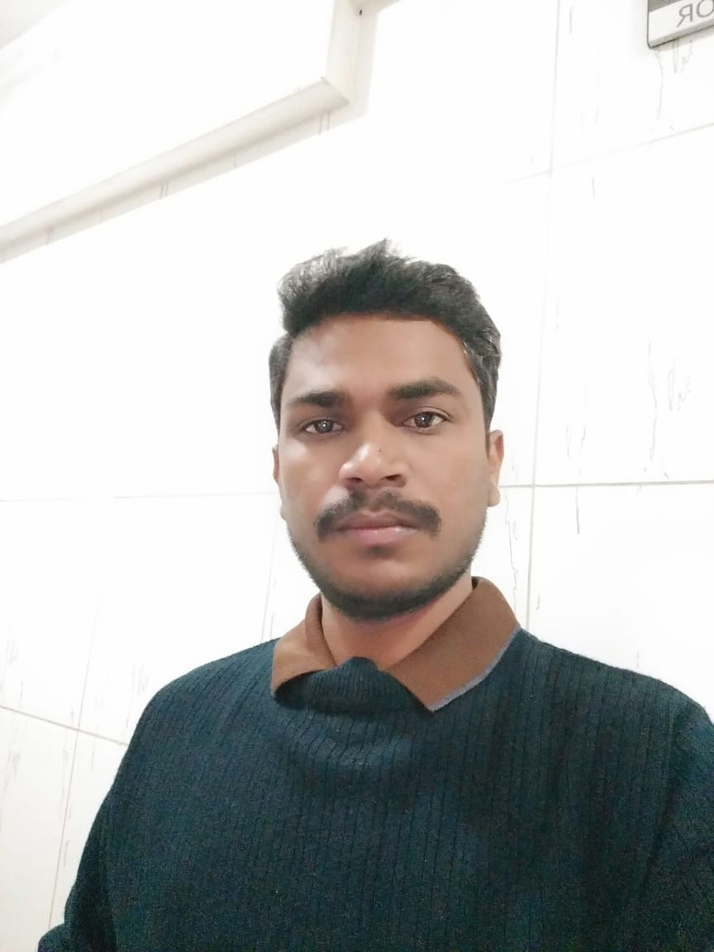
Name: Ambrish
Category: All Rounder
Age: 32 years
Ph: 7619379377
Age: 32 years Ph: 7619379377
Category: All Rounder

Slide 185
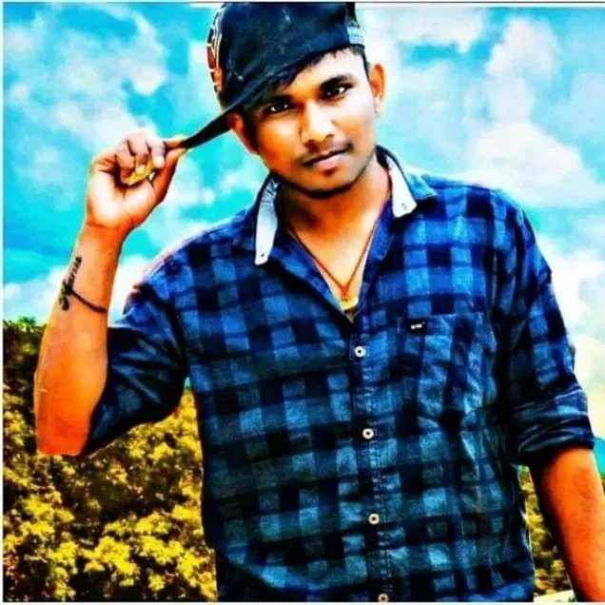
Name: Vikas
Category: Batsman
Age: 24 years
Ph: 7619518400
Age: 24 years Ph: 7619518400
Category: Batsman

Slide 186
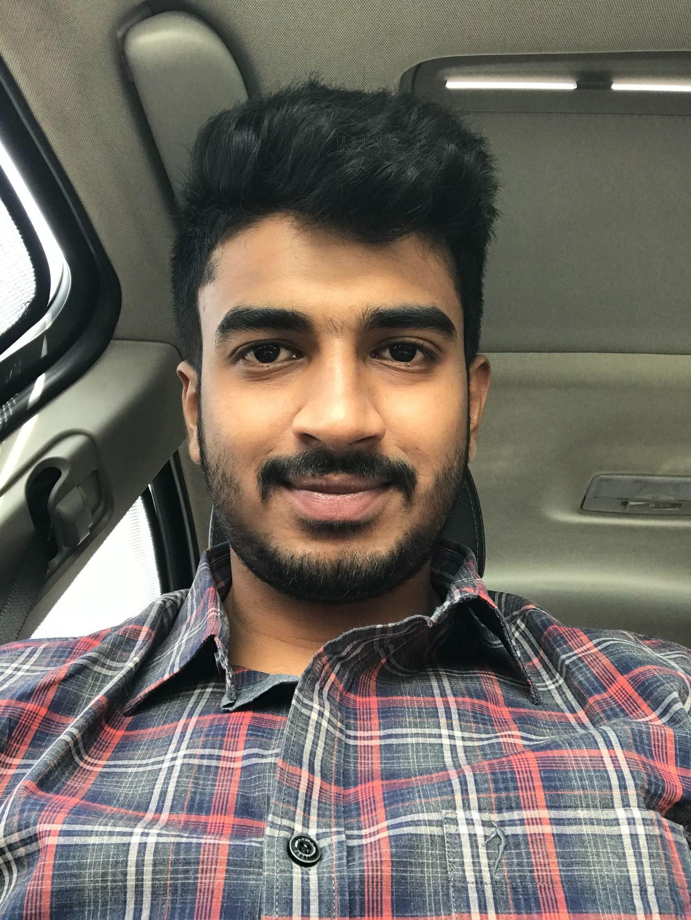
Name: Tarun Reddy
Category: Batsman
Age: 26 years
Ph: 7676761221
Age: 26 years Ph: 7676761221
Category: Batsman

Slide 187
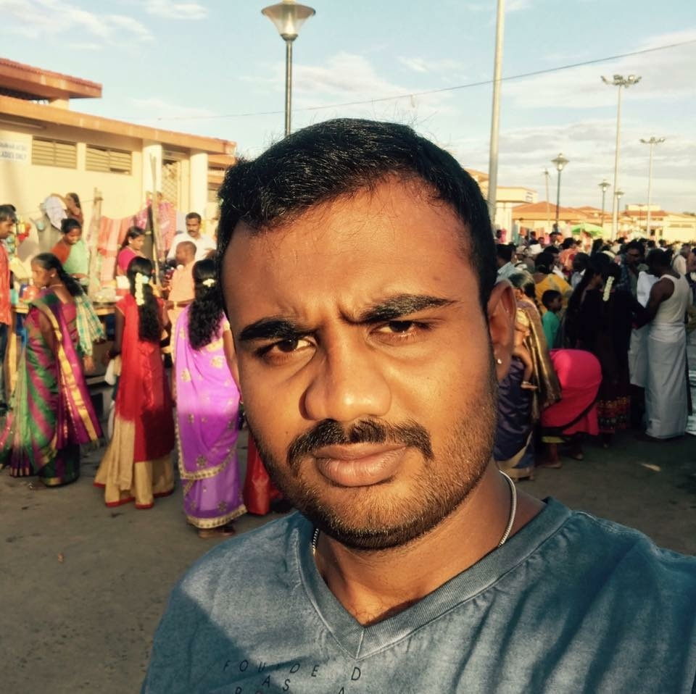
Name: Vishwas R
Category: All Rounder
Age: 26 years
Ph: 7676762367
Age: 26 years Ph: 7676762367
Category: All Rounder

Slide 188
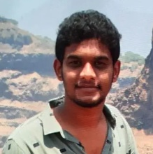
Name: Bharath S
Category: Batsman
Age: 29 years
Ph: 7676765445
Age: 29 years Ph: 7676765445
Category: Batsman

Slide 189
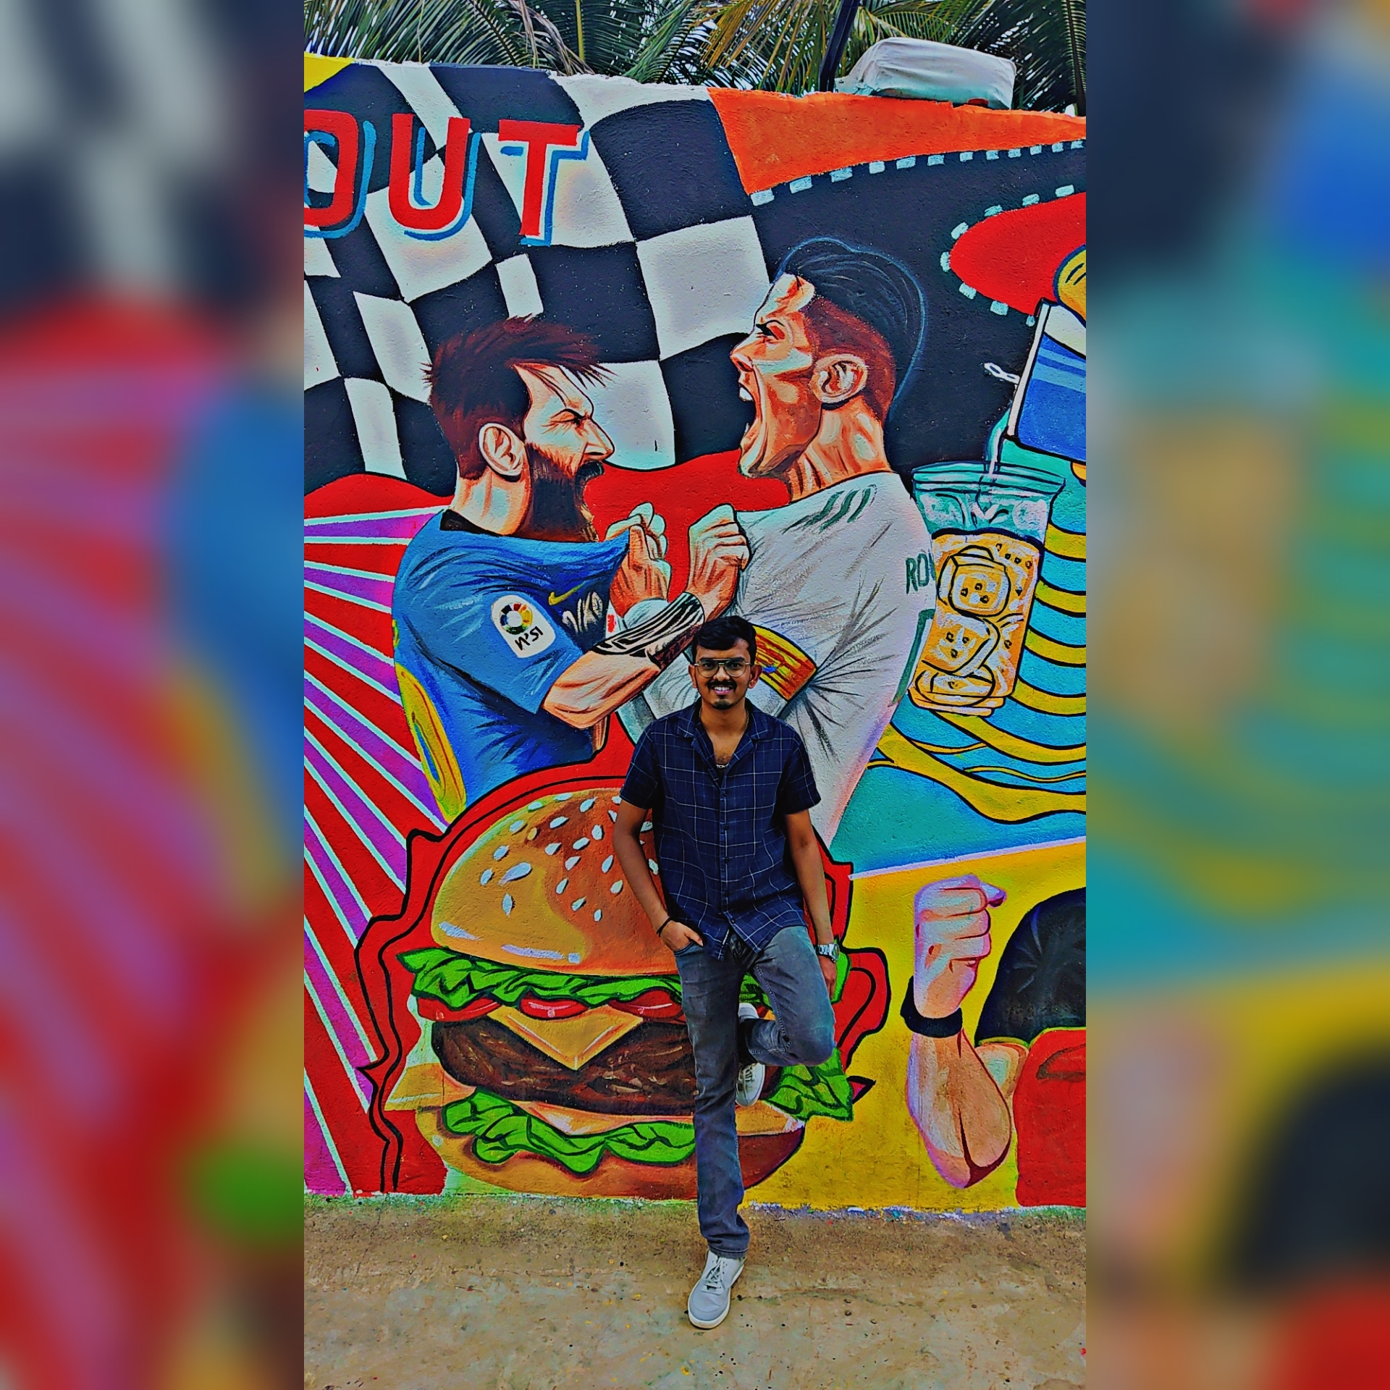
Name: Shiva Prasad
Category: Batsman
Age: 25 years
Ph: 7760218518
Age: 25 years Ph: 7760218518
Category: Batsman

Slide 190
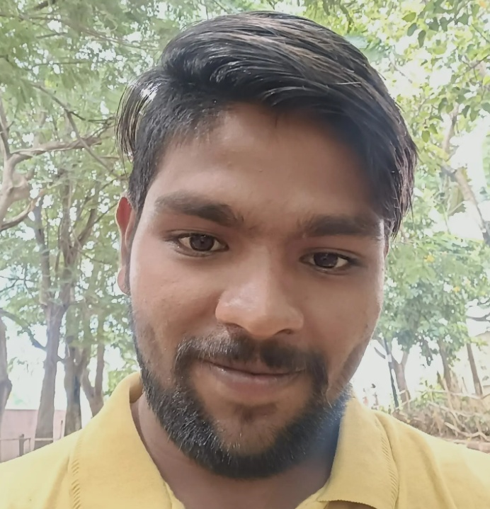
Name: Govardhan
Category: Batsman
Age: 22 years
Ph: 7760993459
Age: 22 years Ph: 7760993459
Category: Batsman

Slide 191
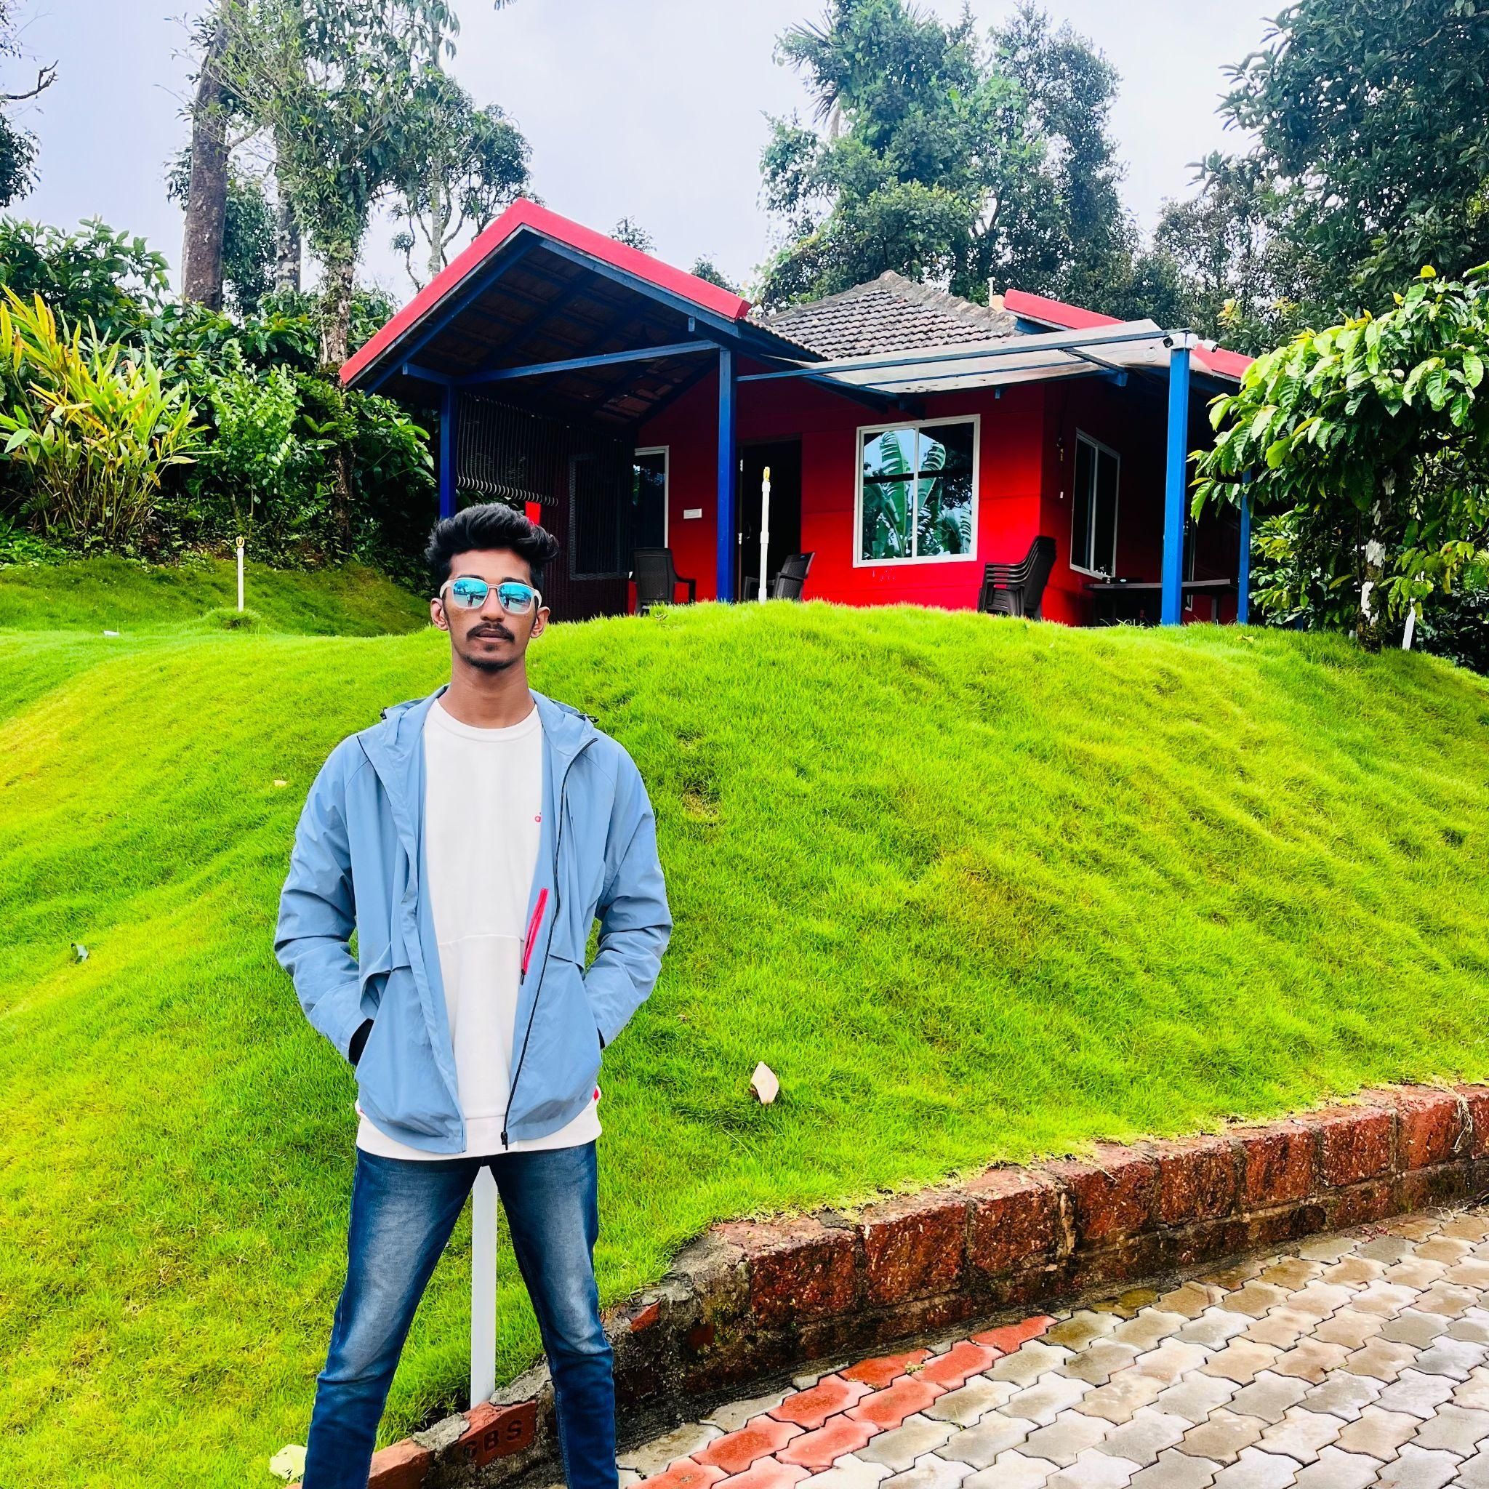
Name: Afthab
Category: Batsman
Age: 23 years
Ph: 7795259224
Age: 23 years Ph: 7795259224
Category: Batsman

Slide 192
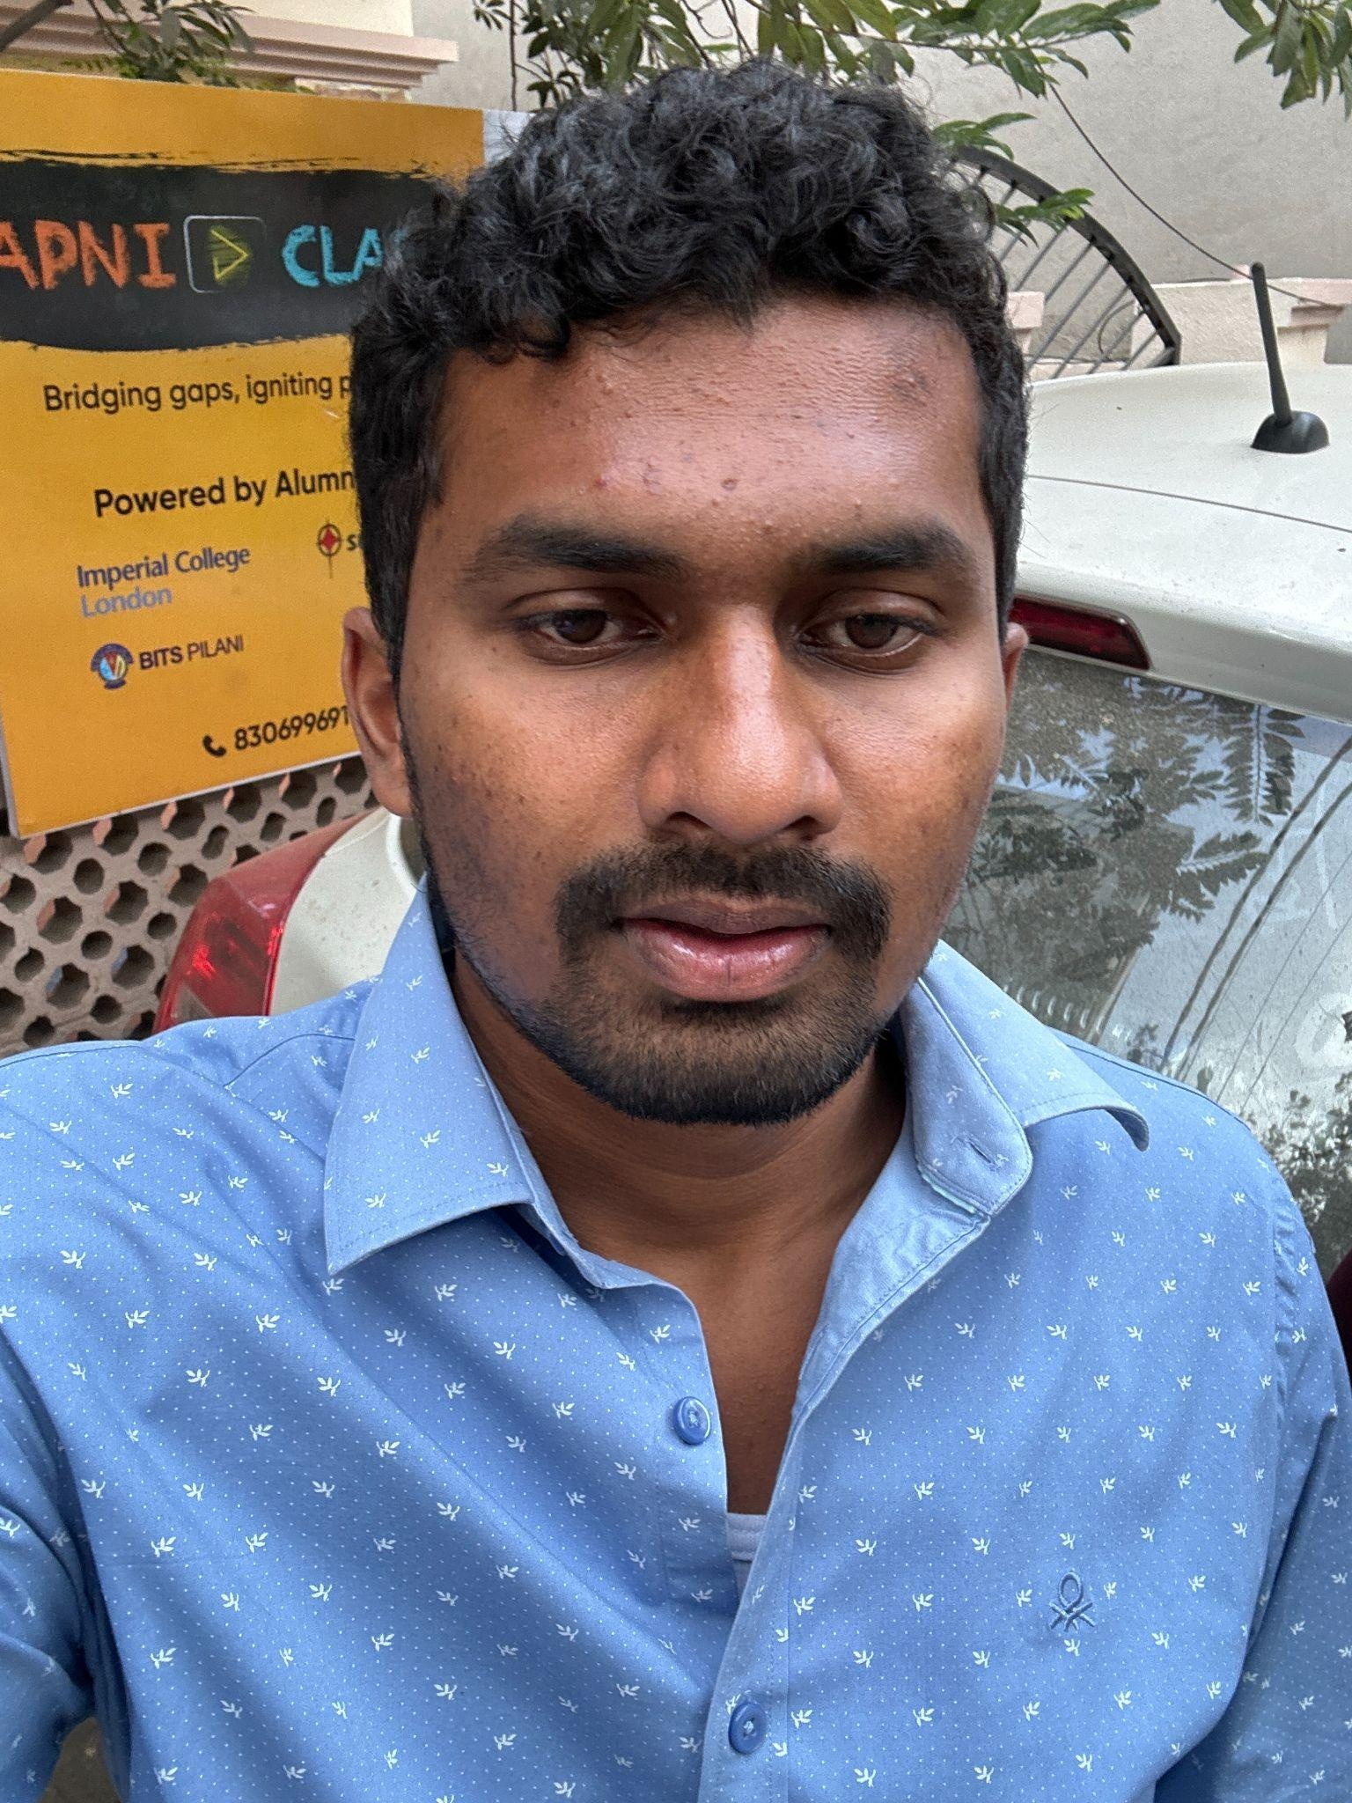
Name: Shashank
Category: Batsman
Age: 21 years
Ph: 7795582288
Age: 21 years Ph: 7795582288
Category: Batsman

Slide 193
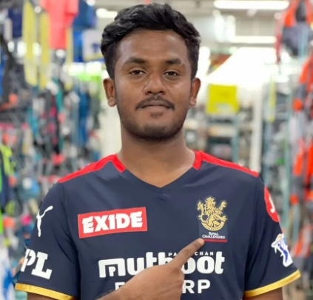
Name: Uday Kiran
Category: Batsman
Age: 25 years
Ph: 7899049568
Age: 25 years Ph: 7899049568
Category: Batsman

Slide 194
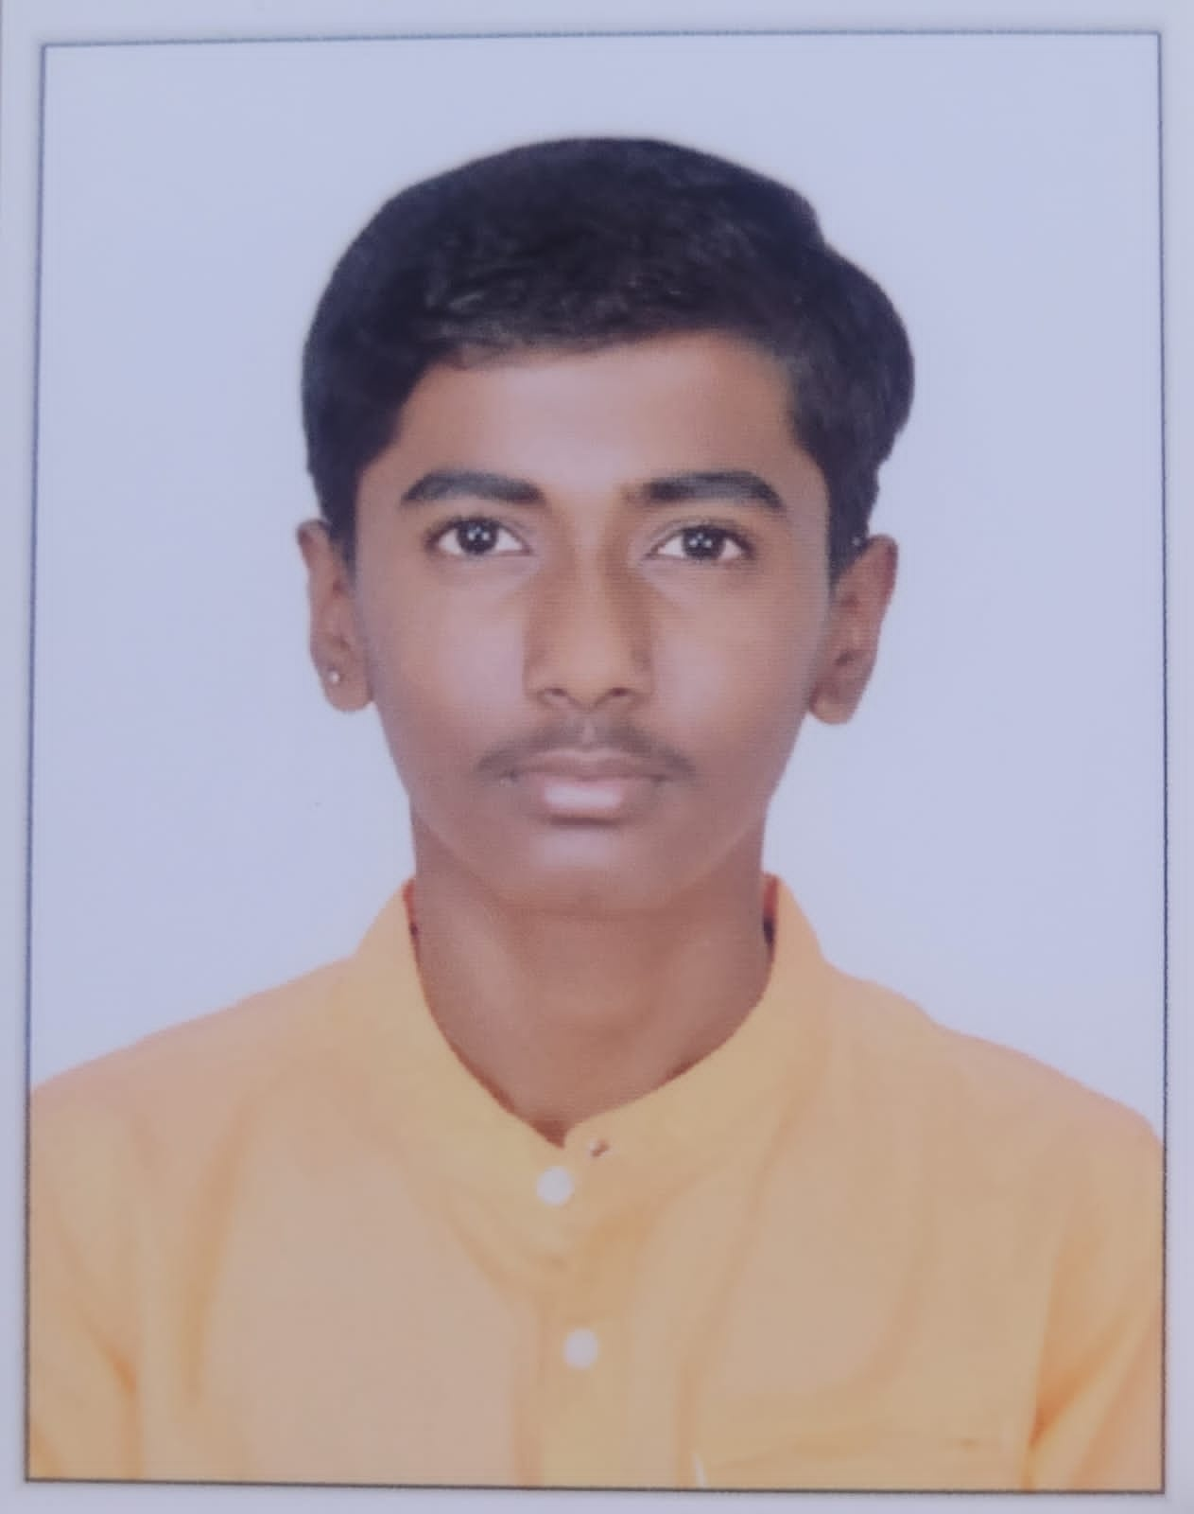
Name: Kishan
Category: All Rounder
Age: 14 years
Ph: 7899392188
Age: 14 years Ph: 7899392188
Category: All Rounder

Slide 195
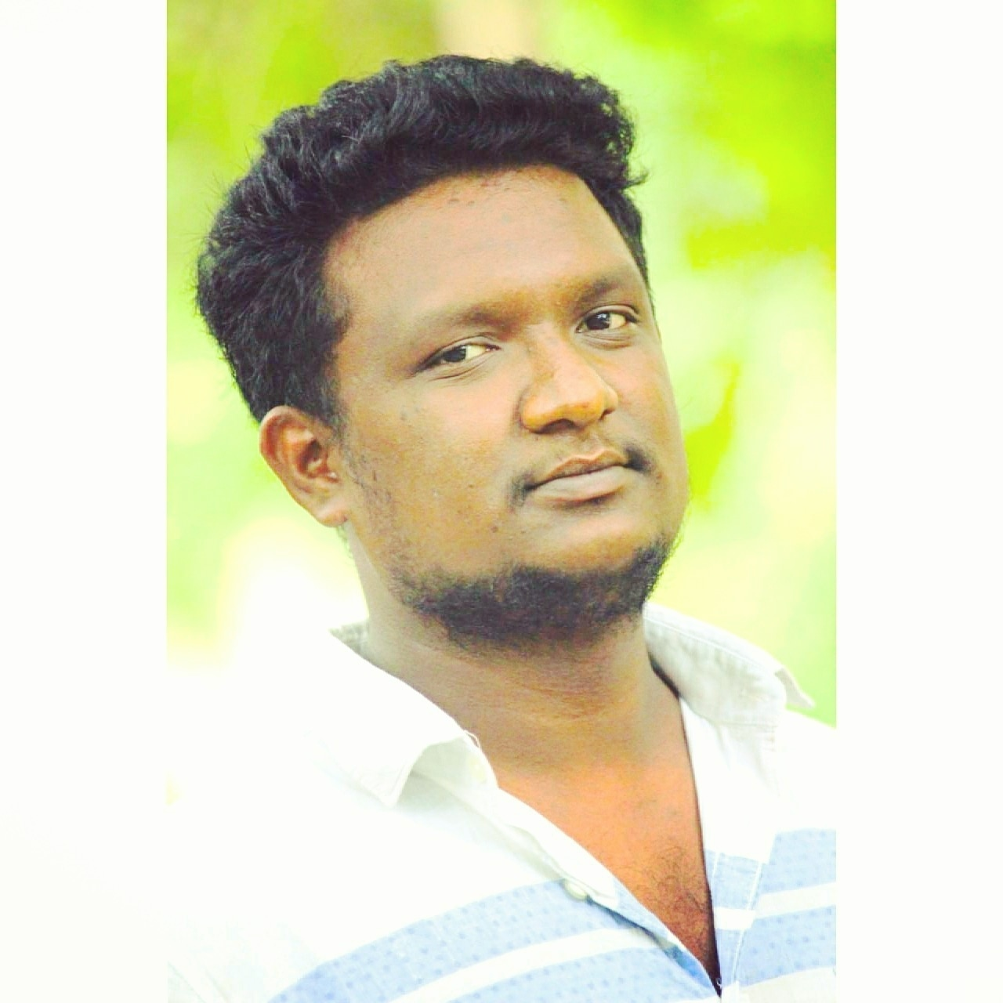
Name: Madhu Prasad
Category: Batsman
Age: 26 years
Ph: 8050867265
Age: 26 years Ph: 8050867265
Category: Batsman

Slide 196
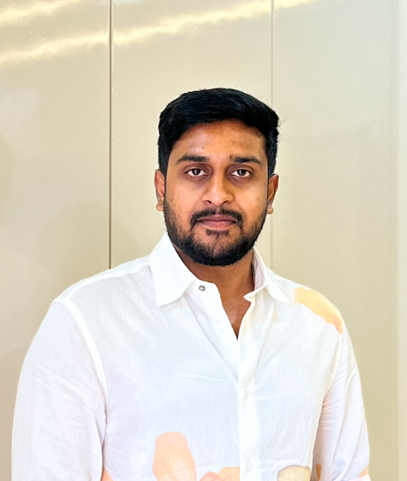
Name: Yeshwanth B S
Category: Batsman
Age: 25 years
Ph: 8073713026
Age: 25 years Ph: 8073713026
Category: Batsman

Slide 197
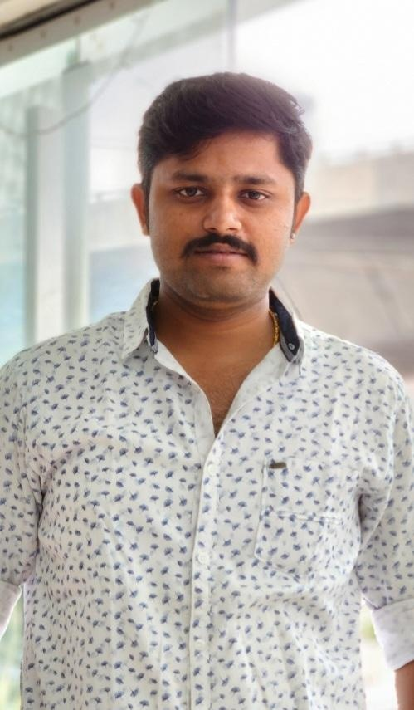
Name: Sachin N
Category: Batsman
Age: 26 years
Ph: 8073943636
Age: 26 years Ph: 8073943636
Category: Batsman

Slide 198
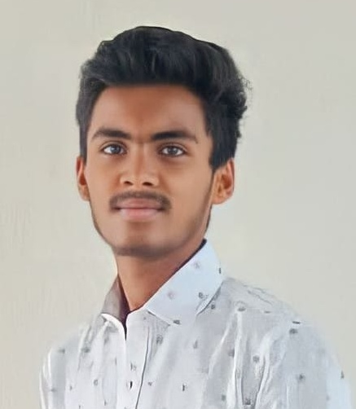
Name: Bhargav K
Category: Batsman
Age: 17 years
Ph: 8123054335
Age: 17 years Ph: 8123054335
Category: Batsman

Slide 199
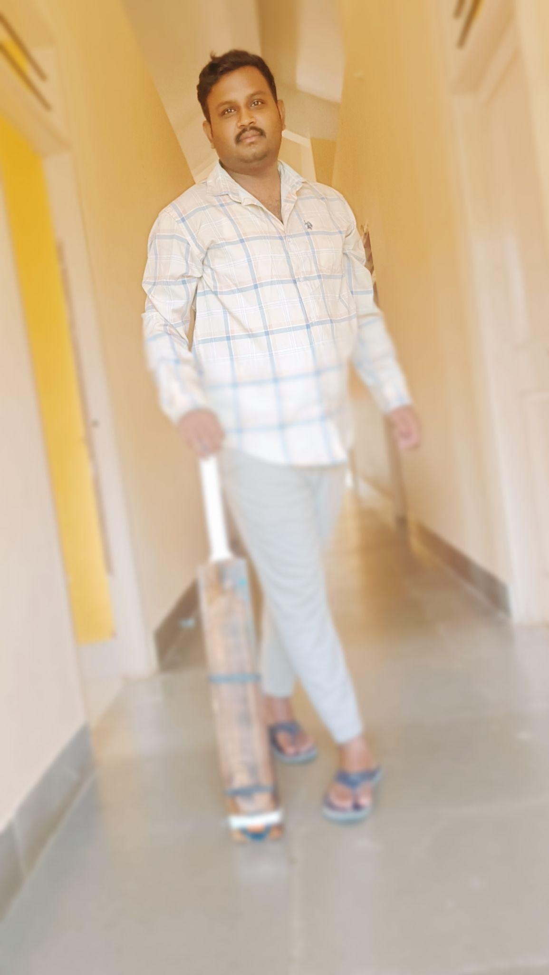
Name: Bharath
Category: All Rounder
Age: 26 years
Ph: 8123263208
Age: 26 years Ph: 8123263208
Category: All Rounder

Slide 200
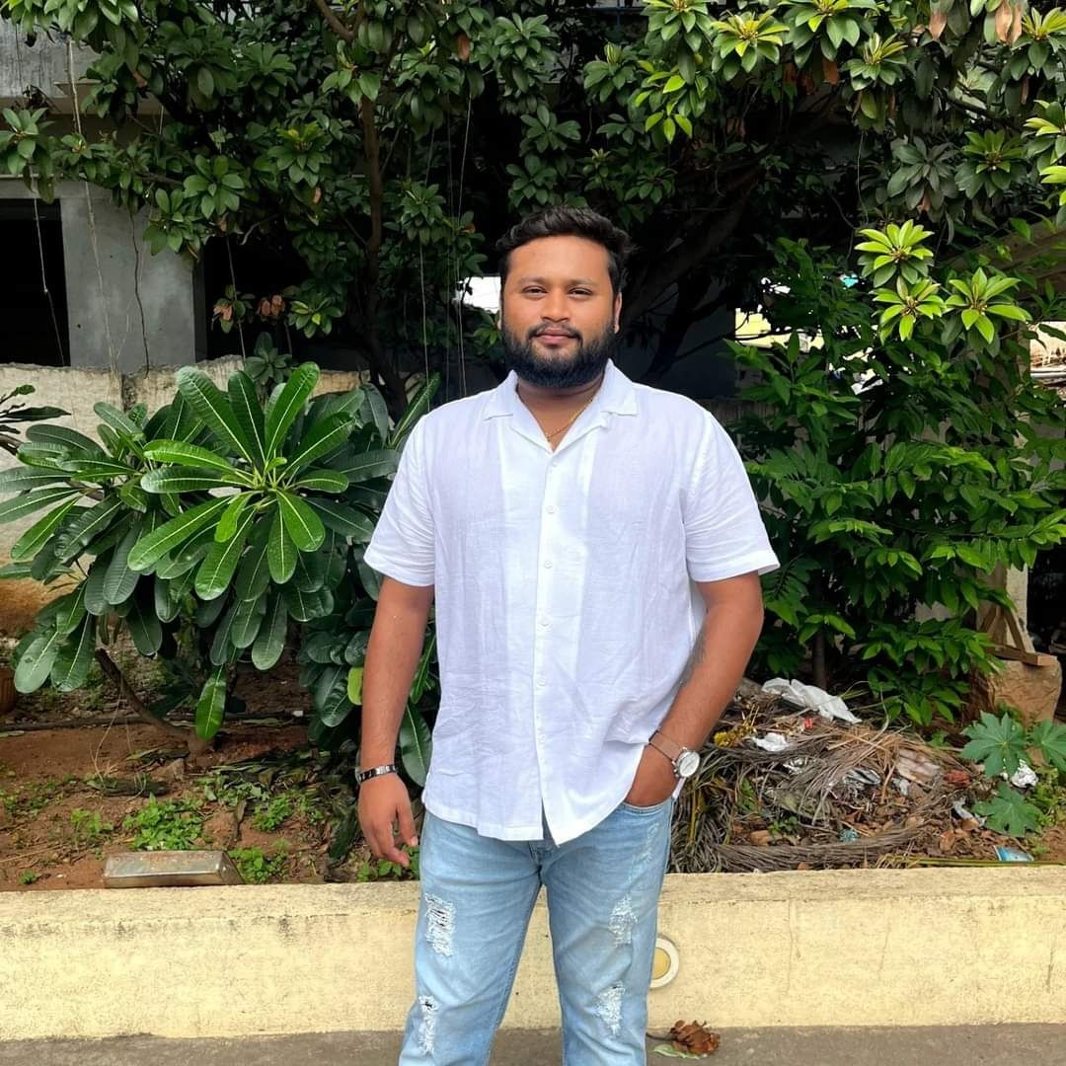
Name: Vinay G
Category: Batsman
Age: 23 years
Ph: 8123265156
ICON Player
Age: 23 years Ph: 8123265156
Category: Batsman
ICON Player

Slide 201
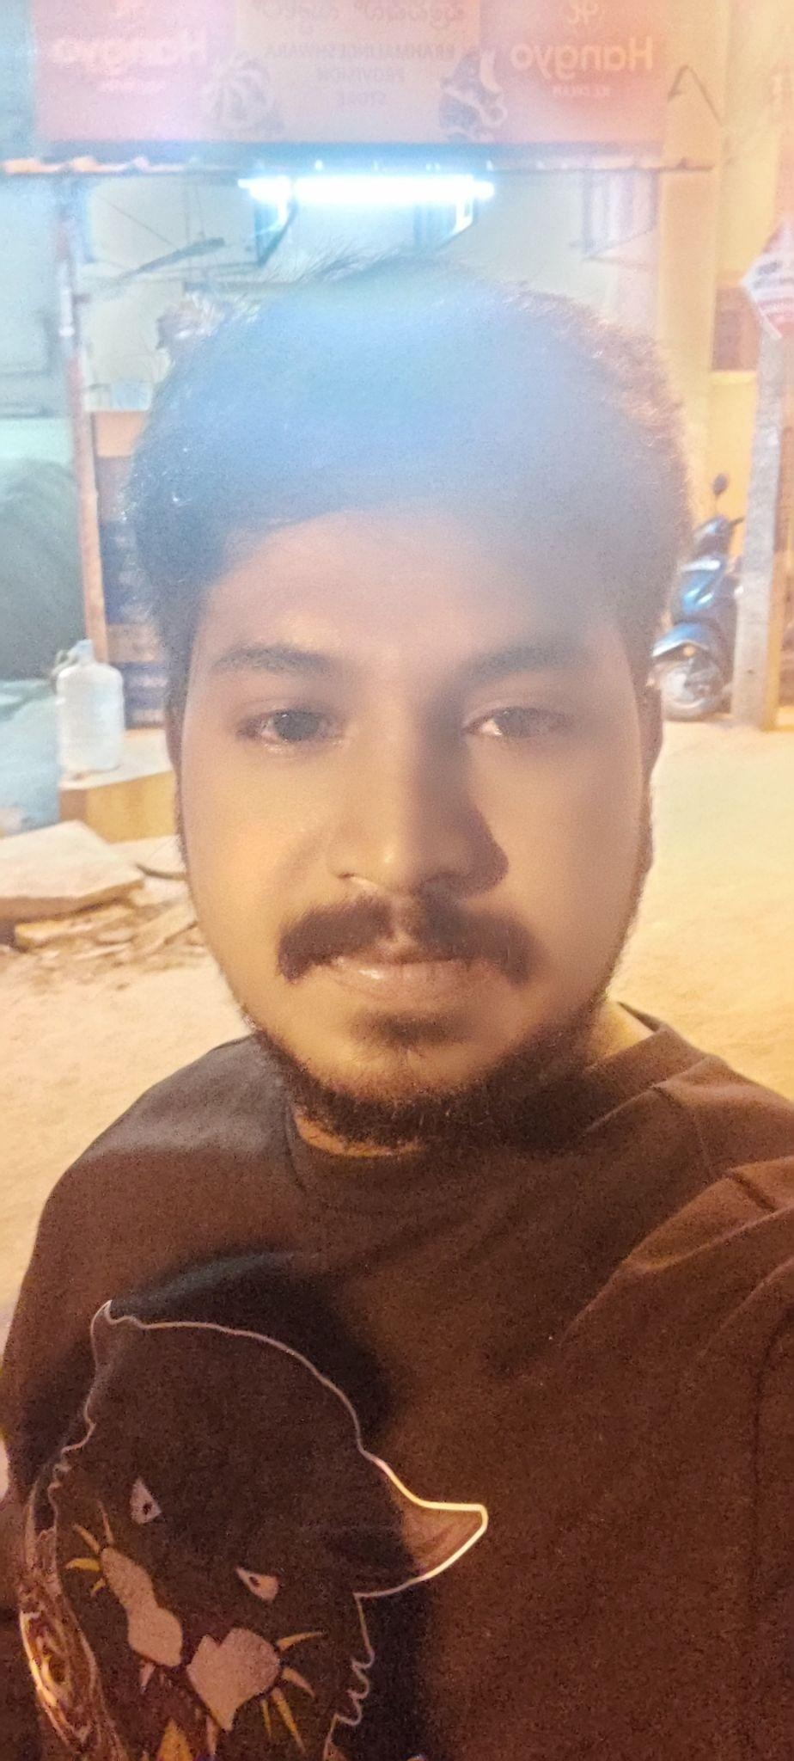
Name: Anil Reddy
Category: All Rounder
Age: 26 years
Ph: 8123388804
Age: 26 years Ph: 8123388804
Category: All Rounder

Slide 202
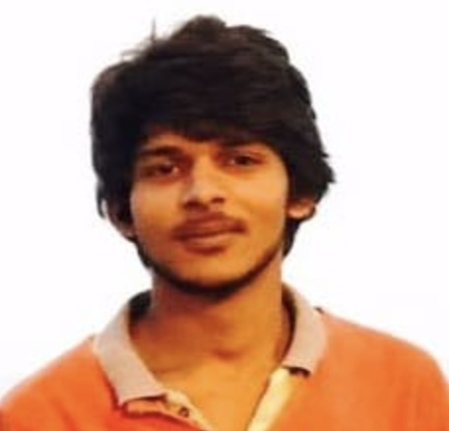
Name: Avinash
Category: Batsman
Age: 29 years
Ph: 8123744990
Age: 29 years Ph: 8123744990
Category: Batsman

Slide 203
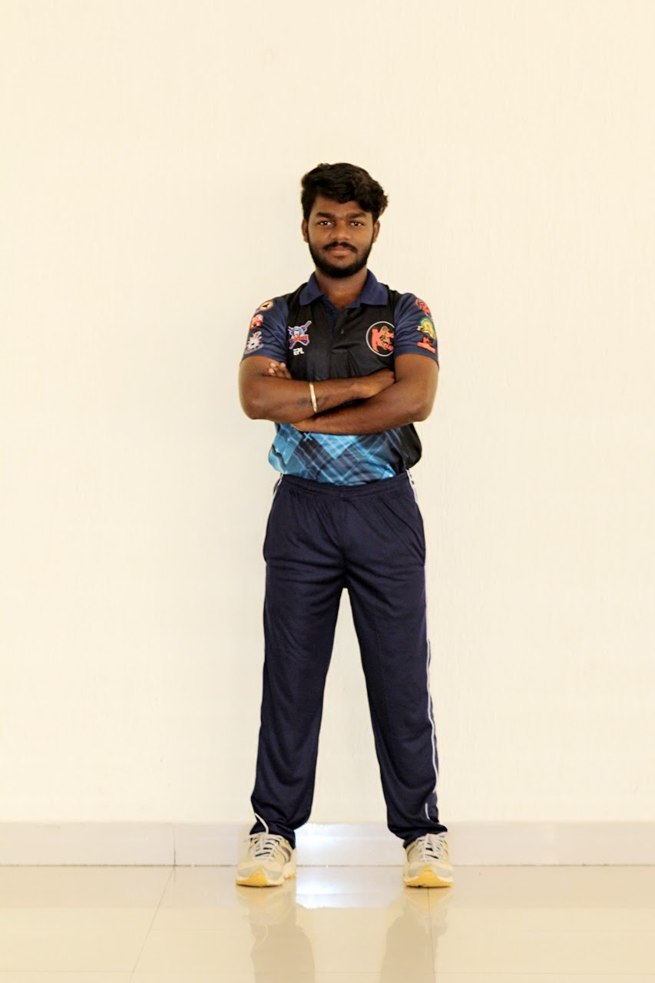
Name: Sanjay Kumar
Category: Batsman
Age: 26 years
Ph: 8147011437
Age: 26 years Ph: 8147011437
Category: Batsman

Slide 204
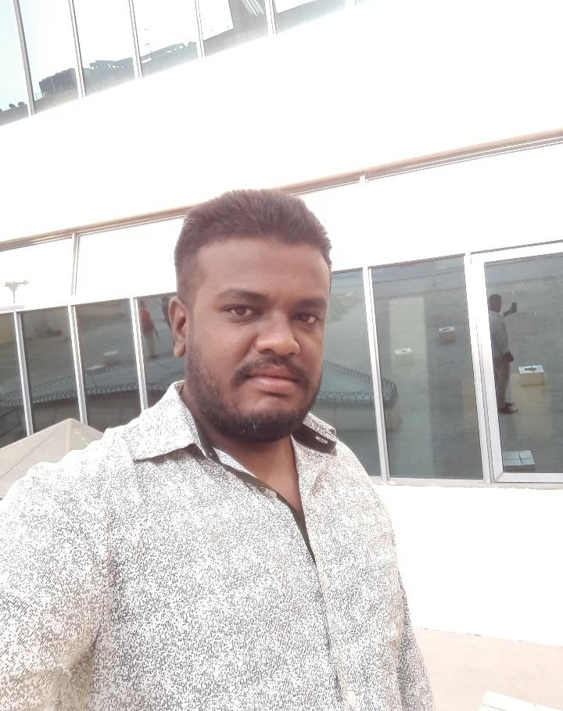
Name: Manjunatha
Category: All Rounder
Age: 31 years
Ph: 8147429118
Age: 31 years Ph: 8147429118
Category: All Rounder

Slide 205
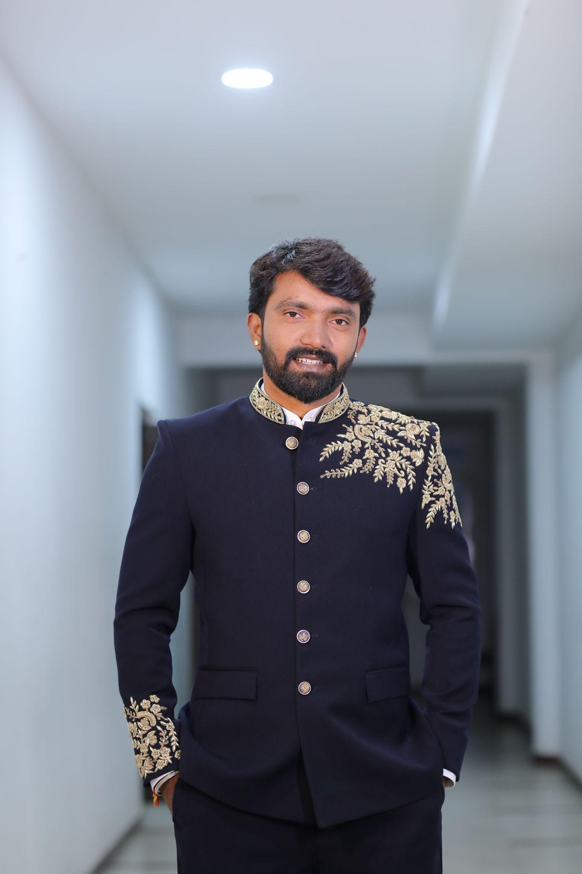
Name: Nagavendra M
Category: All Rounder
Age: 35 years
Ph: 8197661719
Age: 35 years Ph: 8197661719
Category: All Rounder

Slide 206
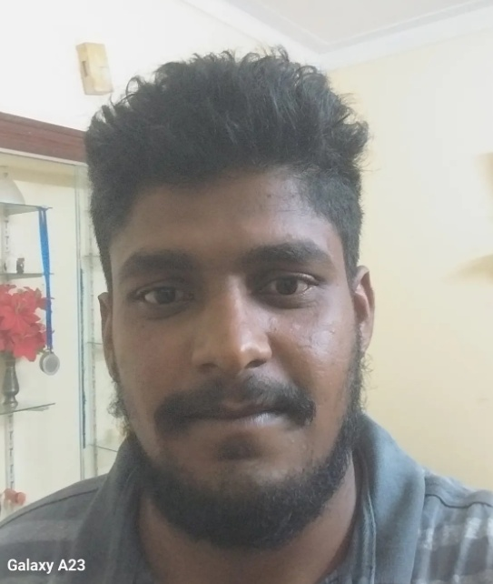
Name: Sachin G
Category: Batsman
Age: 27 years
Ph: 8217347563
Age: 27 years Ph: 8217347563
Category: Batsman

Slide 207
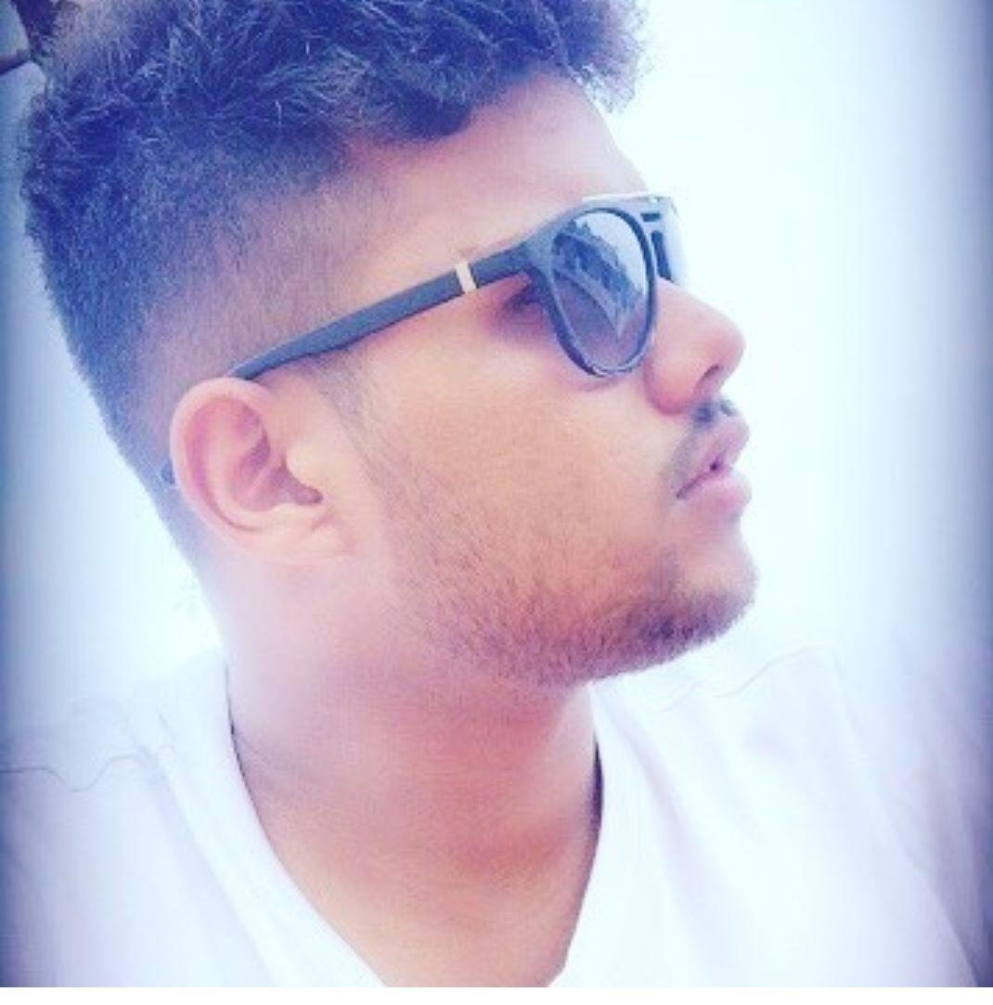
Name: Sanjay BK
Category: All Rounder
Age: 27 years
Ph: 8217853871
Age: 27 years Ph: 8217853871
Category: All Rounder

Slide 208
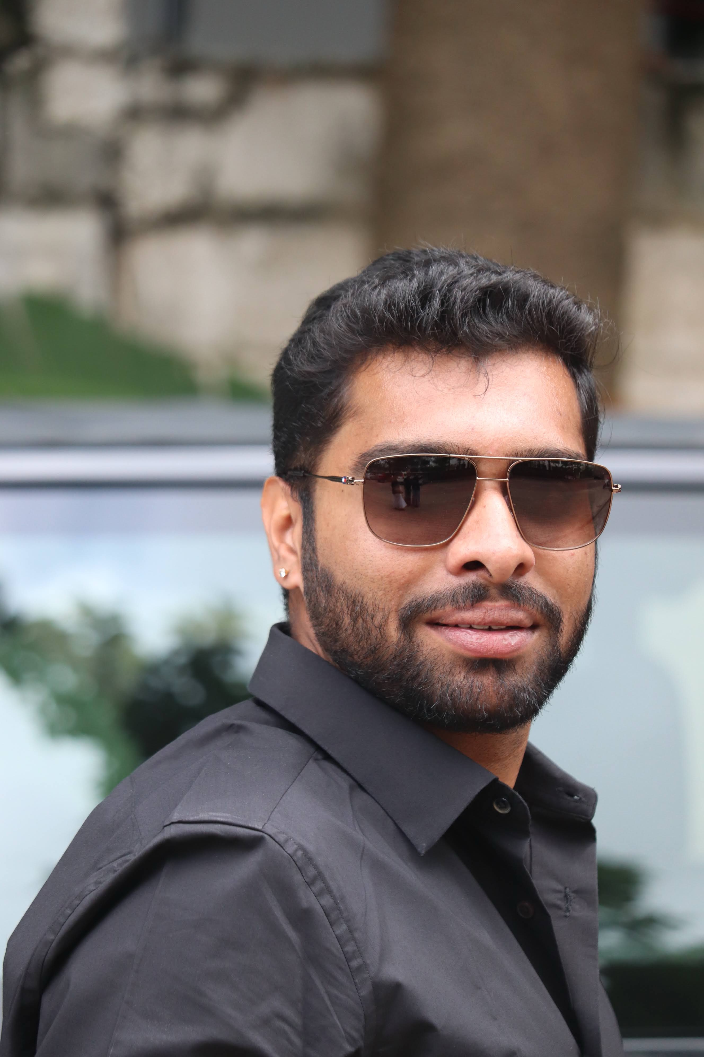
Name: Suman Reddy
Category: Batsman, Wicket Keeper
Age: 28 years
Ph: 8296151789
Age: 28 years Ph: 8296151789
Category: Batsman, Wicket Keeper

Slide 209
Name: Manoj Reddy
Category: All Rounder
Age: 21 years
Ph: 8310511078
Age: 21 years Ph: 8310511078
Category: All Rounder

Slide 210
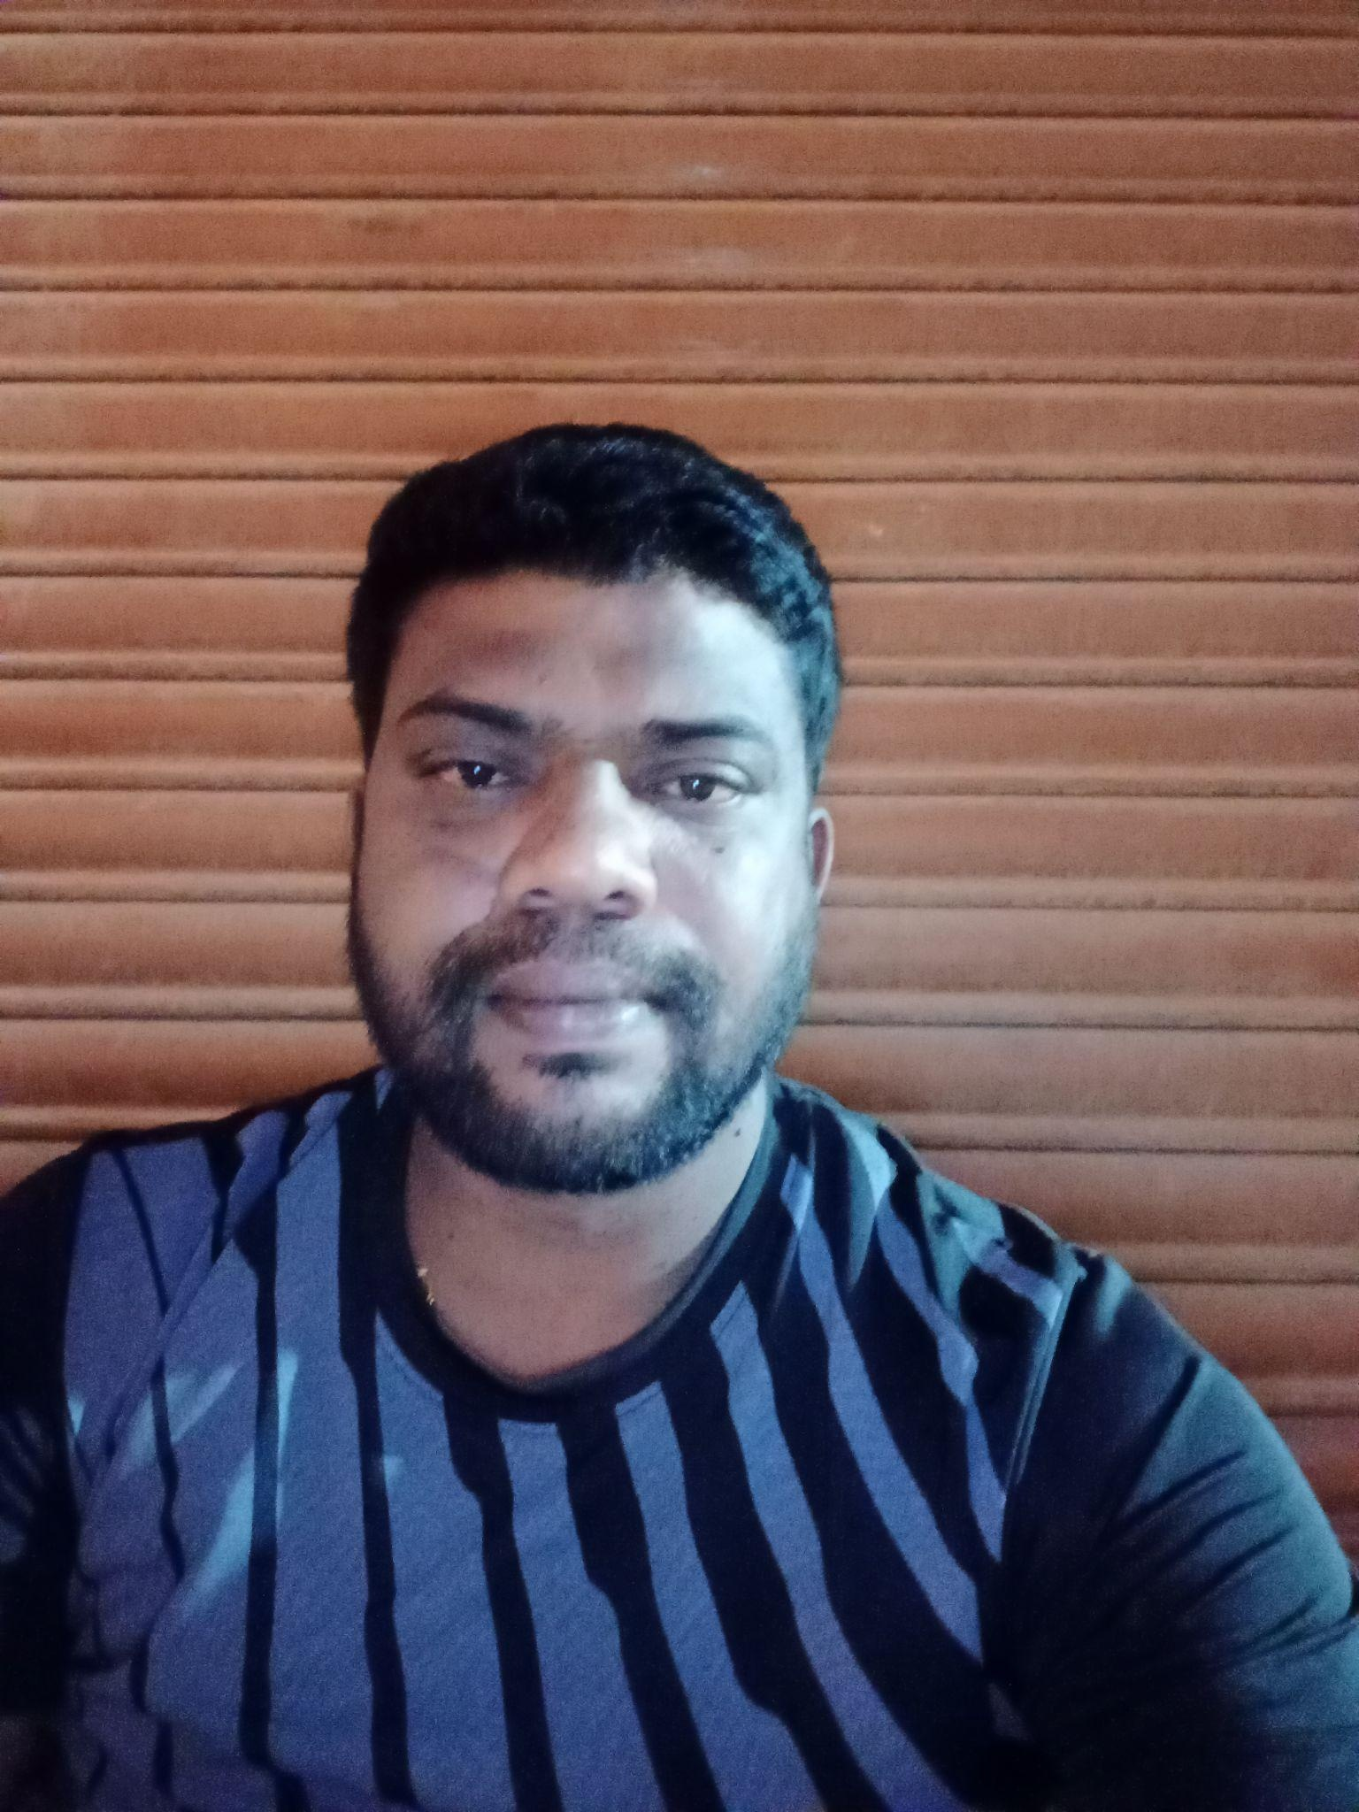
Name: Anil Kumar B K
Category: All Rounder
Age: 35 years
Ph: 8310714306
Age: 35 years Ph: 8310714306
Category: All Rounder

Slide 211
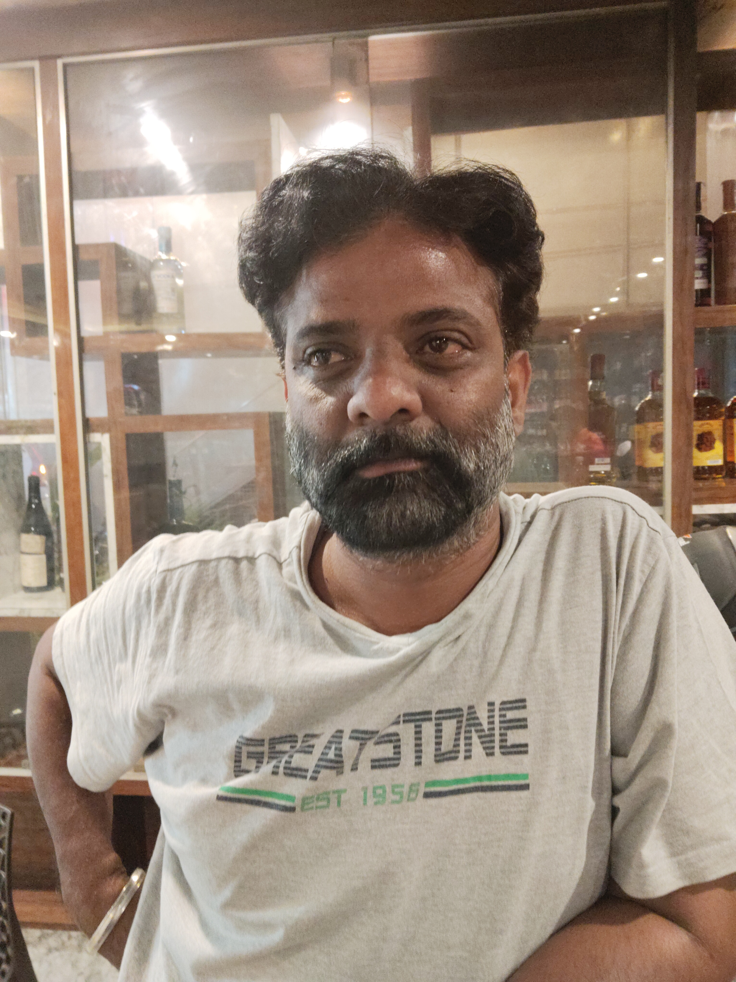
Name: Sunil Diesel
Category: Wicket Keeper
Age: 43 years
Ph: 8317448327
Age: 43 years Ph: 8317448327
Category: Wicket Keeper

Slide 212
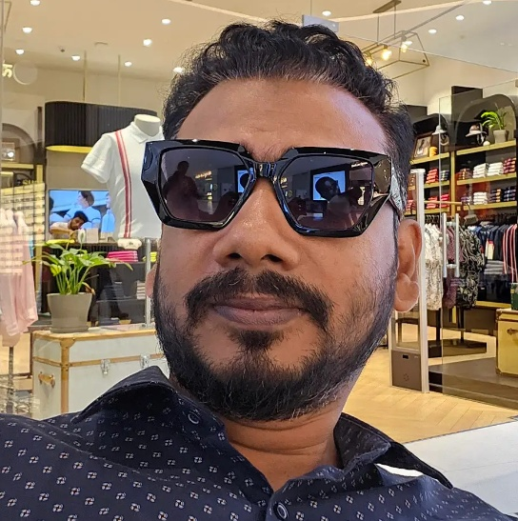
Name: Azhar Khan
Category: Batsman
Age: 39 years
Ph: 8693908342
Age: 39 years Ph: 8693908342
Category: Batsman

Slide 213
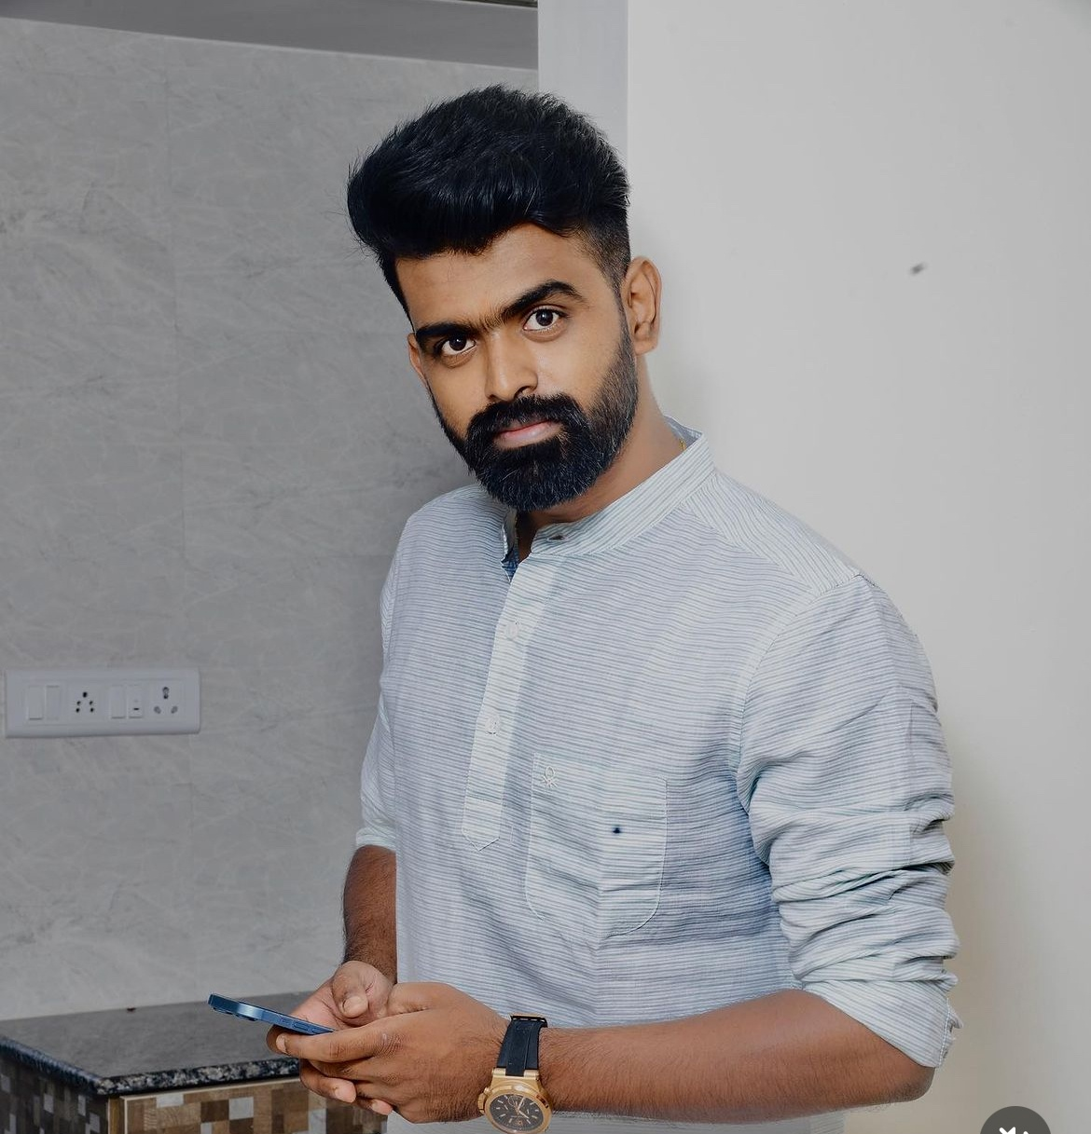
Name: Naveen Kumar
Category: All Rounder
Age: 29 years
Ph: 8867282226
Age: 29 years Ph: 8867282226
Category: All Rounder

Slide 214
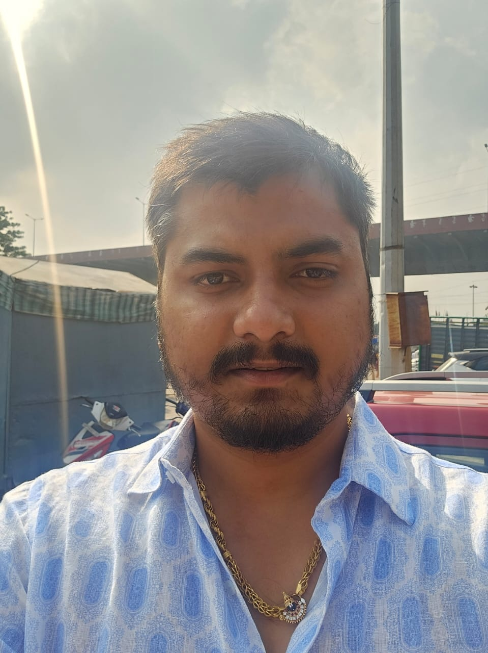
Name: Karthik P
Category: Batsman
Age: 26 years
Ph: 8880388889
Age: 26 years Ph: 8880388889
Category: Batsman

Slide 215
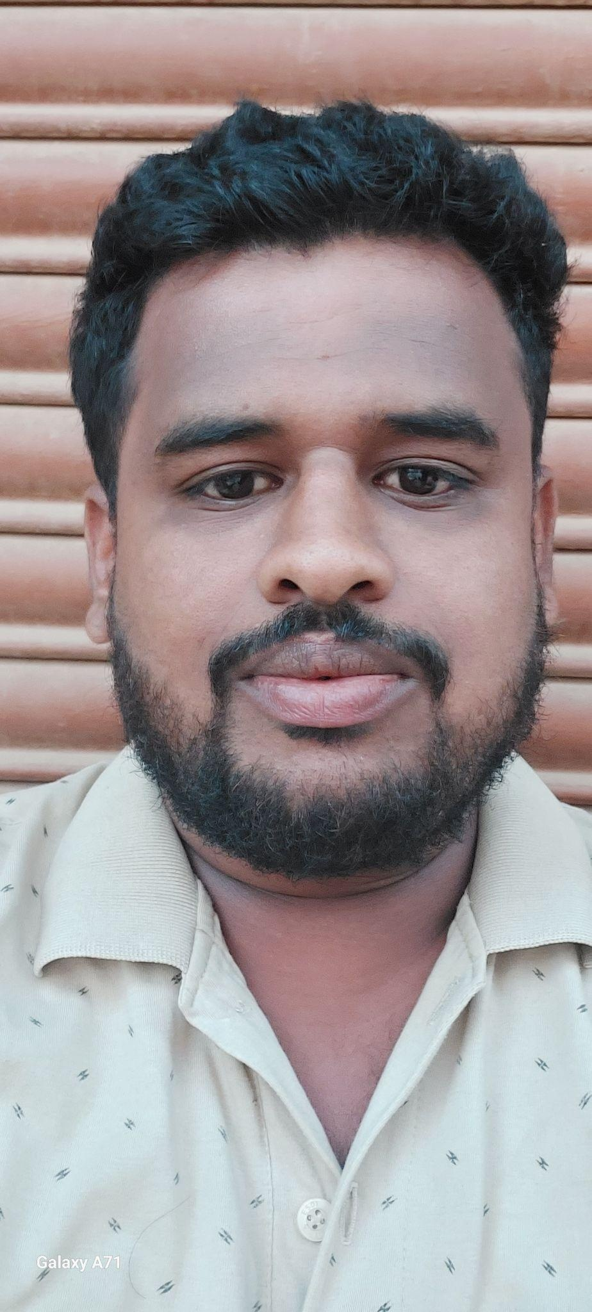
Name: Nithin Kumar
Category: All Rounder
Age: 27 years
Ph: 8904774933
Age: 27 years Ph: 8904774933
Category: All Rounder

Slide 216
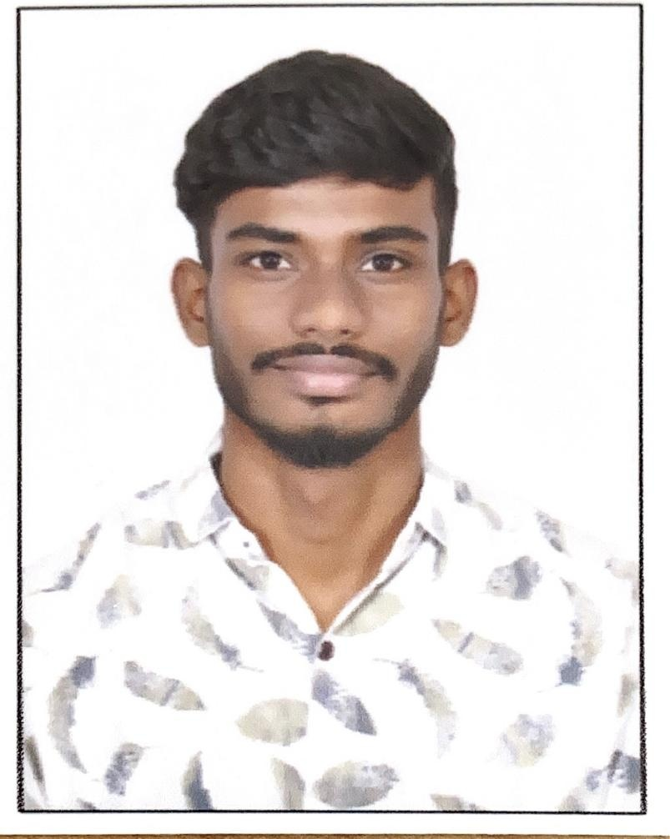
Name: Kashif
Category: All Rounder
Age: 20 years
Ph: 8971110413
Age: 20 years Ph: 8971110413
Category: All Rounder

Slide 217
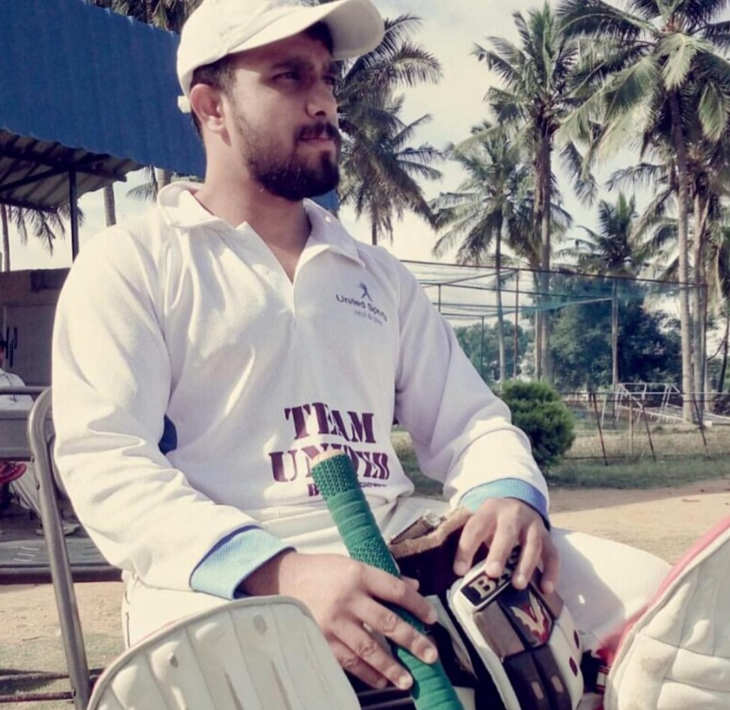
Name: Dishank
Category: All Rounder
Age: 35 years
Ph: 9008481848
Age: 35 years Ph: 9008481848
Category: All Rounder

Slide 218
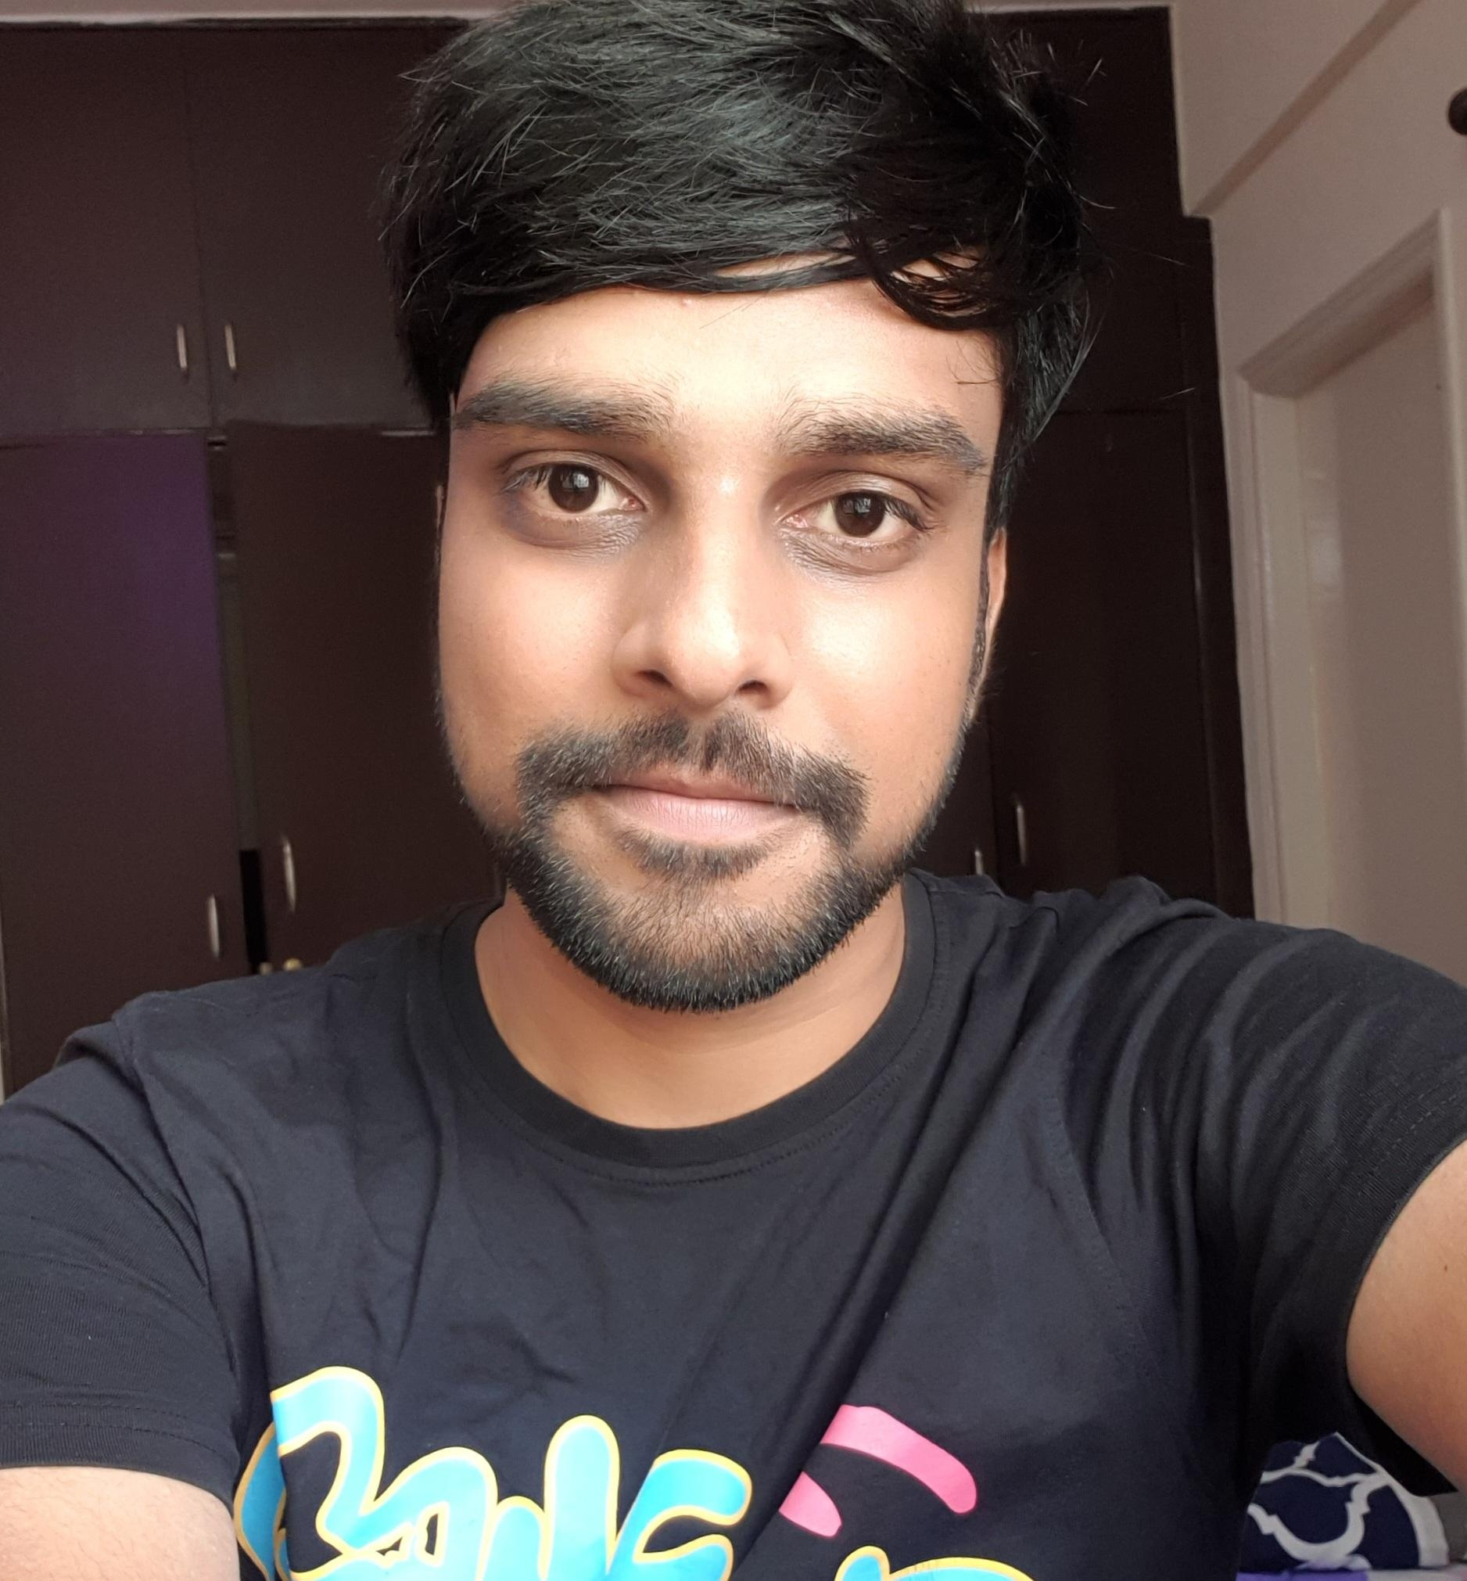
Name: Yash
Category: Batsman
Age: 24 years
Ph: 9008659880
Age: 24 years Ph: 9008659880
Category: Batsman

Slide 219
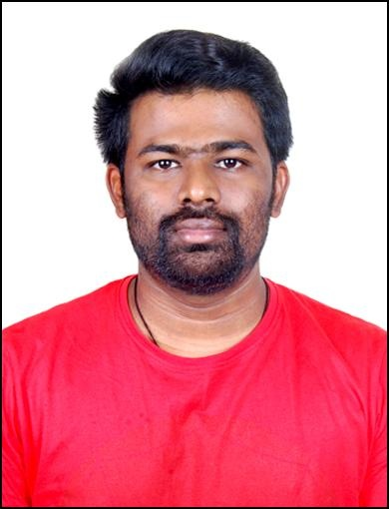
Name: Chethan
Category: Batsman
Age: 31 years
Ph: 9008796333
ICON Player
Age: 31 years Ph: 9008796333
Category: Batsman
ICON Player

Slide 220
Name: Sanjay Kumar Appi
Category: All Rounder
Ph: 9019913566
Age: 30 years Ph: 9019913566

Slide 221
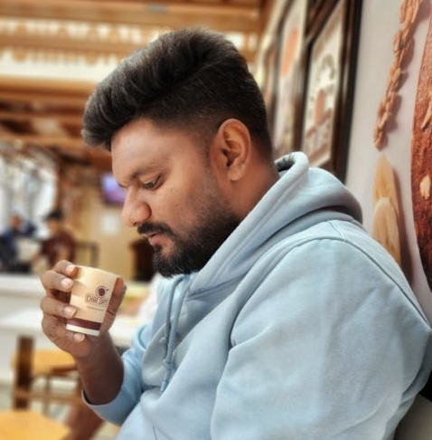
Name: Indresh Kumar
Category: All Rounder
Age: 34 years
Ph: 9035751115
Age: 34 years Ph: 9035751115
Category: All Rounder

Slide 222

Name: Ravindra
Category: Batsman
Age: 40 years
Ph: 9036110064
Age: 40 years Ph: 9036110064
Category: Batsman

Slide 223

Name: Anil
Category: Batsman
Age: 38 years
Ph: 9108444706
ICON Player
Age: 38 years Ph: 9108444706
Category: Batsman
ICON Player

Slide 224

Name: Vinay Kumar
Category: All Rounder
Age: 27 years
Ph: 9113941421
Age: 27 years Ph: 9113941421
Category: All Rounder

Slide 225

Name: Shashidhar
Category: Batsman
Age: 30 years
Ph: 9148046396
Age: 30 years Ph: 9148046396
Category: Batsman

Slide 226

Name: Basavaraj
Category: Batsman
Age: 23 years
Ph: 9148634810
Age: 23 years Ph: 9148634810
Category: Batsman

Slide 227

Name: Shashi Kumar
Category: Batsman
Age: 34 years
Ph: 9148849740
Age: 34 years Ph: 9148849740
Category: Batsman

Slide 228

Name: Mohan M
Category: Batsman
Age: 22 years
Ph: 9148938382
Age: 22 years Ph: 9148938382
Category: Batsman

Slide 229

Name: Mohamad Ali
Category: All Rounder
Age: 26 years
Ph: 9353264372
Age: 26 years Ph: 9353264372
Category: All Rounder

Slide 230

Name: S Manish
Category: Batsman
Age: 20 years
Ph: 9380234874
Age: 20 years Ph: 9380234874
Category: Batsman

Slide 231

Name: Anil Kumar HR
Category: All Rounder
Age: 24 years
Ph: 9380619989
Age: 24 years Ph: 9380619989
Category: All Rounder

Slide 232

Name: Shiva C
Category: All Rounder
Age: 26 years
Ph: 9449777563
Age: 26 years Ph: 9449777563
Category: All Rounder

Slide 233

Name: Mallikarjun
Category: Bowler
Age: 34 years
Ph: 9513465666
Age: 34 years Ph: 9513465666
Category: Bowler

Slide 234

Name: Jaga
Category: All Rounder
Age: 35 years
Ph: 9513631219
Age: 35 years Ph: 9513631219
Category: All Rounder

Slide 235

Name: Srikanth
Category: Batsman
Age: 24 years
Ph: 9535053189
Age: 24 years Ph: 9535053189
Category: Batsman

Slide 236

Name: Yeshwanth V
Category: Batsman
Age: 27 years
Ph: 9535500446
Age: 27 years Ph: 9535500446
Category: Batsman

Slide 237

Name: Satyajit Reddy
Category: All Rounder
Age: 20 years
Ph: 9535533664
Age: 20 years Ph: 9535533664
Category: All Rounder

Slide 238

Name: Narayana Swamy
Category: Batsman
Age: 29 years
Ph: 9535689777
Age: 29 years Ph: 9535689777
Category: Batsman

Slide 239

Name: Kishore
Category: Batsman
Age: 31 years
Ph: 9535815098
Age: 31 years Ph: 9535815098
Category: Batsman

Slide 240

Name: Dhanush B
Category: All Rounder
Age: 28 years
Ph: 9535988176
Age: 28 years Ph: 9535988176
Category: All Rounder

Slide 241

Name: Nitesh S
Category: All Rounder
Age: 28 years
Ph: 9535991650
Age: 28 years Ph: 9535991650
Category: All Rounder

Slide 242

Name: Sandeep Kumar
Category: All Rounder
Age: 31 years
Ph: 9538076343
Age: 31 years Ph: 9538076343
Category: All Rounder

Slide 243

Name: Sridhar
Category: Batsman
Age: 29 years
Ph: 9538658262
Age: 29 years Ph: 9538658262
Category: Batsman

Slide 244

Name: Sudeep G
Category: All Rounder
Age: 20 years
Ph: 9538772943
Age: 20 years Ph: 9538772943
Category: All Rounder

Slide 245

Name: Nikhil Prabhakar
Category: All Rounder
Age: 28 years
Ph: 9591101802
Age: 28 years Ph: 9591101802
Category: All Rounder

Slide 246

Name: Vijay Kumar
Category: All Rounder
Age: 42 years
Ph: 9591383139
Age: 42 years Ph: 9591383139
Category: All Rounder

Slide 247
Name: Manjunth M
Category: All Rounder
Ph: 9591589009
Age: 30 years Ph: 9591589009

Slide 248

Name: Mithun M
Category: All Rounder
Age: 25 years
Ph: 9591755567
Age: 25 years Ph: 9591755567
Category: All Rounder

Slide 249

Name: Sridhar M
Category: Batsman
Age: 20 years
Ph: 9606575937
Age: 20 years Ph: 9606575937
Category: Batsman

Slide 250

Name: Ravi Kumar BK
Category: Batsman
Age: 37 years
Ph: 9611106928
Age: 37 years Ph: 9611106928
Category: Batsman

Slide 251

Name: Chetan N
Category: Batsman
Age: 33 years
Ph: 9611111666
Age: 33 years Ph: 9611111666
Category: Batsman

Slide 252

Name: Basavaraj
Category: All Rounder
Age: 18 years
Ph: 9611144490
Age: 18 years Ph: 9611144490
Category: All Rounder

Slide 253

Name: Varchas Reddy
Category: All Rounder
Age: 22 years
Ph: 9611360570
Age: 22 years Ph: 9611360570
Category: All Rounder

Slide 254

Name: Pradeep BG
Category: Bowler
Age: 35 years
Ph: 9611494999
Age: 35 years Ph: 9611494999
Category: Bowler

Slide 255

Name: Arya
Category: All Rounder
Age: 30 years
Ph: 9611999614
Age: 30 years Ph: 9611999614
Category: All Rounder

Slide 256

Name: Sanjay Kumar
Category: Batsman
Age: 26 years
Ph: 9620191414
Age: 26 years Ph: 9620191414
Category: Batsman

Slide 257

Name: Babu Prasad
Category: All Rounder
Age: 32 years
Ph: 9620206600
Age: 32 years Ph: 9620206600
Category: All Rounder

Slide 258

Name: Yuvaraj
Category: Batsman
Age: 25 years
Ph: 9620310245
Age: 25 years Ph: 9620310245
Category: Batsman

Slide 259

Name: VR Kshatriya
Category: All Rounder
Age: 32 years
Ph: 9632138055
Age: 32 years Ph: 9632138055
Category: All Rounder

Slide 260

Name: Saravana
Category: Batsman
Age: 24 years
Ph: 9632322485
Age: 24 years Ph: 9632322485
Category: Batsman

Slide 261

Name: Shashidhar
Category: Batsman
Age: 35 years
Ph: 9632541001
Age: 35 years Ph: 9632541001
Category: Batsman

Slide 262

Name: Bharath R
Category: All Rounder
Age: 32 years
Ph: 9632558777
Age: 32 years Ph: 9632558777
Category: All Rounder

Slide 263

Name: Chandrashekar
Category: Batsman
Age: 37 years
Ph: 9663510908
Age: 37 years Ph: 9663510908
Category: Batsman

Slide 264

Name: Mahesh
Category: All Rounder
Age: 45 years
Ph: 9663993399
Age: 45 years Ph: 9663993399
Category: All Rounder

Slide 265

Name: Ranjith
Category: All Rounder
Age: 25 years
Ph: 9686208176
Age: 25 years Ph: 9686208176
Category: All Rounder

Slide 266

Name: Siddalinga
Category: All Rounder
Ph: 9686229057
Age: 30 years Ph: 9686229057

Slide 267

Name: Krishnamurthy
Category: Bowler
Age: 32 years
Ph: 9686333928
Age: 32 years Ph: 9686333928
Category: Bowler

Slide 268

Name: M Vamshi
Category: All Rounder
Age: 16 years
Ph: 9686616327
Age: 16 years Ph: 9686616327
Category: All Rounder

Slide 269

Name: Guru Raghavendra
Category: All Rounder
Ph: 9686623625
Age: 30 years Ph: 9686623625

Slide 270

Name: Sandeep Kumar S
Category: All Rounder
Age: 33 years
Ph: 9738342349
Age: 33 years Ph: 9738342349
Category: All Rounder

Slide 271

Name: Dhanush N
Category: Batsman
Age: 27 years
Ph: 9738899414
Age: 27 years Ph: 9738899414
Category: Batsman

Slide 272
Name: Hitesh G
Category: All Rounder
Age: 24 years
Ph: 9739050679
Age: 24 years Ph: 9739050679
Category: All Rounder

Slide 273

Name: Kunal Bhargava
Category: All Rounder
Age: 38 years
Ph: 9739363656
Age: 38 years Ph: 9739363656
Category: All Rounder

Slide 274

Name: Munikrishna
Category: All Rounder
Age: 28 years
Ph: 9739586978
Age: 28 years Ph: 9739586978
Category: All Rounder

Slide 275

Name: Murugesh M
Category: Batsman
Age: 30 years
Ph: 9739721772
Age: 30 years Ph: 9739721772
Category: Batsman

Slide 276

Name: Arun Kumar
Category: Batsman
Age: 26 years
Ph: 9740489284
Age: 26 years Ph: 9740489284
Category: Batsman

Slide 277

Name: Kiran
Category: Batsman
Age: 29 years
Ph: 9740834449
Age: 29 years Ph: 9740834449
Category: Batsman

Slide 278

Name: Mithun Murthy
Category: All Rounder
Age: 20 years
Ph: 9741440817
Age: 20 years Ph: 9741440817
Category: All Rounder

Slide 279

Name: Vasanth Kumar
Category: Batsman
Age: 28 years
Ph: 9742060594
Age: 28 years Ph: 9742060594
Category: Batsman

Slide 280

Name: Kantha Kumar
Category: All Rounder
Age: 32 years
Ph: 9742315080
Age: 32 years Ph: 9742315080
Category: All Rounder

Slide 281

Name: Vinay
Category: Batsman
Age: 25 years
Ph: 9742321215
Age: 25 years Ph: 9742321215
Category: Batsman

Slide 282

Name: Mahadev
Category: Batsman
Age: 26 years
Ph: 9742355554
Age: 26 years Ph: 9742355554
Category: Batsman

Slide 283

Name: Arjun Ramesh Tendulkar
Category: All Rounder
Age: 12 years
Ph: 9742386644
Age: 12 years Ph: 9742386644
Category: All Rounder

Slide 284

Name: Shankar M
Category: Batsman
Age: 30 years
Ph: 9742589701
Age: 30 years Ph: 9742589701
Category: Batsman

Slide 285

Name: Prakash
Category: Batsman
Age: 32 years
Ph: 9742715666
Age: 32 years Ph: 9742715666
Category: Batsman

Slide 286

Name: Manjunath P
Category: All Rounder
Age: 35 years
Ph: 9743015567
Age: 35 years Ph: 9743015567
Category: All Rounder

Slide 287

Name: Girish
Category: Batsman
Age: 44 years
Ph: 9745347173
Age: 44 years Ph: 9745347173
Category: Batsman

Slide 288

Name: Shiva Kumar N
Category: All Rounder
Age: 41 years
Ph: 9845079668
Age: 41 years Ph: 9845079668
Category: All Rounder

Slide 289

Name: Santhosh Reddy
Category: All Rounder
Age: 39 years
Ph: 9845372233
Age: 39 years Ph: 9845372233
Category: All Rounder

Slide 290

Name: Pradeep
Category: Batsman
Age: 42 years
Ph: 9845554410
Age: 42 years Ph: 9845554410
Category: Batsman

Slide 291

Name: Vajresh
Category: Batsman
Age: 36 years
Ph: 9845573427
ICON Player
Age: 36 years Ph: 9845573427
Category: Batsman
ICON Player

Slide 292

Name: Karagappa
Category: Batsman
Age: 43 years
Ph: 9845798817
ICON Player
Age: 43 years Ph: 9845798817
Category: Batsman
ICON Player

Slide 293

Name: BC Harish Kumar
Category: All Rounder
Age: 40 years
Ph: 9845827989
Age: 40 years Ph: 9845827989
Category: All Rounder

Slide 294

Name: Chethan
Category: Batsman
Age: 37 years
Ph: 9845944474
Age: 37 years Ph: 9845944474
Category: Batsman

Slide 295

Name: Rama Chandra
Category: All Rounder
Age: 40 years
Ph: 9845976133
Age: 40 years Ph: 9845976133
Category: All Rounder

Slide 296

Name: Uday Kumar
Category: Batsman
Age: 37 years
Ph: 9880080119
Age: 37 years Ph: 9880080119
Category: Batsman

Slide 297

Name: Narayanaswamy
Category: All Rounder
Age: 40 years
Ph: 9880296843
Age: 40 years Ph: 9880296843
Category: All Rounder

Slide 298

Name: Likith Reddy
Category: Bowler
Age: 18 years
Ph: 9880616057
Age: 18 years Ph: 9880616057
Category: Bowler

Slide 299

Name: Rajesh V
Category: All Rounder
Age: 39 years
Ph: 9880669969
Age: 39 years Ph: 9880669969
Category: All Rounder

Slide 300

Name: Praveen Kumar N
Category: All Rounder
Age: 40 years
Ph: 9880739393
Age: 40 years Ph: 9880739393
Category: All Rounder

Slide 301
Name: Dharshan M
Category: All Rounder
Age: 23 years
Ph: 9886311767
Age: 23 years Ph: 9886311767
Category: All Rounder

Slide 302

Name: Sujan Reddy B S
Category: Batsman
Age: 24 years
Ph: 9886335511
Age: 24 years Ph: 9886335511
Category: Batsman

Slide 303

Name: Dhruva Kumar
Category: Batsman
Age: 37 years
Ph: 9886668883
Age: 37 years Ph: 9886668883
Category: Batsman

Slide 304

Name: Roshan
Category: All Rounder
Age: 48 years
Ph: 9886749342
Age: 48 years Ph: 9886749342
Category: All Rounder

Slide 305

Name: Umesh BK
Category: Batsman
Age: 37 years
Ph: 9900100178
Age: 37 years Ph: 9900100178
Category: Batsman

Slide 306

Name: Bharath
Category: All Rounder
Age: 27 years
Ph: 9900310361
Age: 27 years Ph: 9900310361
Category: All Rounder

Slide 307

Name: Mahadev
Category: Batsman
Age: 24 years
Ph: 9900478358
Age: 24 years Ph: 9900478358
Category: Batsman

Slide 308

Name: Gopinath V
Category: All Rounder
Age: 40 years
Ph: 9900676026
Age: 40 years Ph: 9900676026
Category: All Rounder

Slide 309

Name: Jitin S
Category: All Rounder
Age: 20 years
Ph: 9900900666
Age: 20 years Ph: 9900900666
Category: All Rounder

Slide 310

Name: Devendra
Category: All Rounder
Age: 38 years
Ph: 9900922363
Age: 38 years Ph: 9900922363
Category: All Rounder

Slide 311

Name: Naveen Reddy
Category: All Rounder
Age: 40 years
Ph: 9901096669
Age: 40 years Ph: 9901096669
Category: All Rounder

Slide 312

Name: Anil
Category: All Rounder
Age: 23 years
Ph: 9901115633
Age: 23 years Ph: 9901115633
Category: All Rounder

Slide 313

Name: Harish M
Category: All Rounder
Age: 38 years
Ph: 9902032229
Age: 38 years Ph: 9902032229
Category: All Rounder

Slide 314

Name: Subramani
Category: Batsman
Age: 28 years
Ph: 9902294137
Age: 28 years Ph: 9902294137
Category: Batsman

Slide 315
Name: Naveen M
Category: All Rounder
Age: 28 years
Ph: 9902785999
Age: 28 years Ph: 9902785999
Category: All Rounder

Slide 316

Name: Aditya M
Category: All Rounder
Age: 34 years
Ph: 9902890795
Age: 34 years Ph: 9902890795
Category: All Rounder

Slide 317

Name: Shivaraj K
Category: Batsman
Age: 38 years
Ph: 9916812444
Age: 38 years Ph: 9916812444
Category: Batsman

Slide 318

Name: Manjunath
Category: All Rounder
Age: 47 years
Ph: 9916976357
Age: 47 years Ph: 9916976357
Category: All Rounder

Slide 319

Name: Manjunath NM
Category: All Rounder
Ph: 9945194297
Age: 30 years Ph: 9945194297

Slide 320

Name: Chetan Kumar N
Category: Bowler
Age: 39 years
Ph: 9945621717
Age: 39 years Ph: 9945621717
Category: Bowler

Slide 321

Name: Chethan Kumar
Category: Batsman
Age: 36 years
Ph: 9945829499
Age: 36 years Ph: 9945829499
Category: Batsman

Slide 322

Name: Sunil
Category: Batsman
Age: 33 years
Ph: 9964122322
Age: 33 years Ph: 9964122322
Category: Batsman

Slide 323

Name: Manjunath P
Category: Batsman
Age: 42 years
Ph: 9964399249
ICON Player
Age: 42 years Ph: 9964399249
Category: Batsman
ICON Player

Slide 324

Name: Nandan Chaitanya
Category: Batsman
Age: 37 years
Ph: 9964500100
Age: 37 years Ph: 9964500100
Category: Batsman

Slide 325

Name: Manjunath M
Category: Bowler
Age: 44 years
Ph: 9964821055
Age: 44 years Ph: 9964821055
Category: Bowler

Slide 326

Name: Karthik
Category: All Rounder
Age: 36 years
Ph: 9972418999
Age: 36 years Ph: 9972418999
Category: All Rounder

Slide 327
Name: Rohit Reddy
Category: All Rounder
Age: 19 years
Ph: 9972629127
Age: 19 years Ph: 9972629127
Category: All Rounder

Slide 328

Name: Ramesh G
Category: All Rounder
Age: 37 years
Ph: 9972723408
Age: 37 years Ph: 9972723408
Category: All Rounder

Slide 329

Name: Ishthiyak
Category: Batsman
Age: 26 years
Ph: 9980181786
Age: 26 years Ph: 9980181786
Category: Batsman

Slide 330

Name: Sandeep Reddy
Category: All Rounder
Age: 34 years
Ph: 9980548880
Age: 34 years Ph: 9980548880
Category: All Rounder

Slide 331
Name: Dhanush R
Category: Batsman
Age: 20 years
Ph: 9980598523
Age: 20 years Ph: 9980598523
Category: Batsman

Slide 332

Name: R Prajwal
Category: Batsman
Age: 27 years
Ph: 9980804533
Age: 27 years Ph: 9980804533
Category: Batsman

Slide 333

Name: Sandeep Wadhawan
Category: All Rounder
Age: 43 years
Ph: 9986015073
Age: 43 years Ph: 9986015073
Category: All Rounder

Slide 334

Name: Noorulla
Category: Batsman
Age: 37 years
Ph: 9986188370
Age: 37 years Ph: 9986188370
Category: Batsman

Slide 335

Name: Rajesh R
Category: All Rounder
Age: 35 years
Ph: 9986634888
Age: 35 years Ph: 9986634888
Category: All Rounder

Slide 336

Name: Mithun Reddy
Category: All Rounder
Age: 35 years
Ph: 9986646222
Age: 35 years Ph: 9986646222
Category: All Rounder

Slide 337

Name: Shiva
Category: All Rounder
Age: 36 years
Ph: 9986675261
Age: 36 years Ph: 9986675261
Category: All Rounder

Slide 338

Name: A Ravindranath
Category: All Rounder
Age: 48 years
Ph: 9986998229
Age: 48 years Ph: 9986998229
Category: All Rounder

Slide 339

Name: Prajwal L
Category: All Rounder
Age: 27 years
Ph: 9071198321
Age: 27 years Ph: 9071198321
Category: All Rounder

Slide 340
Name: Punith V
Category: All Rounder
Age: 21 years
Ph: 6360452535
Age: 21 years Ph: 6360452535
Category: All Rounder

Slide 341
Name: Subramani
Category: Batsman
Age: 27 years
Ph: 6360937589
Age: 27 years Ph: 6360937589
Category: Batsman

Slide 342
Name: Manjunatha BG
Category: All Rounder
Age: 32 years
Ph: 6362049445
Age: 32 years Ph: 6362049445
Category: All Rounder

Slide 343
Name: Mohan Rao
Category: All Rounder
Age: 27 years
Ph: 7014841335
Age: 27 years Ph: 7014841335
Category: All Rounder

Slide 344
Name: Lokesh J
Category: Batsman
Age: 22 years
Ph: 7022190895
Age: 22 years Ph: 7022190895
Category: Batsman

Slide 345
Name: Kiran M
Category: Batsman
Age: 23 years
Ph: 7022550833
Age: 23 years Ph: 7022550833
Category: Batsman

Slide 346
Name: Sharanu V
Category: All Rounder
Age: 21 years
Ph: 7022731680
Age: 21 years Ph: 7022731680
Category: All Rounder

Slide 347
Name: Shivanand
Category: All Rounder
Age: 31 years
Ph: 7204691096
Age: 31 years Ph: 7204691096
Category: All Rounder

Slide 348
Name: Kailash
Category: All Rounder
Age: 32 years
Ph: 7259693680
Age: 32 years Ph: 7259693680
Category: All Rounder

Slide 349
Name: Kumar
Category: All Rounder
Age: 26 years
Ph: 7338632438
Age: 26 years Ph: 7338632438
Category: All Rounder

Slide 350
Name: Lingraj
Category: Batsman
Age: 20 years
Ph: 7349651319
Age: 20 years Ph: 7349651319
Category: Batsman

Slide 351
Name: Dhanush R
Category: Batsman
Age: 20 years
Ph: 7411352556
Age: 20 years Ph: 7411352556
Category: Batsman

Slide 352
Name: Goutham
Category: Batsman
Age: 23 years
Ph: 7411721373
Age: 23 years Ph: 7411721373
Category: Batsman

Slide 353
Name: Ambrish
Category: All Rounder
Age: 32 years
Ph: 7619379377
Age: 32 years Ph: 7619379377
Category: All Rounder

Slide 354
Name: Vikas
Category: Batsman
Age: 24 years
Ph: 7619518400
Age: 24 years Ph: 7619518400
Category: Batsman

Slide 355
Name: Tarun Reddy
Category: Batsman
Age: 26 years
Ph: 7676761221
Age: 26 years Ph: 7676761221
Category: Batsman

Slide 356
Name: Vishwas R
Category: All Rounder
Age: 26 years
Ph: 7676762367
Age: 26 years Ph: 7676762367
Category: All Rounder

Slide 357
Name: Bharath S
Category: Batsman
Age: 29 years
Ph: 7676765445
Age: 29 years Ph: 7676765445
Category: Batsman

Slide 358
Name: Shiva Prasad
Category: Batsman
Age: 25 years
Ph: 7760218518
Age: 25 years Ph: 7760218518
Category: Batsman

Slide 359
Name: Govardhan
Category: Batsman
Age: 22 years
Ph: 7760993459
Age: 22 years Ph: 7760993459
Category: Batsman

Slide 360
Name: Afthab
Category: Batsman
Age: 23 years
Ph: 7795259224
Age: 23 years Ph: 7795259224
Category: Batsman

Slide 361
Name: Shashank
Category: Batsman
Age: 21 years
Ph: 7795582288
Age: 21 years Ph: 7795582288
Category: Batsman

Slide 362
Name: Uday Kiran
Category: Batsman
Age: 25 years
Ph: 7899049568
Age: 25 years Ph: 7899049568
Category: Batsman

Slide 363
Name: Kishan
Category: All Rounder
Age: 14 years
Ph: 7899392188
Age: 14 years Ph: 7899392188
Category: All Rounder

Slide 364
Name: Madhu Prasad
Category: Batsman
Age: 26 years
Ph: 8050867265
Age: 26 years Ph: 8050867265
Category: Batsman

Slide 365
Name: Yeshwanth B S
Category: Batsman
Age: 25 years
Ph: 8073713026
Age: 25 years Ph: 8073713026
Category: Batsman

Slide 366
Name: Sachin N
Category: Batsman
Age: 26 years
Ph: 8073943636
Age: 26 years Ph: 8073943636
Category: Batsman

Slide 367
Name: Bhargav K
Category: Batsman
Age: 17 years
Ph: 8123054335
Age: 17 years Ph: 8123054335
Category: Batsman

Slide 368
Name: Bharath
Category: All Rounder
Age: 26 years
Ph: 8123263208
Age: 26 years Ph: 8123263208
Category: All Rounder

Slide 369
Name: Vinay G
Category: Batsman
Age: 23 years
Ph: 8123265156
ICON Player
Age: 23 years Ph: 8123265156
Category: Batsman
ICON Player

Slide 370
Name: Anil Reddy
Category: All Rounder
Age: 26 years
Ph: 8123388804
Age: 26 years Ph: 8123388804
Category: All Rounder

Slide 371
Name: Avinash
Category: Batsman
Age: 29 years
Ph: 8123744990
Age: 29 years Ph: 8123744990
Category: Batsman

Slide 372
Name: Sanjay Kumar
Category: Batsman
Age: 26 years
Ph: 8147011437
Age: 26 years Ph: 8147011437
Category: Batsman

Slide 373
Name: Manjunatha
Category: All Rounder
Age: 31 years
Ph: 8147429118
Age: 31 years Ph: 8147429118
Category: All Rounder

Slide 374
Name: Nagavendra M
Category: All Rounder
Age: 35 years
Ph: 8197661719
Age: 35 years Ph: 8197661719
Category: All Rounder

Slide 375
Name: Sachin G
Category: Batsman
Age: 27 years
Ph: 8217347563
Age: 27 years Ph: 8217347563
Category: Batsman

Slide 376
Name: Sanjay BK
Category: All Rounder
Age: 27 years
Ph: 8217853871
Age: 27 years Ph: 8217853871
Category: All Rounder

Slide 377
Name: Suman Reddy
Category: Batsman, Wicket Keeper
Age: 28 years
Ph: 8296151789
Age: 28 years Ph: 8296151789
Category: Batsman, Wicket Keeper

Slide 378
Name: Manoj Reddy
Category: All Rounder
Age: 21 years
Ph: 8310511078
Age: 21 years Ph: 8310511078
Category: All Rounder

Slide 379
Name: Anil Kumar B K
Category: All Rounder
Age: 35 years
Ph: 8310714306
Age: 35 years Ph: 8310714306
Category: All Rounder

Slide 380
Name: Sunil Diesel
Category: Wicket Keeper
Age: 43 years
Ph: 8317448327
Age: 43 years Ph: 8317448327
Category: Wicket Keeper

Slide 381
Name: Azhar Khan
Category: Batsman
Age: 39 years
Ph: 8693908342
Age: 39 years Ph: 8693908342
Category: Batsman

Slide 382
Name: Naveen Kumar
Category: All Rounder
Age: 29 years
Ph: 8867282226
Age: 29 years Ph: 8867282226
Category: All Rounder

Slide 383
Name: Karthik P
Category: Batsman
Age: 26 years
Ph: 8880388889
Age: 26 years Ph: 8880388889
Category: Batsman

Slide 384
Name: Nithin Kumar
Category: All Rounder
Age: 27 years
Ph: 8904774933
Age: 27 years Ph: 8904774933
Category: All Rounder

Slide 385
Name: Kashif
Category: All Rounder
Age: 20 years
Ph: 8971110413
Age: 20 years Ph: 8971110413
Category: All Rounder

Slide 386
Name: Dishank
Category: All Rounder
Age: 35 years
Ph: 9008481848
Age: 35 years Ph: 9008481848
Category: All Rounder

Slide 387
Name: Yash
Category: Batsman
Age: 24 years
Ph: 9008659880
Age: 24 years Ph: 9008659880
Category: Batsman

Slide 388
Name: Chethan
Category: Batsman
Age: 31 years
Ph: 9008796333
ICON Player
Age: 31 years Ph: 9008796333
Category: Batsman
ICON Player

Slide 389
Name: Sanjay Kumar Appi
Category: All Rounder
Ph: 9019913566
Age: 30 years Ph: 9019913566

Slide 390
Name: Indresh Kumar
Category: All Rounder
Age: 34 years
Ph: 9035751115
Age: 34 years Ph: 9035751115
Category: All Rounder

Slide 391
Name: Ravindra
Category: Batsman
Age: 40 years
Ph: 9036110064
Age: 40 years Ph: 9036110064
Category: Batsman

Slide 392
Name: Anil
Category: Batsman
Age: 38 years
Ph: 9108444706
ICON Player
Age: 38 years Ph: 9108444706
Category: Batsman
ICON Player

Slide 393
Name: Vinay Kumar
Category: All Rounder
Age: 27 years
Ph: 9113941421
Age: 27 years Ph: 9113941421
Category: All Rounder

Slide 394
Name: Shashidhar
Category: Batsman
Age: 30 years
Ph: 9148046396
Age: 30 years Ph: 9148046396
Category: Batsman

Slide 395
Name: Basavaraj
Category: Batsman
Age: 23 years
Ph: 9148634810
Age: 23 years Ph: 9148634810
Category: Batsman

Slide 396
Name: Shashi Kumar
Category: Batsman
Age: 34 years
Ph: 9148849740
Age: 34 years Ph: 9148849740
Category: Batsman

Slide 397
Name: Mohan M
Category: Batsman
Age: 22 years
Ph: 9148938382
Age: 22 years Ph: 9148938382
Category: Batsman

Slide 398
Name: Mohamad Ali
Category: All Rounder
Age: 26 years
Ph: 9353264372
Age: 26 years Ph: 9353264372
Category: All Rounder

Slide 399
Name: S Manish
Category: Batsman
Age: 20 years
Ph: 9380234874
Age: 20 years Ph: 9380234874
Category: Batsman

Slide 400
Name: Anil Kumar HR
Category: All Rounder
Age: 24 years
Ph: 9380619989
Age: 24 years Ph: 9380619989
Category: All Rounder

Slide 401
Name: Shiva C
Category: All Rounder
Age: 26 years
Ph: 9449777563
Age: 26 years Ph: 9449777563
Category: All Rounder

Slide 402
Name: Mallikarjun
Category: Bowler
Age: 34 years
Ph: 9513465666
Age: 34 years Ph: 9513465666
Category: Bowler

Slide 403
Name: Jaga
Category: All Rounder
Age: 35 years
Ph: 9513631219
Age: 35 years Ph: 9513631219
Category: All Rounder

Slide 404
Name: Srikanth
Category: Batsman
Age: 24 years
Ph: 9535053189
Age: 24 years Ph: 9535053189
Category: Batsman

Slide 405
Name: Yeshwanth V
Category: Batsman
Age: 27 years
Ph: 9535500446
Age: 27 years Ph: 9535500446
Category: Batsman

Slide 406
Name: Satyajit Reddy
Category: All Rounder
Age: 20 years
Ph: 9535533664
Age: 20 years Ph: 9535533664
Category: All Rounder

Slide 407
Name: Narayana Swamy
Category: Batsman
Age: 29 years
Ph: 9535689777
Age: 29 years Ph: 9535689777
Category: Batsman

Slide 408
Name: Kishore
Category: Batsman
Age: 31 years
Ph: 9535815098
Age: 31 years Ph: 9535815098
Category: Batsman

Slide 409
Name: Dhanush B
Category: All Rounder
Age: 28 years
Ph: 9535988176
Age: 28 years Ph: 9535988176
Category: All Rounder

Slide 410
Name: Nitesh S
Category: All Rounder
Age: 28 years
Ph: 9535991650
Age: 28 years Ph: 9535991650
Category: All Rounder

Slide 411
Name: Sandeep Kumar
Category: All Rounder
Age: 31 years
Ph: 9538076343
Age: 31 years Ph: 9538076343
Category: All Rounder

Slide 412
Name: Sridhar
Category: Batsman
Age: 29 years
Ph: 9538658262
Age: 29 years Ph: 9538658262
Category: Batsman

Slide 413
Name: Sudeep G
Category: All Rounder
Age: 20 years
Ph: 9538772943
Age: 20 years Ph: 9538772943
Category: All Rounder

Slide 414
Name: Nikhil Prabhakar
Category: All Rounder
Age: 28 years
Ph: 9591101802
Age: 28 years Ph: 9591101802
Category: All Rounder

Slide 415
Name: Vijay Kumar
Category: All Rounder
Age: 42 years
Ph: 9591383139
Age: 42 years Ph: 9591383139
Category: All Rounder

Slide 416
Name: Manjunth M
Category: All Rounder
Ph: 9591589009
Age: 30 years Ph: 9591589009

Slide 417
Name: Mithun M
Category: All Rounder
Age: 25 years
Ph: 9591755567
Age: 25 years Ph: 9591755567
Category: All Rounder

Slide 418
Name: Sridhar M
Category: Batsman
Age: 20 years
Ph: 9606575937
Age: 20 years Ph: 9606575937
Category: Batsman

Slide 419
Name: Ravi Kumar BK
Category: Batsman
Age: 37 years
Ph: 9611106928
Age: 37 years Ph: 9611106928
Category: Batsman

Slide 420
Name: Chetan N
Category: Batsman
Age: 33 years
Ph: 9611111666
Age: 33 years Ph: 9611111666
Category: Batsman

Slide 421
Name: Basavaraj
Category: All Rounder
Age: 18 years
Ph: 9611144490
Age: 18 years Ph: 9611144490
Category: All Rounder

Slide 422
Name: Varchas Reddy
Category: All Rounder
Age: 22 years
Ph: 9611360570
Age: 22 years Ph: 9611360570
Category: All Rounder

Slide 423
Name: Pradeep BG
Category: Bowler
Age: 35 years
Ph: 9611494999
Age: 35 years Ph: 9611494999
Category: Bowler

Slide 424
Name: Arya
Category: All Rounder
Age: 30 years
Ph: 9611999614
Age: 30 years Ph: 9611999614
Category: All Rounder

Slide 425
Name: Sanjay Kumar
Category: Batsman
Age: 26 years
Ph: 9620191414
Age: 26 years Ph: 9620191414
Category: Batsman

Slide 426
Name: Babu Prasad
Category: All Rounder
Age: 32 years
Ph: 9620206600
Age: 32 years Ph: 9620206600
Category: All Rounder

Slide 427
Name: Yuvaraj
Category: Batsman
Age: 25 years
Ph: 9620310245
Age: 25 years Ph: 9620310245
Category: Batsman

Slide 428
Name: VR Kshatriya
Category: All Rounder
Age: 32 years
Ph: 9632138055
Age: 32 years Ph: 9632138055
Category: All Rounder

Slide 429
Name: Saravana
Category: Batsman
Age: 24 years
Ph: 9632322485
Age: 24 years Ph: 9632322485
Category: Batsman

Slide 430
Name: Shashidhar
Category: Batsman
Age: 35 years
Ph: 9632541001
Age: 35 years Ph: 9632541001
Category: Batsman

Slide 431
Name: Bharath R
Category: All Rounder
Age: 32 years
Ph: 9632558777
Age: 32 years Ph: 9632558777
Category: All Rounder

Slide 432
Name: Chandrashekar
Category: Batsman
Age: 37 years
Ph: 9663510908
Age: 37 years Ph: 9663510908
Category: Batsman

Slide 433
Name: Mahesh
Category: All Rounder
Age: 45 years
Ph: 9663993399
Age: 45 years Ph: 9663993399
Category: All Rounder

Slide 434
Name: Ranjith
Category: All Rounder
Age: 25 years
Ph: 9686208176
Age: 25 years Ph: 9686208176
Category: All Rounder

Slide 435
Name: Siddalinga
Category: All Rounder
Ph: 9686229057
Age: 30 years Ph: 9686229057

Slide 436
Name: Krishnamurthy
Category: Bowler
Age: 32 years
Ph: 9686333928
Age: 32 years Ph: 9686333928
Category: Bowler

Slide 437
Name: M Vamshi
Category: All Rounder
Age: 16 years
Ph: 9686616327
Age: 16 years Ph: 9686616327
Category: All Rounder

Slide 438
Name: Guru Raghavendra
Category: All Rounder
Ph: 9686623625
Age: 30 years Ph: 9686623625

Slide 439
Name: Sandeep Kumar S
Category: All Rounder
Age: 33 years
Ph: 9738342349
Age: 33 years Ph: 9738342349
Category: All Rounder

Slide 440
Name: Dhanush N
Category: Batsman
Age: 27 years
Ph: 9738899414
Age: 27 years Ph: 9738899414
Category: Batsman

Slide 441
Name: Hitesh G
Category: All Rounder
Age: 24 years
Ph: 9739050679
Age: 24 years Ph: 9739050679
Category: All Rounder

Slide 442
Name: Kunal Bhargava
Category: All Rounder
Age: 38 years
Ph: 9739363656
Age: 38 years Ph: 9739363656
Category: All Rounder

Slide 443
Name: Munikrishna
Category: All Rounder
Age: 28 years
Ph: 9739586978
Age: 28 years Ph: 9739586978
Category: All Rounder

Slide 444
Name: Murugesh M
Category: Batsman
Age: 30 years
Ph: 9739721772
Age: 30 years Ph: 9739721772
Category: Batsman

Slide 445
Name: Arun Kumar
Category: Batsman
Age: 26 years
Ph: 9740489284
Age: 26 years Ph: 9740489284
Category: Batsman

Slide 446
Name: Kiran
Category: Batsman
Age: 29 years
Ph: 9740834449
Age: 29 years Ph: 9740834449
Category: Batsman

Slide 447
Name: Mithun Murthy
Category: All Rounder
Age: 20 years
Ph: 9741440817
Age: 20 years Ph: 9741440817
Category: All Rounder

Slide 448
Name: Vasanth Kumar
Category: Batsman
Age: 28 years
Ph: 9742060594
Age: 28 years Ph: 9742060594
Category: Batsman

Slide 449
Name: Kantha Kumar
Category: All Rounder
Age: 32 years
Ph: 9742315080
Age: 32 years Ph: 9742315080
Category: All Rounder

Slide 450
Name: Vinay
Category: Batsman
Age: 25 years
Ph: 9742321215
Age: 25 years Ph: 9742321215
Category: Batsman

Slide 451
Name: Mahadev
Category: Batsman
Age: 26 years
Ph: 9742355554
Age: 26 years Ph: 9742355554
Category: Batsman

Slide 452
Name: Arjun Ramesh Tendulkar
Category: All Rounder
Age: 12 years
Ph: 9742386644
Age: 12 years Ph: 9742386644
Category: All Rounder

Slide 453
Name: Shankar M
Category: Batsman
Age: 30 years
Ph: 9742589701
Age: 30 years Ph: 9742589701
Category: Batsman

Slide 454
Name: Prakash
Category: Batsman
Age: 32 years
Ph: 9742715666
Age: 32 years Ph: 9742715666
Category: Batsman

Slide 455
Name: Manjunath P
Category: All Rounder
Age: 35 years
Ph: 9743015567
Age: 35 years Ph: 9743015567
Category: All Rounder

Slide 456
Name: Girish
Category: Batsman
Age: 44 years
Ph: 9745347173
Age: 44 years Ph: 9745347173
Category: Batsman

Slide 457
Name: Shiva Kumar N
Category: All Rounder
Age: 41 years
Ph: 9845079668
Age: 41 years Ph: 9845079668
Category: All Rounder

Slide 458
Name: Santhosh Reddy
Category: All Rounder
Age: 39 years
Ph: 9845372233
Age: 39 years Ph: 9845372233
Category: All Rounder

Slide 459
Name: Pradeep
Category: Batsman
Age: 42 years
Ph: 9845554410
Age: 42 years Ph: 9845554410
Category: Batsman

Slide 460
Name: Vajresh
Category: Batsman
Age: 36 years
Ph: 9845573427
ICON Player
Age: 36 years Ph: 9845573427
Category: Batsman
ICON Player

Slide 461
Name: Karagappa
Category: Batsman
Age: 43 years
Ph: 9845798817
ICON Player
Age: 43 years Ph: 9845798817
Category: Batsman
ICON Player

Slide 462
Name: BC Harish Kumar
Category: All Rounder
Age: 40 years
Ph: 9845827989
Age: 40 years Ph: 9845827989
Category: All Rounder

Slide 463
Name: Chethan
Category: Batsman
Age: 37 years
Ph: 9845944474
Age: 37 years Ph: 9845944474
Category: Batsman

Slide 464
Name: Rama Chandra
Category: All Rounder
Age: 40 years
Ph: 9845976133
Age: 40 years Ph: 9845976133
Category: All Rounder

Slide 465
Name: Uday Kumar
Category: Batsman
Age: 37 years
Ph: 9880080119
Age: 37 years Ph: 9880080119
Category: Batsman

Slide 466
Name: Narayanaswamy
Category: All Rounder
Age: 40 years
Ph: 9880296843
Age: 40 years Ph: 9880296843
Category: All Rounder

Slide 467
Name: Likith Reddy
Category: Bowler
Age: 18 years
Ph: 9880616057
Age: 18 years Ph: 9880616057
Category: Bowler

Slide 468
Name: Rajesh V
Category: All Rounder
Age: 39 years
Ph: 9880669969
Age: 39 years Ph: 9880669969
Category: All Rounder

Slide 469
Name: Praveen Kumar N
Category: All Rounder
Age: 40 years
Ph: 9880739393
Age: 40 years Ph: 9880739393
Category: All Rounder

Slide 470
Name: Dharshan M
Category: All Rounder
Age: 23 years
Ph: 9886311767
Age: 23 years Ph: 9886311767
Category: All Rounder

Slide 471
Name: Sujan Reddy B S
Category: Batsman
Age: 24 years
Ph: 9886335511
Age: 24 years Ph: 9886335511
Category: Batsman

Slide 472
Name: Dhruva Kumar
Category: Batsman
Age: 37 years
Ph: 9886668883
Age: 37 years Ph: 9886668883
Category: Batsman

Slide 473
Name: Roshan
Category: All Rounder
Age: 48 years
Ph: 9886749342
Age: 48 years Ph: 9886749342
Category: All Rounder

Slide 474
Name: Umesh BK
Category: Batsman
Age: 37 years
Ph: 9900100178
Age: 37 years Ph: 9900100178
Category: Batsman

Slide 475
Name: Bharath
Category: All Rounder
Age: 27 years
Ph: 9900310361
Age: 27 years Ph: 9900310361
Category: All Rounder

Slide 476
Name: Mahadev
Category: Batsman
Age: 24 years
Ph: 9900478358
Age: 24 years Ph: 9900478358
Category: Batsman

Slide 477
Name: Gopinath V
Category: All Rounder
Age: 40 years
Ph: 9900676026
Age: 40 years Ph: 9900676026
Category: All Rounder

Slide 478
Name: Jitin S
Category: All Rounder
Age: 20 years
Ph: 9900900666
Age: 20 years Ph: 9900900666
Category: All Rounder

Slide 479
Name: Devendra
Category: All Rounder
Age: 38 years
Ph: 9900922363
Age: 38 years Ph: 9900922363
Category: All Rounder

Slide 480
Name: Naveen Reddy
Category: All Rounder
Age: 40 years
Ph: 9901096669
Age: 40 years Ph: 9901096669
Category: All Rounder

Slide 481
Name: Anil
Category: All Rounder
Age: 23 years
Ph: 9901115633
Age: 23 years Ph: 9901115633
Category: All Rounder

Slide 482
Name: Harish M
Category: All Rounder
Age: 38 years
Ph: 9902032229
Age: 38 years Ph: 9902032229
Category: All Rounder

Slide 483
Name: Subramani
Category: Batsman
Age: 28 years
Ph: 9902294137
Age: 28 years Ph: 9902294137
Category: Batsman

Slide 484
Name: Naveen M
Category: All Rounder
Age: 28 years
Ph: 9902785999
Age: 28 years Ph: 9902785999
Category: All Rounder

Slide 485
Name: Aditya M
Category: All Rounder
Age: 34 years
Ph: 9902890795
Age: 34 years Ph: 9902890795
Category: All Rounder

Slide 486
Name: Shivaraj K
Category: Batsman
Age: 38 years
Ph: 9916812444
Age: 38 years Ph: 9916812444
Category: Batsman

Slide 487
Name: Manjunath
Category: All Rounder
Age: 47 years
Ph: 9916976357
Age: 47 years Ph: 9916976357
Category: All Rounder

Slide 488
Name: Manjunath NM
Category: All Rounder
Ph: 9945194297
Age: 30 years Ph: 9945194297

Slide 489
Name: Chetan Kumar N
Category: Bowler
Age: 39 years
Ph: 9945621717
Age: 39 years Ph: 9945621717
Category: Bowler

Slide 490
Name: Chethan Kumar
Category: Batsman
Age: 36 years
Ph: 9945829499
Age: 36 years Ph: 9945829499
Category: Batsman

Slide 491
Name: Sunil
Category: Batsman
Age: 33 years
Ph: 9964122322
Age: 33 years Ph: 9964122322
Category: Batsman

Slide 492
Name: Manjunath P
Category: Batsman
Age: 42 years
Ph: 9964399249
ICON Player
Age: 42 years Ph: 9964399249
Category: Batsman
ICON Player

Slide 493
Name: Nandan Chaitanya
Category: Batsman
Age: 37 years
Ph: 9964500100
Age: 37 years Ph: 9964500100
Category: Batsman

Slide 494
Name: Manjunath M
Category: Bowler
Age: 44 years
Ph: 9964821055
Age: 44 years Ph: 9964821055
Category: Bowler

Slide 495
Name: Karthik
Category: All Rounder
Age: 36 years
Ph: 9972418999
Age: 36 years Ph: 9972418999
Category: All Rounder

Slide 496
Name: Rohit Reddy
Category: All Rounder
Age: 19 years
Ph: 9972629127
Age: 19 years Ph: 9972629127
Category: All Rounder

Slide 497
Name: Ramesh G
Category: All Rounder
Age: 37 years
Ph: 9972723408
Age: 37 years Ph: 9972723408
Category: All Rounder

Slide 498
Name: Ishthiyak
Category: Batsman
Age: 26 years
Ph: 9980181786
Age: 26 years Ph: 9980181786
Category: Batsman

Slide 499
Name: Sandeep Reddy
Category: All Rounder
Age: 34 years
Ph: 9980548880
Age: 34 years Ph: 9980548880
Category: All Rounder

Slide 500
Name: Dhanush R
Category: Batsman
Age: 20 years
Ph: 9980598523
Age: 20 years Ph: 9980598523
Category: Batsman

Slide 501
Name: R Prajwal
Category: Batsman
Age: 27 years
Ph: 9980804533
Age: 27 years Ph: 9980804533
Category: Batsman

Slide 502
Name: Sandeep Wadhawan
Category: All Rounder
Age: 43 years
Ph: 9986015073
Age: 43 years Ph: 9986015073
Category: All Rounder

Slide 503
Name: Noorulla
Category: Batsman
Age: 37 years
Ph: 9986188370
Age: 37 years Ph: 9986188370
Category: Batsman

Slide 504
Name: Rajesh R
Category: All Rounder
Age: 35 years
Ph: 9986634888
Age: 35 years Ph: 9986634888
Category: All Rounder

Slide 505
Name: Mithun Reddy
Category: All Rounder
Age: 35 years
Ph: 9986646222
Age: 35 years Ph: 9986646222
Category: All Rounder

Slide 506
Name: Shiva
Category: All Rounder
Age: 36 years
Ph: 9986675261
Age: 36 years Ph: 9986675261
Category: All Rounder

Slide 507
Name: A Ravindranath
Category: All Rounder
Age: 48 years
Ph: 9986998229
Age: 48 years Ph: 9986998229
Category: All Rounder

Slide 508
Name: Prajwal L
Category: All Rounder
Age: 27 years
Ph: 9071198321
Age: 27 years Ph: 9071198321
Category: All Rounder

Slide 509
Name: Punith V
Category: All Rounder
Age: 21 years
Ph: 6360452535
Age: 21 years Ph: 6360452535
Category: All Rounder

Slide 510
Name: Subramani
Category: Batsman
Age: 27 years
Ph: 6360937589
Age: 27 years Ph: 6360937589
Category: Batsman

Slide 511
Name: Manjunatha BG
Category: All Rounder
Age: 32 years
Ph: 6362049445
Age: 32 years Ph: 6362049445
Category: All Rounder

Slide 512
Name: Mohan Rao
Category: All Rounder
Age: 27 years
Ph: 7014841335
Age: 27 years Ph: 7014841335
Category: All Rounder

Slide 513
Name: Lokesh J
Category: Batsman
Age: 22 years
Ph: 7022190895
Age: 22 years Ph: 7022190895
Category: Batsman

Slide 514
Name: Kiran M
Category: Batsman
Age: 23 years
Ph: 7022550833
Age: 23 years Ph: 7022550833
Category: Batsman

Slide 515
Name: Sharanu V
Category: All Rounder
Age: 21 years
Ph: 7022731680
Age: 21 years Ph: 7022731680
Category: All Rounder

Slide 516
Name: Shivanand
Category: All Rounder
Age: 31 years
Ph: 7204691096
Age: 31 years Ph: 7204691096
Category: All Rounder

Slide 517
Name: Kailash
Category: All Rounder
Age: 32 years
Ph: 7259693680
Age: 32 years Ph: 7259693680
Category: All Rounder

Slide 518
Name: Kumar
Category: All Rounder
Age: 26 years
Ph: 7338632438
Age: 26 years Ph: 7338632438
Category: All Rounder

Slide 519
Name: Lingraj
Category: Batsman
Age: 20 years
Ph: 7349651319
Age: 20 years Ph: 7349651319
Category: Batsman

Slide 520
Name: Dhanush R
Category: Batsman
Age: 20 years
Ph: 7411352556
Age: 20 years Ph: 7411352556
Category: Batsman

Slide 521
Name: Goutham
Category: Batsman
Age: 23 years
Ph: 7411721373
Age: 23 years Ph: 7411721373
Category: Batsman

Slide 522
Name: Ambrish
Category: All Rounder
Age: 32 years
Ph: 7619379377
Age: 32 years Ph: 7619379377
Category: All Rounder

Slide 523
Name: Vikas
Category: Batsman
Age: 24 years
Ph: 7619518400
Age: 24 years Ph: 7619518400
Category: Batsman

Slide 524
Name: Tarun Reddy
Category: Batsman
Age: 26 years
Ph: 7676761221
Age: 26 years Ph: 7676761221
Category: Batsman

Slide 525
Name: Vishwas R
Category: All Rounder
Age: 26 years
Ph: 7676762367
Age: 26 years Ph: 7676762367
Category: All Rounder

Slide 526
Name: Bharath S
Category: Batsman
Age: 29 years
Ph: 7676765445
Age: 29 years Ph: 7676765445
Category: Batsman

Slide 527
Name: Shiva Prasad
Category: Batsman
Age: 25 years
Ph: 7760218518
Age: 25 years Ph: 7760218518
Category: Batsman

Slide 528
Name: Govardhan
Category: Batsman
Age: 22 years
Ph: 7760993459
Age: 22 years Ph: 7760993459
Category: Batsman

Slide 529
Name: Afthab
Category: Batsman
Age: 23 years
Ph: 7795259224
Age: 23 years Ph: 7795259224
Category: Batsman

Slide 530
Name: Shashank
Category: Batsman
Age: 21 years
Ph: 7795582288
Age: 21 years Ph: 7795582288
Category: Batsman

Slide 531
Name: Uday Kiran
Category: Batsman
Age: 25 years
Ph: 7899049568
Age: 25 years Ph: 7899049568
Category: Batsman

Slide 532
Name: Kishan
Category: All Rounder
Age: 14 years
Ph: 7899392188
Age: 14 years Ph: 7899392188
Category: All Rounder

Slide 533
Name: Madhu Prasad
Category: Batsman
Age: 26 years
Ph: 8050867265
Age: 26 years Ph: 8050867265
Category: Batsman

Slide 534
Name: Yeshwanth B S
Category: Batsman
Age: 25 years
Ph: 8073713026
Age: 25 years Ph: 8073713026
Category: Batsman

Slide 535
Name: Sachin N
Category: Batsman
Age: 26 years
Ph: 8073943636
Age: 26 years Ph: 8073943636
Category: Batsman

Slide 536
Name: Bhargav K
Category: Batsman
Age: 17 years
Ph: 8123054335
Age: 17 years Ph: 8123054335
Category: Batsman

Slide 537
Name: Bharath
Category: All Rounder
Age: 26 years
Ph: 8123263208
Age: 26 years Ph: 8123263208
Category: All Rounder

Slide 538
Name: Vinay G
Category: Batsman
Age: 23 years
Ph: 8123265156
ICON Player
Age: 23 years Ph: 8123265156
Category: Batsman
ICON Player

Slide 539
Name: Anil Reddy
Category: All Rounder
Age: 26 years
Ph: 8123388804
Age: 26 years Ph: 8123388804
Category: All Rounder

Slide 540
Name: Avinash
Category: Batsman
Age: 29 years
Ph: 8123744990
Age: 29 years Ph: 8123744990
Category: Batsman

Slide 541
Name: Sanjay Kumar
Category: Batsman
Age: 26 years
Ph: 8147011437
Age: 26 years Ph: 8147011437
Category: Batsman

Slide 542
Name: Manjunatha
Category: All Rounder
Age: 31 years
Ph: 8147429118
Age: 31 years Ph: 8147429118
Category: All Rounder

Slide 543
Name: Nagavendra M
Category: All Rounder
Age: 35 years
Ph: 8197661719
Age: 35 years Ph: 8197661719
Category: All Rounder

Slide 544
Name: Sachin G
Category: Batsman
Age: 27 years
Ph: 8217347563
Age: 27 years Ph: 8217347563
Category: Batsman

Slide 545
Name: Sanjay BK
Category: All Rounder
Age: 27 years
Ph: 8217853871
Age: 27 years Ph: 8217853871
Category: All Rounder

Slide 546
Name: Suman Reddy
Category: Batsman, Wicket Keeper
Age: 28 years
Ph: 8296151789
Age: 28 years Ph: 8296151789
Category: Batsman, Wicket Keeper

Slide 547
Name: Manoj Reddy
Category: All Rounder
Age: 21 years
Ph: 8310511078
Age: 21 years Ph: 8310511078
Category: All Rounder

Slide 548
Name: Anil Kumar B K
Category: All Rounder
Age: 35 years
Ph: 8310714306
Age: 35 years Ph: 8310714306
Category: All Rounder

Slide 549
Name: Sunil Diesel
Category: Wicket Keeper
Age: 43 years
Ph: 8317448327
Age: 43 years Ph: 8317448327
Category: Wicket Keeper

Slide 550
Name: Azhar Khan
Category: Batsman
Age: 39 years
Ph: 8693908342
Age: 39 years Ph: 8693908342
Category: Batsman

Slide 551
Name: Naveen Kumar
Category: All Rounder
Age: 29 years
Ph: 8867282226
Age: 29 years Ph: 8867282226
Category: All Rounder

Slide 552
Name: Karthik P
Category: Batsman
Age: 26 years
Ph: 8880388889
Age: 26 years Ph: 8880388889
Category: Batsman

Slide 553
Name: Nithin Kumar
Category: All Rounder
Age: 27 years
Ph: 8904774933
Age: 27 years Ph: 8904774933
Category: All Rounder

Slide 554
Name: Kashif
Category: All Rounder
Age: 20 years
Ph: 8971110413
Age: 20 years Ph: 8971110413
Category: All Rounder

Slide 555
Name: Dishank
Category: All Rounder
Age: 35 years
Ph: 9008481848
Age: 35 years Ph: 9008481848
Category: All Rounder

Slide 556
Name: Yash
Category: Batsman
Age: 24 years
Ph: 9008659880
Age: 24 years Ph: 9008659880
Category: Batsman

Slide 557
Name: Chethan
Category: Batsman
Age: 31 years
Ph: 9008796333
ICON Player
Age: 31 years Ph: 9008796333
Category: Batsman
ICON Player

Slide 558
Name: Sanjay Kumar Appi
Category: All Rounder
Ph: 9019913566
Age: 30 years Ph: 9019913566

Slide 559
Name: Indresh Kumar
Category: All Rounder
Age: 34 years
Ph: 9035751115
Age: 34 years Ph: 9035751115
Category: All Rounder

Slide 560
Name: Ravindra
Category: Batsman
Age: 40 years
Ph: 9036110064
Age: 40 years Ph: 9036110064
Category: Batsman

Slide 561
Name: Anil
Category: Batsman
Age: 38 years
Ph: 9108444706
ICON Player
Age: 38 years Ph: 9108444706
Category: Batsman
ICON Player

Slide 562
Name: Vinay Kumar
Category: All Rounder
Age: 27 years
Ph: 9113941421
Age: 27 years Ph: 9113941421
Category: All Rounder

Slide 563
Name: Shashidhar
Category: Batsman
Age: 30 years
Ph: 9148046396
Age: 30 years Ph: 9148046396
Category: Batsman

Slide 564
Name: Basavaraj
Category: Batsman
Age: 23 years
Ph: 9148634810
Age: 23 years Ph: 9148634810
Category: Batsman

Slide 565
Name: Shashi Kumar
Category: Batsman
Age: 34 years
Ph: 9148849740
Age: 34 years Ph: 9148849740
Category: Batsman

Slide 566
Name: Mohan M
Category: Batsman
Age: 22 years
Ph: 9148938382
Age: 22 years Ph: 9148938382
Category: Batsman

Slide 567
Name: Mohamad Ali
Category: All Rounder
Age: 26 years
Ph: 9353264372
Age: 26 years Ph: 9353264372
Category: All Rounder

Slide 568
Name: S Manish
Category: Batsman
Age: 20 years
Ph: 9380234874
Age: 20 years Ph: 9380234874
Category: Batsman

Slide 569
Name: Anil Kumar HR
Category: All Rounder
Age: 24 years
Ph: 9380619989
Age: 24 years Ph: 9380619989
Category: All Rounder

Slide 570
Name: Shiva C
Category: All Rounder
Age: 26 years
Ph: 9449777563
Age: 26 years Ph: 9449777563
Category: All Rounder

Slide 571
Name: Mallikarjun
Category: Bowler
Age: 34 years
Ph: 9513465666
Age: 34 years Ph: 9513465666
Category: Bowler

Slide 572
Name: Jaga
Category: All Rounder
Age: 35 years
Ph: 9513631219
Age: 35 years Ph: 9513631219
Category: All Rounder

Slide 573
Name: Srikanth
Category: Batsman
Age: 24 years
Ph: 9535053189
Age: 24 years Ph: 9535053189
Category: Batsman

Slide 574
Name: Yeshwanth V
Category: Batsman
Age: 27 years
Ph: 9535500446
Age: 27 years Ph: 9535500446
Category: Batsman

Slide 575
Name: Satyajit Reddy
Category: All Rounder
Age: 20 years
Ph: 9535533664
Age: 20 years Ph: 9535533664
Category: All Rounder

Slide 576
Name: Narayana Swamy
Category: Batsman
Age: 29 years
Ph: 9535689777
Age: 29 years Ph: 9535689777
Category: Batsman

Slide 577
Name: Kishore
Category: Batsman
Age: 31 years
Ph: 9535815098
Age: 31 years Ph: 9535815098
Category: Batsman

Slide 578
Name: Dhanush B
Category: All Rounder
Age: 28 years
Ph: 9535988176
Age: 28 years Ph: 9535988176
Category: All Rounder

Slide 579
Name: Nitesh S
Category: All Rounder
Age: 28 years
Ph: 9535991650
Age: 28 years Ph: 9535991650
Category: All Rounder

Slide 580
Name: Sandeep Kumar
Category: All Rounder
Age: 31 years
Ph: 9538076343
Age: 31 years Ph: 9538076343
Category: All Rounder

Slide 581
Name: Sridhar
Category: Batsman
Age: 29 years
Ph: 9538658262
Age: 29 years Ph: 9538658262
Category: Batsman

Slide 582
Name: Sudeep G
Category: All Rounder
Age: 20 years
Ph: 9538772943
Age: 20 years Ph: 9538772943
Category: All Rounder

Slide 583
Name: Nikhil Prabhakar
Category: All Rounder
Age: 28 years
Ph: 9591101802
Age: 28 years Ph: 9591101802
Category: All Rounder

Slide 584
Name: Vijay Kumar
Category: All Rounder
Age: 42 years
Ph: 9591383139
Age: 42 years Ph: 9591383139
Category: All Rounder

Slide 585
Name: Manjunth M
Category: All Rounder
Ph: 9591589009
Age: 30 years Ph: 9591589009

Slide 586
Name: Mithun M
Category: All Rounder
Age: 25 years
Ph: 9591755567
Age: 25 years Ph: 9591755567
Category: All Rounder

Slide 587
Name: Sridhar M
Category: Batsman
Age: 20 years
Ph: 9606575937
Age: 20 years Ph: 9606575937
Category: Batsman

Slide 588
Name: Ravi Kumar BK
Category: Batsman
Age: 37 years
Ph: 9611106928
Age: 37 years Ph: 9611106928
Category: Batsman

Slide 589
Name: Chetan N
Category: Batsman
Age: 33 years
Ph: 9611111666
Age: 33 years Ph: 9611111666
Category: Batsman

Slide 590
Name: Basavaraj
Category: All Rounder
Age: 18 years
Ph: 9611144490
Age: 18 years Ph: 9611144490
Category: All Rounder

Slide 591
Name: Varchas Reddy
Category: All Rounder
Age: 22 years
Ph: 9611360570
Age: 22 years Ph: 9611360570
Category: All Rounder

Slide 592
Name: Pradeep BG
Category: Bowler
Age: 35 years
Ph: 9611494999
Age: 35 years Ph: 9611494999
Category: Bowler

Slide 593
Name: Arya
Category: All Rounder
Age: 30 years
Ph: 9611999614
Age: 30 years Ph: 9611999614
Category: All Rounder

Slide 594
Name: Sanjay Kumar
Category: Batsman
Age: 26 years
Ph: 9620191414
Age: 26 years Ph: 9620191414
Category: Batsman

Slide 595
Name: Babu Prasad
Category: All Rounder
Age: 32 years
Ph: 9620206600
Age: 32 years Ph: 9620206600
Category: All Rounder

Slide 596
Name: Yuvaraj
Category: Batsman
Age: 25 years
Ph: 9620310245
Age: 25 years Ph: 9620310245
Category: Batsman

Slide 597
Name: VR Kshatriya
Category: All Rounder
Age: 32 years
Ph: 9632138055
Age: 32 years Ph: 9632138055
Category: All Rounder

Slide 598
Name: Saravana
Category: Batsman
Age: 24 years
Ph: 9632322485
Age: 24 years Ph: 9632322485
Category: Batsman

Slide 599
Name: Shashidhar
Category: Batsman
Age: 35 years
Ph: 9632541001
Age: 35 years Ph: 9632541001
Category: Batsman

Slide 600
Name: Bharath R
Category: All Rounder
Age: 32 years
Ph: 9632558777
Age: 32 years Ph: 9632558777
Category: All Rounder

Slide 601
Name: Chandrashekar
Category: Batsman
Age: 37 years
Ph: 9663510908
Age: 37 years Ph: 9663510908
Category: Batsman

Slide 602
Name: Mahesh
Category: All Rounder
Age: 45 years
Ph: 9663993399
Age: 45 years Ph: 9663993399
Category: All Rounder

Slide 603
Name: Ranjith
Category: All Rounder
Age: 25 years
Ph: 9686208176
Age: 25 years Ph: 9686208176
Category: All Rounder

Slide 604
Name: Siddalinga
Category: All Rounder
Ph: 9686229057
Age: 30 years Ph: 9686229057

Slide 605
Name: Krishnamurthy
Category: Bowler
Age: 32 years
Ph: 9686333928
Age: 32 years Ph: 9686333928
Category: Bowler

Slide 606
Name: M Vamshi
Category: All Rounder
Age: 16 years
Ph: 9686616327
Age: 16 years Ph: 9686616327
Category: All Rounder

Slide 607
Name: Guru Raghavendra
Category: All Rounder
Ph: 9686623625
Age: 30 years Ph: 9686623625

Slide 608
Name: Sandeep Kumar S
Category: All Rounder
Age: 33 years
Ph: 9738342349
Age: 33 years Ph: 9738342349
Category: All Rounder

Slide 609
Name: Dhanush N
Category: Batsman
Age: 27 years
Ph: 9738899414
Age: 27 years Ph: 9738899414
Category: Batsman

Slide 610
Name: Hitesh G
Category: All Rounder
Age: 24 years
Ph: 9739050679
Age: 24 years Ph: 9739050679
Category: All Rounder

Slide 611
Name: Kunal Bhargava
Category: All Rounder
Age: 38 years
Ph: 9739363656
Age: 38 years Ph: 9739363656
Category: All Rounder

Slide 612
Name: Munikrishna
Category: All Rounder
Age: 28 years
Ph: 9739586978
Age: 28 years Ph: 9739586978
Category: All Rounder

Slide 613
Name: Murugesh M
Category: Batsman
Age: 30 years
Ph: 9739721772
Age: 30 years Ph: 9739721772
Category: Batsman

Slide 614
Name: Arun Kumar
Category: Batsman
Age: 26 years
Ph: 9740489284
Age: 26 years Ph: 9740489284
Category: Batsman

Slide 615
Name: Kiran
Category: Batsman
Age: 29 years
Ph: 9740834449
Age: 29 years Ph: 9740834449
Category: Batsman

Slide 616
Name: Mithun Murthy
Category: All Rounder
Age: 20 years
Ph: 9741440817
Age: 20 years Ph: 9741440817
Category: All Rounder

Slide 617
Name: Vasanth Kumar
Category: Batsman
Age: 28 years
Ph: 9742060594
Age: 28 years Ph: 9742060594
Category: Batsman

Slide 618
Name: Kantha Kumar
Category: All Rounder
Age: 32 years
Ph: 9742315080
Age: 32 years Ph: 9742315080
Category: All Rounder

Slide 619
Name: Vinay
Category: Batsman
Age: 25 years
Ph: 9742321215
Age: 25 years Ph: 9742321215
Category: Batsman

Slide 620
Name: Mahadev
Category: Batsman
Age: 26 years
Ph: 9742355554
Age: 26 years Ph: 9742355554
Category: Batsman

Slide 621
Name: Arjun Ramesh Tendulkar
Category: All Rounder
Age: 12 years
Ph: 9742386644
Age: 12 years Ph: 9742386644
Category: All Rounder

Slide 622
Name: Shankar M
Category: Batsman
Age: 30 years
Ph: 9742589701
Age: 30 years Ph: 9742589701
Category: Batsman

Slide 623
Name: Prakash
Category: Batsman
Age: 32 years
Ph: 9742715666
Age: 32 years Ph: 9742715666
Category: Batsman

Slide 624
Name: Manjunath P
Category: All Rounder
Age: 35 years
Ph: 9743015567
Age: 35 years Ph: 9743015567
Category: All Rounder

Slide 625
Name: Girish
Category: Batsman
Age: 44 years
Ph: 9745347173
Age: 44 years Ph: 9745347173
Category: Batsman

Slide 626
Name: Shiva Kumar N
Category: All Rounder
Age: 41 years
Ph: 9845079668
Age: 41 years Ph: 9845079668
Category: All Rounder

Slide 627
Name: Santhosh Reddy
Category: All Rounder
Age: 39 years
Ph: 9845372233
Age: 39 years Ph: 9845372233
Category: All Rounder

Slide 628
Name: Pradeep
Category: Batsman
Age: 42 years
Ph: 9845554410
Age: 42 years Ph: 9845554410
Category: Batsman

Slide 629
Name: Vajresh
Category: Batsman
Age: 36 years
Ph: 9845573427
ICON Player
Age: 36 years Ph: 9845573427
Category: Batsman
ICON Player

Slide 630
Name: Karagappa
Category: Batsman
Age: 43 years
Ph: 9845798817
ICON Player
Age: 43 years Ph: 9845798817
Category: Batsman
ICON Player

Slide 631
Name: BC Harish Kumar
Category: All Rounder
Age: 40 years
Ph: 9845827989
Age: 40 years Ph: 9845827989
Category: All Rounder

Slide 632
Name: Chethan
Category: Batsman
Age: 37 years
Ph: 9845944474
Age: 37 years Ph: 9845944474
Category: Batsman

Slide 633
Name: Rama Chandra
Category: All Rounder
Age: 40 years
Ph: 9845976133
Age: 40 years Ph: 9845976133
Category: All Rounder

Slide 634
Name: Uday Kumar
Category: Batsman
Age: 37 years
Ph: 9880080119
Age: 37 years Ph: 9880080119
Category: Batsman

Slide 635
Name: Narayanaswamy
Category: All Rounder
Age: 40 years
Ph: 9880296843
Age: 40 years Ph: 9880296843
Category: All Rounder

Slide 636
Name: Likith Reddy
Category: Bowler
Age: 18 years
Ph: 9880616057
Age: 18 years Ph: 9880616057
Category: Bowler

Slide 637
Name: Rajesh V
Category: All Rounder
Age: 39 years
Ph: 9880669969
Age: 39 years Ph: 9880669969
Category: All Rounder

Slide 638
Name: Praveen Kumar N
Category: All Rounder
Age: 40 years
Ph: 9880739393
Age: 40 years Ph: 9880739393
Category: All Rounder

Slide 639
Name: Dharshan M
Category: All Rounder
Age: 23 years
Ph: 9886311767
Age: 23 years Ph: 9886311767
Category: All Rounder

Slide 640
Name: Sujan Reddy B S
Category: Batsman
Age: 24 years
Ph: 9886335511
Age: 24 years Ph: 9886335511
Category: Batsman

Slide 641
Name: Dhruva Kumar
Category: Batsman
Age: 37 years
Ph: 9886668883
Age: 37 years Ph: 9886668883
Category: Batsman

Slide 642
Name: Roshan
Category: All Rounder
Age: 48 years
Ph: 9886749342
Age: 48 years Ph: 9886749342
Category: All Rounder

Slide 643
Name: Umesh BK
Category: Batsman
Age: 37 years
Ph: 9900100178
Age: 37 years Ph: 9900100178
Category: Batsman

Slide 644
Name: Bharath
Category: All Rounder
Age: 27 years
Ph: 9900310361
Age: 27 years Ph: 9900310361
Category: All Rounder

Slide 645
Name: Mahadev
Category: Batsman
Age: 24 years
Ph: 9900478358
Age: 24 years Ph: 9900478358
Category: Batsman

Slide 646
Name: Gopinath V
Category: All Rounder
Age: 40 years
Ph: 9900676026
Age: 40 years Ph: 9900676026
Category: All Rounder

Slide 647
Name: Jitin S
Category: All Rounder
Age: 20 years
Ph: 9900900666
Age: 20 years Ph: 9900900666
Category: All Rounder

Slide 648
Name: Devendra
Category: All Rounder
Age: 38 years
Ph: 9900922363
Age: 38 years Ph: 9900922363
Category: All Rounder

Slide 649
Name: Naveen Reddy
Category: All Rounder
Age: 40 years
Ph: 9901096669
Age: 40 years Ph: 9901096669
Category: All Rounder

Slide 650
Name: Anil
Category: All Rounder
Age: 23 years
Ph: 9901115633
Age: 23 years Ph: 9901115633
Category: All Rounder

Slide 651
Name: Harish M
Category: All Rounder
Age: 38 years
Ph: 9902032229
Age: 38 years Ph: 9902032229
Category: All Rounder

Slide 652
Name: Subramani
Category: Batsman
Age: 28 years
Ph: 9902294137
Age: 28 years Ph: 9902294137
Category: Batsman

Slide 653
Name: Naveen M
Category: All Rounder
Age: 28 years
Ph: 9902785999
Age: 28 years Ph: 9902785999
Category: All Rounder

Slide 654
Name: Aditya M
Category: All Rounder
Age: 34 years
Ph: 9902890795
Age: 34 years Ph: 9902890795
Category: All Rounder

Slide 655
Name: Shivaraj K
Category: Batsman
Age: 38 years
Ph: 9916812444
Age: 38 years Ph: 9916812444
Category: Batsman

Slide 656
Name: Manjunath
Category: All Rounder
Age: 47 years
Ph: 9916976357
Age: 47 years Ph: 9916976357
Category: All Rounder

Slide 657
Name: Manjunath NM
Category: All Rounder
Ph: 9945194297
Age: 30 years Ph: 9945194297

Slide 658
Name: Chetan Kumar N
Category: Bowler
Age: 39 years
Ph: 9945621717
Age: 39 years Ph: 9945621717
Category: Bowler

Slide 659
Name: Chethan Kumar
Category: Batsman
Age: 36 years
Ph: 9945829499
Age: 36 years Ph: 9945829499
Category: Batsman

Slide 660
Name: Sunil
Category: Batsman
Age: 33 years
Ph: 9964122322
Age: 33 years Ph: 9964122322
Category: Batsman

Slide 661
Name: Manjunath P
Category: Batsman
Age: 42 years
Ph: 9964399249
ICON Player
Age: 42 years Ph: 9964399249
Category: Batsman
ICON Player

Slide 662
Name: Nandan Chaitanya
Category: Batsman
Age: 37 years
Ph: 9964500100
Age: 37 years Ph: 9964500100
Category: Batsman

Slide 663
Name: Manjunath M
Category: Bowler
Age: 44 years
Ph: 9964821055
Age: 44 years Ph: 9964821055
Category: Bowler

Slide 664
Name: Karthik
Category: All Rounder
Age: 36 years
Ph: 9972418999
Age: 36 years Ph: 9972418999
Category: All Rounder

Slide 665
Name: Rohit Reddy
Category: All Rounder
Age: 19 years
Ph: 9972629127
Age: 19 years Ph: 9972629127
Category: All Rounder

Slide 666
Name: Ramesh G
Category: All Rounder
Age: 37 years
Ph: 9972723408
Age: 37 years Ph: 9972723408
Category: All Rounder

Slide 667
Name: Ishthiyak
Category: Batsman
Age: 26 years
Ph: 9980181786
Age: 26 years Ph: 9980181786
Category: Batsman

Slide 668
Name: Sandeep Reddy
Category: All Rounder
Age: 34 years
Ph: 9980548880
Age: 34 years Ph: 9980548880
Category: All Rounder

Slide 669
Name: Dhanush R
Category: Batsman
Age: 20 years
Ph: 9980598523
Age: 20 years Ph: 9980598523
Category: Batsman

Slide 670
Name: R Prajwal
Category: Batsman
Age: 27 years
Ph: 9980804533
Age: 27 years Ph: 9980804533
Category: Batsman

Slide 671
Name: Sandeep Wadhawan
Category: All Rounder
Age: 43 years
Ph: 9986015073
Age: 43 years Ph: 9986015073
Category: All Rounder

Slide 672
Name: Noorulla
Category: Batsman
Age: 37 years
Ph: 9986188370
Age: 37 years Ph: 9986188370
Category: Batsman

Slide 673
Name: Rajesh R
Category: All Rounder
Age: 35 years
Ph: 9986634888
Age: 35 years Ph: 9986634888
Category: All Rounder

Slide 674
Name: Mithun Reddy
Category: All Rounder
Age: 35 years
Ph: 9986646222
Age: 35 years Ph: 9986646222
Category: All Rounder

Slide 675
Name: Shiva
Category: All Rounder
Age: 36 years
Ph: 9986675261
Age: 36 years Ph: 9986675261
Category: All Rounder

Slide 676
Name: A Ravindranath
Category: All Rounder
Age: 48 years
Ph: 9986998229
Age: 48 years Ph: 9986998229
Category: All Rounder

Slide 677
Name: Prajwal L
Category: All Rounder
Age: 27 years
Ph: 9071198321
Age: 27 years Ph: 9071198321
Category: All Rounder

Slide 678
Name: Punith V
Category: All Rounder
Age: 21 years
Ph: 6360452535
Age: 21 years Ph: 6360452535
Category: All Rounder

Slide 679
Name: Subramani
Category: Batsman
Age: 27 years
Ph: 6360937589
Age: 27 years Ph: 6360937589
Category: Batsman

Slide 680
Name: Manjunatha BG
Category: All Rounder
Age: 32 years
Ph: 6362049445
Age: 32 years Ph: 6362049445
Category: All Rounder

Slide 681
Name: Mohan Rao
Category: All Rounder
Age: 27 years
Ph: 7014841335
Age: 27 years Ph: 7014841335
Category: All Rounder

Slide 682
Name: Lokesh J
Category: Batsman
Age: 22 years
Ph: 7022190895
Age: 22 years Ph: 7022190895
Category: Batsman

Slide 683
Name: Kiran M
Category: Batsman
Age: 23 years
Ph: 7022550833
Age: 23 years Ph: 7022550833
Category: Batsman

Slide 684
Name: Sharanu V
Category: All Rounder
Age: 21 years
Ph: 7022731680
Age: 21 years Ph: 7022731680
Category: All Rounder

Slide 685
Name: Shivanand
Category: All Rounder
Age: 31 years
Ph: 7204691096
Age: 31 years Ph: 7204691096
Category: All Rounder

Slide 686
Name: Kailash
Category: All Rounder
Age: 32 years
Ph: 7259693680
Age: 32 years Ph: 7259693680
Category: All Rounder

Slide 687
Name: Kumar
Category: All Rounder
Age: 26 years
Ph: 7338632438
Age: 26 years Ph: 7338632438
Category: All Rounder

Slide 688
Name: Lingraj
Category: Batsman
Age: 20 years
Ph: 7349651319
Age: 20 years Ph: 7349651319
Category: Batsman

Slide 689
Name: Dhanush R
Category: Batsman
Age: 20 years
Ph: 7411352556
Age: 20 years Ph: 7411352556
Category: Batsman

Slide 690
Name: Goutham
Category: Batsman
Age: 23 years
Ph: 7411721373
Age: 23 years Ph: 7411721373
Category: Batsman

Slide 691
Name: Ambrish
Category: All Rounder
Age: 32 years
Ph: 7619379377
Age: 32 years Ph: 7619379377
Category: All Rounder

Slide 692
Name: Vikas
Category: Batsman
Age: 24 years
Ph: 7619518400
Age: 24 years Ph: 7619518400
Category: Batsman

Slide 693
Name: Tarun Reddy
Category: Batsman
Age: 26 years
Ph: 7676761221
Age: 26 years Ph: 7676761221
Category: Batsman

Slide 694
Name: Vishwas R
Category: All Rounder
Age: 26 years
Ph: 7676762367
Age: 26 years Ph: 7676762367
Category: All Rounder

Slide 695
Name: Bharath S
Category: Batsman
Age: 29 years
Ph: 7676765445
Age: 29 years Ph: 7676765445
Category: Batsman

Slide 696
Name: Shiva Prasad
Category: Batsman
Age: 25 years
Ph: 7760218518
Age: 25 years Ph: 7760218518
Category: Batsman

Slide 697
Name: Govardhan
Category: Batsman
Age: 22 years
Ph: 7760993459
Age: 22 years Ph: 7760993459
Category: Batsman

Slide 698
Name: Afthab
Category: Batsman
Age: 23 years
Ph: 7795259224
Age: 23 years Ph: 7795259224
Category: Batsman

Slide 699
Name: Shashank
Category: Batsman
Age: 21 years
Ph: 7795582288
Age: 21 years Ph: 7795582288
Category: Batsman

Slide 700
Name: Uday Kiran
Category: Batsman
Age: 25 years
Ph: 7899049568
Age: 25 years Ph: 7899049568
Category: Batsman

Slide 701
Name: Kishan
Category: All Rounder
Age: 14 years
Ph: 7899392188
Age: 14 years Ph: 7899392188
Category: All Rounder

Slide 702
Name: Madhu Prasad
Category: Batsman
Age: 26 years
Ph: 8050867265
Age: 26 years Ph: 8050867265
Category: Batsman

Slide 703
Name: Yeshwanth B S
Category: Batsman
Age: 25 years
Ph: 8073713026
Age: 25 years Ph: 8073713026
Category: Batsman

Slide 704
Name: Sachin N
Category: Batsman
Age: 26 years
Ph: 8073943636
Age: 26 years Ph: 8073943636
Category: Batsman

Slide 705
Name: Bhargav K
Category: Batsman
Age: 17 years
Ph: 8123054335
Age: 17 years Ph: 8123054335
Category: Batsman

Slide 706
Name: Bharath
Category: All Rounder
Age: 26 years
Ph: 8123263208
Age: 26 years Ph: 8123263208
Category: All Rounder

Slide 707
Name: Vinay G
Category: Batsman
Age: 23 years
Ph: 8123265156
ICON Player
Age: 23 years Ph: 8123265156
Category: Batsman
ICON Player

Slide 708
Name: Anil Reddy
Category: All Rounder
Age: 26 years
Ph: 8123388804
Age: 26 years Ph: 8123388804
Category: All Rounder

Slide 709
Name: Avinash
Category: Batsman
Age: 29 years
Ph: 8123744990
Age: 29 years Ph: 8123744990
Category: Batsman

Slide 710
Name: Sanjay Kumar
Category: Batsman
Age: 26 years
Ph: 8147011437
Age: 26 years Ph: 8147011437
Category: Batsman

Slide 711
Name: Manjunatha
Category: All Rounder
Age: 31 years
Ph: 8147429118
Age: 31 years Ph: 8147429118
Category: All Rounder

Slide 712
Name: Nagavendra M
Category: All Rounder
Age: 35 years
Ph: 8197661719
Age: 35 years Ph: 8197661719
Category: All Rounder

Slide 713
Name: Sachin G
Category: Batsman
Age: 27 years
Ph: 8217347563
Age: 27 years Ph: 8217347563
Category: Batsman

Slide 714
Name: Sanjay BK
Category: All Rounder
Age: 27 years
Ph: 8217853871
Age: 27 years Ph: 8217853871
Category: All Rounder

Slide 715
Name: Suman Reddy
Category: Batsman, Wicket Keeper
Age: 28 years
Ph: 8296151789
Age: 28 years Ph: 8296151789
Category: Batsman, Wicket Keeper

Slide 716
Name: Manoj Reddy
Category: All Rounder
Age: 21 years
Ph: 8310511078
Age: 21 years Ph: 8310511078
Category: All Rounder

Slide 717
Name: Anil Kumar B K
Category: All Rounder
Age: 35 years
Ph: 8310714306
Age: 35 years Ph: 8310714306
Category: All Rounder

Slide 718
Name: Sunil Diesel
Category: Wicket Keeper
Age: 43 years
Ph: 8317448327
Age: 43 years Ph: 8317448327
Category: Wicket Keeper

Slide 719
Name: Azhar Khan
Category: Batsman
Age: 39 years
Ph: 8693908342
Age: 39 years Ph: 8693908342
Category: Batsman

Slide 720
Name: Naveen Kumar
Category: All Rounder
Age: 29 years
Ph: 8867282226
Age: 29 years Ph: 8867282226
Category: All Rounder

Slide 721
Name: Karthik P
Category: Batsman
Age: 26 years
Ph: 8880388889
Age: 26 years Ph: 8880388889
Category: Batsman

Slide 722
Name: Nithin Kumar
Category: All Rounder
Age: 27 years
Ph: 8904774933
Age: 27 years Ph: 8904774933
Category: All Rounder

Slide 723
Name: Kashif
Category: All Rounder
Age: 20 years
Ph: 8971110413
Age: 20 years Ph: 8971110413
Category: All Rounder

Slide 724
Name: Dishank
Category: All Rounder
Age: 35 years
Ph: 9008481848
Age: 35 years Ph: 9008481848
Category: All Rounder

Slide 725
Name: Yash
Category: Batsman
Age: 24 years
Ph: 9008659880
Age: 24 years Ph: 9008659880
Category: Batsman

Slide 726
Name: Chethan
Category: Batsman
Age: 31 years
Ph: 9008796333
ICON Player
Age: 31 years Ph: 9008796333
Category: Batsman
ICON Player

Slide 727
Name: Sanjay Kumar Appi
Category: All Rounder
Ph: 9019913566
Age: 30 years Ph: 9019913566

Slide 728
Name: Indresh Kumar
Category: All Rounder
Age: 34 years
Ph: 9035751115
Age: 34 years Ph: 9035751115
Category: All Rounder

Slide 729
Name: Ravindra
Category: Batsman
Age: 40 years
Ph: 9036110064
Age: 40 years Ph: 9036110064
Category: Batsman

Slide 730
Name: Anil
Category: Batsman
Age: 38 years
Ph: 9108444706
ICON Player
Age: 38 years Ph: 9108444706
Category: Batsman
ICON Player

Slide 731
Name: Vinay Kumar
Category: All Rounder
Age: 27 years
Ph: 9113941421
Age: 27 years Ph: 9113941421
Category: All Rounder

Slide 732
Name: Shashidhar
Category: Batsman
Age: 30 years
Ph: 9148046396
Age: 30 years Ph: 9148046396
Category: Batsman

Slide 733
Name: Basavaraj
Category: Batsman
Age: 23 years
Ph: 9148634810
Age: 23 years Ph: 9148634810
Category: Batsman

Slide 734
Name: Shashi Kumar
Category: Batsman
Age: 34 years
Ph: 9148849740
Age: 34 years Ph: 9148849740
Category: Batsman

Slide 735
Name: Mohan M
Category: Batsman
Age: 22 years
Ph: 9148938382
Age: 22 years Ph: 9148938382
Category: Batsman

Slide 736
Name: Mohamad Ali
Category: All Rounder
Age: 26 years
Ph: 9353264372
Age: 26 years Ph: 9353264372
Category: All Rounder

Slide 737
Name: S Manish
Category: Batsman
Age: 20 years
Ph: 9380234874
Age: 20 years Ph: 9380234874
Category: Batsman

Slide 738
Name: Anil Kumar HR
Category: All Rounder
Age: 24 years
Ph: 9380619989
Age: 24 years Ph: 9380619989
Category: All Rounder

Slide 739
Name: Shiva C
Category: All Rounder
Age: 26 years
Ph: 9449777563
Age: 26 years Ph: 9449777563
Category: All Rounder

Slide 740
Name: Mallikarjun
Category: Bowler
Age: 34 years
Ph: 9513465666
Age: 34 years Ph: 9513465666
Category: Bowler

Slide 741
Name: Jaga
Category: All Rounder
Age: 35 years
Ph: 9513631219
Age: 35 years Ph: 9513631219
Category: All Rounder

Slide 742
Name: Srikanth
Category: Batsman
Age: 24 years
Ph: 9535053189
Age: 24 years Ph: 9535053189
Category: Batsman

Slide 743
Name: Yeshwanth V
Category: Batsman
Age: 27 years
Ph: 9535500446
Age: 27 years Ph: 9535500446
Category: Batsman

Slide 744
Name: Satyajit Reddy
Category: All Rounder
Age: 20 years
Ph: 9535533664
Age: 20 years Ph: 9535533664
Category: All Rounder

Slide 745
Name: Narayana Swamy
Category: Batsman
Age: 29 years
Ph: 9535689777
Age: 29 years Ph: 9535689777
Category: Batsman

Slide 746
Name: Kishore
Category: Batsman
Age: 31 years
Ph: 9535815098
Age: 31 years Ph: 9535815098
Category: Batsman

Slide 747
Name: Dhanush B
Category: All Rounder
Age: 28 years
Ph: 9535988176
Age: 28 years Ph: 9535988176
Category: All Rounder

Slide 748
Name: Nitesh S
Category: All Rounder
Age: 28 years
Ph: 9535991650
Age: 28 years Ph: 9535991650
Category: All Rounder

Slide 749
Name: Sandeep Kumar
Category: All Rounder
Age: 31 years
Ph: 9538076343
Age: 31 years Ph: 9538076343
Category: All Rounder

Slide 750
Name: Sridhar
Category: Batsman
Age: 29 years
Ph: 9538658262
Age: 29 years Ph: 9538658262
Category: Batsman

Slide 751
Name: Sudeep G
Category: All Rounder
Age: 20 years
Ph: 9538772943
Age: 20 years Ph: 9538772943
Category: All Rounder

Slide 752
Name: Nikhil Prabhakar
Category: All Rounder
Age: 28 years
Ph: 9591101802
Age: 28 years Ph: 9591101802
Category: All Rounder

Slide 753
Name: Vijay Kumar
Category: All Rounder
Age: 42 years
Ph: 9591383139
Age: 42 years Ph: 9591383139
Category: All Rounder

Slide 754
Name: Manjunth M
Category: All Rounder
Ph: 9591589009
Age: 30 years Ph: 9591589009

Slide 755
Name: Mithun M
Category: All Rounder
Age: 25 years
Ph: 9591755567
Age: 25 years Ph: 9591755567
Category: All Rounder

Slide 756
Name: Sridhar M
Category: Batsman
Age: 20 years
Ph: 9606575937
Age: 20 years Ph: 9606575937
Category: Batsman

Slide 757
Name: Ravi Kumar BK
Category: Batsman
Age: 37 years
Ph: 9611106928
Age: 37 years Ph: 9611106928
Category: Batsman

Slide 758
Name: Chetan N
Category: Batsman
Age: 33 years
Ph: 9611111666
Age: 33 years Ph: 9611111666
Category: Batsman

Slide 759
Name: Basavaraj
Category: All Rounder
Age: 18 years
Ph: 9611144490
Age: 18 years Ph: 9611144490
Category: All Rounder

Slide 760
Name: Varchas Reddy
Category: All Rounder
Age: 22 years
Ph: 9611360570
Age: 22 years Ph: 9611360570
Category: All Rounder

Slide 761
Name: Pradeep BG
Category: Bowler
Age: 35 years
Ph: 9611494999
Age: 35 years Ph: 9611494999
Category: Bowler

Slide 762
Name: Arya
Category: All Rounder
Age: 30 years
Ph: 9611999614
Age: 30 years Ph: 9611999614
Category: All Rounder

Slide 763
Name: Sanjay Kumar
Category: Batsman
Age: 26 years
Ph: 9620191414
Age: 26 years Ph: 9620191414
Category: Batsman

Slide 764
Name: Babu Prasad
Category: All Rounder
Age: 32 years
Ph: 9620206600
Age: 32 years Ph: 9620206600
Category: All Rounder

Slide 765
Name: Yuvaraj
Category: Batsman
Age: 25 years
Ph: 9620310245
Age: 25 years Ph: 9620310245
Category: Batsman

Slide 766
Name: VR Kshatriya
Category: All Rounder
Age: 32 years
Ph: 9632138055
Age: 32 years Ph: 9632138055
Category: All Rounder

Slide 767
Name: Saravana
Category: Batsman
Age: 24 years
Ph: 9632322485
Age: 24 years Ph: 9632322485
Category: Batsman

Slide 768
Name: Shashidhar
Category: Batsman
Age: 35 years
Ph: 9632541001
Age: 35 years Ph: 9632541001
Category: Batsman

Slide 769
Name: Bharath R
Category: All Rounder
Age: 32 years
Ph: 9632558777
Age: 32 years Ph: 9632558777
Category: All Rounder

Slide 770
Name: Chandrashekar
Category: Batsman
Age: 37 years
Ph: 9663510908
Age: 37 years Ph: 9663510908
Category: Batsman

Slide 771
Name: Mahesh
Category: All Rounder
Age: 45 years
Ph: 9663993399
Age: 45 years Ph: 9663993399
Category: All Rounder

Slide 772
Name: Ranjith
Category: All Rounder
Age: 25 years
Ph: 9686208176
Age: 25 years Ph: 9686208176
Category: All Rounder

Slide 773
Name: Siddalinga
Category: All Rounder
Ph: 9686229057
Age: 30 years Ph: 9686229057

Slide 774
Name: Krishnamurthy
Category: Bowler
Age: 32 years
Ph: 9686333928
Age: 32 years Ph: 9686333928
Category: Bowler

Slide 775
Name: M Vamshi
Category: All Rounder
Age: 16 years
Ph: 9686616327
Age: 16 years Ph: 9686616327
Category: All Rounder

Slide 776
Name: Guru Raghavendra
Category: All Rounder
Ph: 9686623625
Age: 30 years Ph: 9686623625

Slide 777
Name: Sandeep Kumar S
Category: All Rounder
Age: 33 years
Ph: 9738342349
Age: 33 years Ph: 9738342349
Category: All Rounder

Slide 778
Name: Dhanush N
Category: Batsman
Age: 27 years
Ph: 9738899414
Age: 27 years Ph: 9738899414
Category: Batsman

Slide 779
Name: Hitesh G
Category: All Rounder
Age: 24 years
Ph: 9739050679
Age: 24 years Ph: 9739050679
Category: All Rounder

Slide 780
Name: Kunal Bhargava
Category: All Rounder
Age: 38 years
Ph: 9739363656
Age: 38 years Ph: 9739363656
Category: All Rounder

Slide 781
Name: Munikrishna
Category: All Rounder
Age: 28 years
Ph: 9739586978
Age: 28 years Ph: 9739586978
Category: All Rounder

Slide 782
Name: Murugesh M
Category: Batsman
Age: 30 years
Ph: 9739721772
Age: 30 years Ph: 9739721772
Category: Batsman

Slide 783
Name: Arun Kumar
Category: Batsman
Age: 26 years
Ph: 9740489284
Age: 26 years Ph: 9740489284
Category: Batsman

Slide 784
Name: Kiran
Category: Batsman
Age: 29 years
Ph: 9740834449
Age: 29 years Ph: 9740834449
Category: Batsman

Slide 785
Name: Mithun Murthy
Category: All Rounder
Age: 20 years
Ph: 9741440817
Age: 20 years Ph: 9741440817
Category: All Rounder

Slide 786
Name: Vasanth Kumar
Category: Batsman
Age: 28 years
Ph: 9742060594
Age: 28 years Ph: 9742060594
Category: Batsman

Slide 787
Name: Kantha Kumar
Category: All Rounder
Age: 32 years
Ph: 9742315080
Age: 32 years Ph: 9742315080
Category: All Rounder

Slide 788
Name: Vinay
Category: Batsman
Age: 25 years
Ph: 9742321215
Age: 25 years Ph: 9742321215
Category: Batsman

Slide 789
Name: Mahadev
Category: Batsman
Age: 26 years
Ph: 9742355554
Age: 26 years Ph: 9742355554
Category: Batsman

Slide 790
Name: Arjun Ramesh Tendulkar
Category: All Rounder
Age: 12 years
Ph: 9742386644
Age: 12 years Ph: 9742386644
Category: All Rounder

Slide 791
Name: Shankar M
Category: Batsman
Age: 30 years
Ph: 9742589701
Age: 30 years Ph: 9742589701
Category: Batsman

Slide 792
Name: Prakash
Category: Batsman
Age: 32 years
Ph: 9742715666
Age: 32 years Ph: 9742715666
Category: Batsman

Slide 793
Name: Manjunath P
Category: All Rounder
Age: 35 years
Ph: 9743015567
Age: 35 years Ph: 9743015567
Category: All Rounder

Slide 794
Name: Girish
Category: Batsman
Age: 44 years
Ph: 9745347173
Age: 44 years Ph: 9745347173
Category: Batsman

Slide 795
Name: Shiva Kumar N
Category: All Rounder
Age: 41 years
Ph: 9845079668
Age: 41 years Ph: 9845079668
Category: All Rounder

Slide 796
Name: Santhosh Reddy
Category: All Rounder
Age: 39 years
Ph: 9845372233
Age: 39 years Ph: 9845372233
Category: All Rounder

Slide 797
Name: Pradeep
Category: Batsman
Age: 42 years
Ph: 9845554410
Age: 42 years Ph: 9845554410
Category: Batsman

Slide 798
Name: Vajresh
Category: Batsman
Age: 36 years
Ph: 9845573427
ICON Player
Age: 36 years Ph: 9845573427
Category: Batsman
ICON Player

Slide 799
Name: Karagappa
Category: Batsman
Age: 43 years
Ph: 9845798817
ICON Player
Age: 43 years Ph: 9845798817
Category: Batsman
ICON Player

Slide 800
Name: BC Harish Kumar
Category: All Rounder
Age: 40 years
Ph: 9845827989
Age: 40 years Ph: 9845827989
Category: All Rounder

Slide 801
Name: Chethan
Category: Batsman
Age: 37 years
Ph: 9845944474
Age: 37 years Ph: 9845944474
Category: Batsman

Slide 802
Name: Rama Chandra
Category: All Rounder
Age: 40 years
Ph: 9845976133
Age: 40 years Ph: 9845976133
Category: All Rounder

Slide 803
Name: Uday Kumar
Category: Batsman
Age: 37 years
Ph: 9880080119
Age: 37 years Ph: 9880080119
Category: Batsman

Slide 804
Name: Narayanaswamy
Category: All Rounder
Age: 40 years
Ph: 9880296843
Age: 40 years Ph: 9880296843
Category: All Rounder

Slide 805
Name: Likith Reddy
Category: Bowler
Age: 18 years
Ph: 9880616057
Age: 18 years Ph: 9880616057
Category: Bowler

Slide 806
Name: Rajesh V
Category: All Rounder
Age: 39 years
Ph: 9880669969
Age: 39 years Ph: 9880669969
Category: All Rounder

Slide 807
Name: Praveen Kumar N
Category: All Rounder
Age: 40 years
Ph: 9880739393
Age: 40 years Ph: 9880739393
Category: All Rounder

Slide 808
Name: Dharshan M
Category: All Rounder
Age: 23 years
Ph: 9886311767
Age: 23 years Ph: 9886311767
Category: All Rounder

Slide 809
Name: Sujan Reddy B S
Category: Batsman
Age: 24 years
Ph: 9886335511
Age: 24 years Ph: 9886335511
Category: Batsman

Slide 810
Name: Dhruva Kumar
Category: Batsman
Age: 37 years
Ph: 9886668883
Age: 37 years Ph: 9886668883
Category: Batsman

Slide 811
Name: Roshan
Category: All Rounder
Age: 48 years
Ph: 9886749342
Age: 48 years Ph: 9886749342
Category: All Rounder

Slide 812
Name: Umesh BK
Category: Batsman
Age: 37 years
Ph: 9900100178
Age: 37 years Ph: 9900100178
Category: Batsman

Slide 813
Name: Bharath
Category: All Rounder
Age: 27 years
Ph: 9900310361
Age: 27 years Ph: 9900310361
Category: All Rounder

Slide 814
Name: Mahadev
Category: Batsman
Age: 24 years
Ph: 9900478358
Age: 24 years Ph: 9900478358
Category: Batsman

Slide 815
Name: Gopinath V
Category: All Rounder
Age: 40 years
Ph: 9900676026
Age: 40 years Ph: 9900676026
Category: All Rounder

Slide 816
Name: Jitin S
Category: All Rounder
Age: 20 years
Ph: 9900900666
Age: 20 years Ph: 9900900666
Category: All Rounder

Slide 817
Name: Devendra
Category: All Rounder
Age: 38 years
Ph: 9900922363
Age: 38 years Ph: 9900922363
Category: All Rounder

Slide 818
Name: Naveen Reddy
Category: All Rounder
Age: 40 years
Ph: 9901096669
Age: 40 years Ph: 9901096669
Category: All Rounder

Slide 819
Name: Anil
Category: All Rounder
Age: 23 years
Ph: 9901115633
Age: 23 years Ph: 9901115633
Category: All Rounder

Slide 820
Name: Harish M
Category: All Rounder
Age: 38 years
Ph: 9902032229
Age: 38 years Ph: 9902032229
Category: All Rounder

Slide 821
Name: Subramani
Category: Batsman
Age: 28 years
Ph: 9902294137
Age: 28 years Ph: 9902294137
Category: Batsman

Slide 822
Name: Naveen M
Category: All Rounder
Age: 28 years
Ph: 9902785999
Age: 28 years Ph: 9902785999
Category: All Rounder

Slide 823
Name: Aditya M
Category: All Rounder
Age: 34 years
Ph: 9902890795
Age: 34 years Ph: 9902890795
Category: All Rounder

Slide 824
Name: Shivaraj K
Category: Batsman
Age: 38 years
Ph: 9916812444
Age: 38 years Ph: 9916812444
Category: Batsman

Slide 825
Name: Manjunath
Category: All Rounder
Age: 47 years
Ph: 9916976357
Age: 47 years Ph: 9916976357
Category: All Rounder

Slide 826
Name: Manjunath NM
Category: All Rounder
Ph: 9945194297
Age: 30 years Ph: 9945194297

Slide 827
Name: Chetan Kumar N
Category: Bowler
Age: 39 years
Ph: 9945621717
Age: 39 years Ph: 9945621717
Category: Bowler

Slide 828
Name: Chethan Kumar
Category: Batsman
Age: 36 years
Ph: 9945829499
Age: 36 years Ph: 9945829499
Category: Batsman

Slide 829
Name: Sunil
Category: Batsman
Age: 33 years
Ph: 9964122322
Age: 33 years Ph: 9964122322
Category: Batsman

Slide 830
Name: Manjunath P
Category: Batsman
Age: 42 years
Ph: 9964399249
ICON Player
Age: 42 years Ph: 9964399249
Category: Batsman
ICON Player

Slide 831
Name: Nandan Chaitanya
Category: Batsman
Age: 37 years
Ph: 9964500100
Age: 37 years Ph: 9964500100
Category: Batsman

Slide 832
Name: Manjunath M
Category: Bowler
Age: 44 years
Ph: 9964821055
Age: 44 years Ph: 9964821055
Category: Bowler

Slide 833
Name: Karthik
Category: All Rounder
Age: 36 years
Ph: 9972418999
Age: 36 years Ph: 9972418999
Category: All Rounder

Slide 834
Name: Rohit Reddy
Category: All Rounder
Age: 19 years
Ph: 9972629127
Age: 19 years Ph: 9972629127
Category: All Rounder

Slide 835
Name: Ramesh G
Category: All Rounder
Age: 37 years
Ph: 9972723408
Age: 37 years Ph: 9972723408
Category: All Rounder

Slide 836
Name: Ishthiyak
Category: Batsman
Age: 26 years
Ph: 9980181786
Age: 26 years Ph: 9980181786
Category: Batsman

Slide 837
Name: Sandeep Reddy
Category: All Rounder
Age: 34 years
Ph: 9980548880
Age: 34 years Ph: 9980548880
Category: All Rounder

Slide 838
Name: Dhanush R
Category: Batsman
Age: 20 years
Ph: 9980598523
Age: 20 years Ph: 9980598523
Category: Batsman

Slide 839
Name: R Prajwal
Category: Batsman
Age: 27 years
Ph: 9980804533
Age: 27 years Ph: 9980804533
Category: Batsman

Slide 840
Name: Sandeep Wadhawan
Category: All Rounder
Age: 43 years
Ph: 9986015073
Age: 43 years Ph: 9986015073
Category: All Rounder

Slide 841
Name: Noorulla
Category: Batsman
Age: 37 years
Ph: 9986188370
Age: 37 years Ph: 9986188370
Category: Batsman

Slide 842
Name: Rajesh R
Category: All Rounder
Age: 35 years
Ph: 9986634888
Age: 35 years Ph: 9986634888
Category: All Rounder

Slide 843
Name: Mithun Reddy
Category: All Rounder
Age: 35 years
Ph: 9986646222
Age: 35 years Ph: 9986646222
Category: All Rounder

Slide 844
Name: Shiva
Category: All Rounder
Age: 36 years
Ph: 9986675261
Age: 36 years Ph: 9986675261
Category: All Rounder

Slide 845
Name: A Ravindranath
Category: All Rounder
Age: 48 years
Ph: 9986998229
Age: 48 years Ph: 9986998229
Category: All Rounder

Slide 846
Name: Prajwal L
Category: All Rounder
Age: 27 years
Ph: 9071198321
Age: 27 years Ph: 9071198321
Category: All Rounder

Slide 847
Name: Punith V
Category: All Rounder
Age: 21 years
Ph: 6360452535
Age: 21 years Ph: 6360452535
Category: All Rounder

Slide 848
Name: Subramani
Category: Batsman
Age: 27 years
Ph: 6360937589
Age: 27 years Ph: 6360937589
Category: Batsman

Slide 849
Name: Manjunatha BG
Category: All Rounder
Age: 32 years
Ph: 6362049445
Age: 32 years Ph: 6362049445
Category: All Rounder

Slide 850
Name: Mohan Rao
Category: All Rounder
Age: 27 years
Ph: 7014841335
Age: 27 years Ph: 7014841335
Category: All Rounder

Slide 851
Name: Lokesh J
Category: Batsman
Age: 22 years
Ph: 7022190895
Age: 22 years Ph: 7022190895
Category: Batsman

Slide 852
Name: Kiran M
Category: Batsman
Age: 23 years
Ph: 7022550833
Age: 23 years Ph: 7022550833
Category: Batsman

Slide 853
Name: Sharanu V
Category: All Rounder
Age: 21 years
Ph: 7022731680
Age: 21 years Ph: 7022731680
Category: All Rounder

Slide 854
Name: Shivanand
Category: All Rounder
Age: 31 years
Ph: 7204691096
Age: 31 years Ph: 7204691096
Category: All Rounder

Slide 855
Name: Kailash
Category: All Rounder
Age: 32 years
Ph: 7259693680
Age: 32 years Ph: 7259693680
Category: All Rounder

Slide 856
Name: Kumar
Category: All Rounder
Age: 26 years
Ph: 7338632438
Age: 26 years Ph: 7338632438
Category: All Rounder

Slide 857
Name: Lingraj
Category: Batsman
Age: 20 years
Ph: 7349651319
Age: 20 years Ph: 7349651319
Category: Batsman

Slide 858
Name: Dhanush R
Category: Batsman
Age: 20 years
Ph: 7411352556
Age: 20 years Ph: 7411352556
Category: Batsman

Slide 859
Name: Goutham
Category: Batsman
Age: 23 years
Ph: 7411721373
Age: 23 years Ph: 7411721373
Category: Batsman

Slide 860
Name: Ambrish
Category: All Rounder
Age: 32 years
Ph: 7619379377
Age: 32 years Ph: 7619379377
Category: All Rounder

Slide 861
Name: Vikas
Category: Batsman
Age: 24 years
Ph: 7619518400
Age: 24 years Ph: 7619518400
Category: Batsman

Slide 862
Name: Tarun Reddy
Category: Batsman
Age: 26 years
Ph: 7676761221
Age: 26 years Ph: 7676761221
Category: Batsman

Slide 863
Name: Vishwas R
Category: All Rounder
Age: 26 years
Ph: 7676762367
Age: 26 years Ph: 7676762367
Category: All Rounder

Slide 864
Name: Bharath S
Category: Batsman
Age: 29 years
Ph: 7676765445
Age: 29 years Ph: 7676765445
Category: Batsman

Slide 865
Name: Shiva Prasad
Category: Batsman
Age: 25 years
Ph: 7760218518
Age: 25 years Ph: 7760218518
Category: Batsman

Slide 866
Name: Govardhan
Category: Batsman
Age: 22 years
Ph: 7760993459
Age: 22 years Ph: 7760993459
Category: Batsman

Slide 867
Name: Afthab
Category: Batsman
Age: 23 years
Ph: 7795259224
Age: 23 years Ph: 7795259224
Category: Batsman

Slide 868
Name: Shashank
Category: Batsman
Age: 21 years
Ph: 7795582288
Age: 21 years Ph: 7795582288
Category: Batsman

Slide 869
Name: Uday Kiran
Category: Batsman
Age: 25 years
Ph: 7899049568
Age: 25 years Ph: 7899049568
Category: Batsman

Slide 870
Name: Kishan
Category: All Rounder
Age: 14 years
Ph: 7899392188
Age: 14 years Ph: 7899392188
Category: All Rounder

Slide 871
Name: Madhu Prasad
Category: Batsman
Age: 26 years
Ph: 8050867265
Age: 26 years Ph: 8050867265
Category: Batsman

Slide 872
Name: Yeshwanth B S
Category: Batsman
Age: 25 years
Ph: 8073713026
Age: 25 years Ph: 8073713026
Category: Batsman

Slide 873
Name: Sachin N
Category: Batsman
Age: 26 years
Ph: 8073943636
Age: 26 years Ph: 8073943636
Category: Batsman

Slide 874
Name: Bhargav K
Category: Batsman
Age: 17 years
Ph: 8123054335
Age: 17 years Ph: 8123054335
Category: Batsman

Slide 875
Name: Bharath
Category: All Rounder
Age: 26 years
Ph: 8123263208
Age: 26 years Ph: 8123263208
Category: All Rounder

Slide 876
Name: Vinay G
Category: Batsman
Age: 23 years
Ph: 8123265156
ICON Player
Age: 23 years Ph: 8123265156
Category: Batsman
ICON Player

Slide 877
Name: Anil Reddy
Category: All Rounder
Age: 26 years
Ph: 8123388804
Age: 26 years Ph: 8123388804
Category: All Rounder

Slide 878
Name: Avinash
Category: Batsman
Age: 29 years
Ph: 8123744990
Age: 29 years Ph: 8123744990
Category: Batsman

Slide 879
Name: Sanjay Kumar
Category: Batsman
Age: 26 years
Ph: 8147011437
Age: 26 years Ph: 8147011437
Category: Batsman

Slide 880
Name: Manjunatha
Category: All Rounder
Age: 31 years
Ph: 8147429118
Age: 31 years Ph: 8147429118
Category: All Rounder

Slide 881
Name: Nagavendra M
Category: All Rounder
Age: 35 years
Ph: 8197661719
Age: 35 years Ph: 8197661719
Category: All Rounder

Slide 882
Name: Sachin G
Category: Batsman
Age: 27 years
Ph: 8217347563
Age: 27 years Ph: 8217347563
Category: Batsman

Slide 883
Name: Sanjay BK
Category: All Rounder
Age: 27 years
Ph: 8217853871
Age: 27 years Ph: 8217853871
Category: All Rounder

Slide 884
Name: Suman Reddy
Category: Batsman, Wicket Keeper
Age: 28 years
Ph: 8296151789
Age: 28 years Ph: 8296151789
Category: Batsman, Wicket Keeper

Slide 885
Name: Manoj Reddy
Category: All Rounder
Age: 21 years
Ph: 8310511078
Age: 21 years Ph: 8310511078
Category: All Rounder

Slide 886
Name: Anil Kumar B K
Category: All Rounder
Age: 35 years
Ph: 8310714306
Age: 35 years Ph: 8310714306
Category: All Rounder

Slide 887
Name: Sunil Diesel
Category: Wicket Keeper
Age: 43 years
Ph: 8317448327
Age: 43 years Ph: 8317448327
Category: Wicket Keeper

Slide 888
Name: Azhar Khan
Category: Batsman
Age: 39 years
Ph: 8693908342
Age: 39 years Ph: 8693908342
Category: Batsman

Slide 889
Name: Naveen Kumar
Category: All Rounder
Age: 29 years
Ph: 8867282226
Age: 29 years Ph: 8867282226
Category: All Rounder

Slide 890
Name: Karthik P
Category: Batsman
Age: 26 years
Ph: 8880388889
Age: 26 years Ph: 8880388889
Category: Batsman

Slide 891
Name: Nithin Kumar
Category: All Rounder
Age: 27 years
Ph: 8904774933
Age: 27 years Ph: 8904774933
Category: All Rounder

Slide 892
Name: Kashif
Category: All Rounder
Age: 20 years
Ph: 8971110413
Age: 20 years Ph: 8971110413
Category: All Rounder

Slide 893
Name: Dishank
Category: All Rounder
Age: 35 years
Ph: 9008481848
Age: 35 years Ph: 9008481848
Category: All Rounder

Slide 894
Name: Yash
Category: Batsman
Age: 24 years
Ph: 9008659880
Age: 24 years Ph: 9008659880
Category: Batsman

Slide 895
Name: Chethan
Category: Batsman
Age: 31 years
Ph: 9008796333
ICON Player
Age: 31 years Ph: 9008796333
Category: Batsman
ICON Player

Slide 896
Name: Sanjay Kumar Appi
Category: All Rounder
Ph: 9019913566
Age: 30 years Ph: 9019913566

Slide 897
Name: Indresh Kumar
Category: All Rounder
Age: 34 years
Ph: 9035751115
Age: 34 years Ph: 9035751115
Category: All Rounder

Slide 898
Name: Ravindra
Category: Batsman
Age: 40 years
Ph: 9036110064
Age: 40 years Ph: 9036110064
Category: Batsman

Slide 899
Name: Anil
Category: Batsman
Age: 38 years
Ph: 9108444706
ICON Player
Age: 38 years Ph: 9108444706
Category: Batsman
ICON Player

Slide 900
Name: Vinay Kumar
Category: All Rounder
Age: 27 years
Ph: 9113941421
Age: 27 years Ph: 9113941421
Category: All Rounder

Slide 901
Name: Shashidhar
Category: Batsman
Age: 30 years
Ph: 9148046396
Age: 30 years Ph: 9148046396
Category: Batsman

Slide 902
Name: Basavaraj
Category: Batsman
Age: 23 years
Ph: 9148634810
Age: 23 years Ph: 9148634810
Category: Batsman

Slide 903
Name: Shashi Kumar
Category: Batsman
Age: 34 years
Ph: 9148849740
Age: 34 years Ph: 9148849740
Category: Batsman

Slide 904
Name: Mohan M
Category: Batsman
Age: 22 years
Ph: 9148938382
Age: 22 years Ph: 9148938382
Category: Batsman

Slide 905
Name: Mohamad Ali
Category: All Rounder
Age: 26 years
Ph: 9353264372
Age: 26 years Ph: 9353264372
Category: All Rounder

Slide 906
Name: S Manish
Category: Batsman
Age: 20 years
Ph: 9380234874
Age: 20 years Ph: 9380234874
Category: Batsman

Slide 907
Name: Anil Kumar HR
Category: All Rounder
Age: 24 years
Ph: 9380619989
Age: 24 years Ph: 9380619989
Category: All Rounder

Slide 908
Name: Shiva C
Category: All Rounder
Age: 26 years
Ph: 9449777563
Age: 26 years Ph: 9449777563
Category: All Rounder

Slide 909
Name: Mallikarjun
Category: Bowler
Age: 34 years
Ph: 9513465666
Age: 34 years Ph: 9513465666
Category: Bowler

Slide 910
Name: Jaga
Category: All Rounder
Age: 35 years
Ph: 9513631219
Age: 35 years Ph: 9513631219
Category: All Rounder

Slide 911
Name: Srikanth
Category: Batsman
Age: 24 years
Ph: 9535053189
Age: 24 years Ph: 9535053189
Category: Batsman

Slide 912
Name: Yeshwanth V
Category: Batsman
Age: 27 years
Ph: 9535500446
Age: 27 years Ph: 9535500446
Category: Batsman

Slide 913
Name: Satyajit Reddy
Category: All Rounder
Age: 20 years
Ph: 9535533664
Age: 20 years Ph: 9535533664
Category: All Rounder

Slide 914
Name: Narayana Swamy
Category: Batsman
Age: 29 years
Ph: 9535689777
Age: 29 years Ph: 9535689777
Category: Batsman

Slide 915
Name: Kishore
Category: Batsman
Age: 31 years
Ph: 9535815098
Age: 31 years Ph: 9535815098
Category: Batsman

Slide 916
Name: Dhanush B
Category: All Rounder
Age: 28 years
Ph: 9535988176
Age: 28 years Ph: 9535988176
Category: All Rounder

Slide 917
Name: Nitesh S
Category: All Rounder
Age: 28 years
Ph: 9535991650
Age: 28 years Ph: 9535991650
Category: All Rounder

Slide 918
Name: Sandeep Kumar
Category: All Rounder
Age: 31 years
Ph: 9538076343
Age: 31 years Ph: 9538076343
Category: All Rounder

Slide 919
Name: Sridhar
Category: Batsman
Age: 29 years
Ph: 9538658262
Age: 29 years Ph: 9538658262
Category: Batsman

Slide 920
Name: Sudeep G
Category: All Rounder
Age: 20 years
Ph: 9538772943
Age: 20 years Ph: 9538772943
Category: All Rounder

Slide 921
Name: Nikhil Prabhakar
Category: All Rounder
Age: 28 years
Ph: 9591101802
Age: 28 years Ph: 9591101802
Category: All Rounder

Slide 922
Name: Vijay Kumar
Category: All Rounder
Age: 42 years
Ph: 9591383139
Age: 42 years Ph: 9591383139
Category: All Rounder

Slide 923
Name: Manjunth M
Category: All Rounder
Ph: 9591589009
Age: 30 years Ph: 9591589009

Slide 924
Name: Mithun M
Category: All Rounder
Age: 25 years
Ph: 9591755567
Age: 25 years Ph: 9591755567
Category: All Rounder

Slide 925
Name: Sridhar M
Category: Batsman
Age: 20 years
Ph: 9606575937
Age: 20 years Ph: 9606575937
Category: Batsman

Slide 926
Name: Ravi Kumar BK
Category: Batsman
Age: 37 years
Ph: 9611106928
Age: 37 years Ph: 9611106928
Category: Batsman

Slide 927
Name: Chetan N
Category: Batsman
Age: 33 years
Ph: 9611111666
Age: 33 years Ph: 9611111666
Category: Batsman

Slide 928
Name: Basavaraj
Category: All Rounder
Age: 18 years
Ph: 9611144490
Age: 18 years Ph: 9611144490
Category: All Rounder

Slide 929
Name: Varchas Reddy
Category: All Rounder
Age: 22 years
Ph: 9611360570
Age: 22 years Ph: 9611360570
Category: All Rounder

Slide 930
Name: Pradeep BG
Category: Bowler
Age: 35 years
Ph: 9611494999
Age: 35 years Ph: 9611494999
Category: Bowler

Slide 931
Name: Arya
Category: All Rounder
Age: 30 years
Ph: 9611999614
Age: 30 years Ph: 9611999614
Category: All Rounder

Slide 932
Name: Sanjay Kumar
Category: Batsman
Age: 26 years
Ph: 9620191414
Age: 26 years Ph: 9620191414
Category: Batsman

Slide 933
Name: Babu Prasad
Category: All Rounder
Age: 32 years
Ph: 9620206600
Age: 32 years Ph: 9620206600
Category: All Rounder

Slide 934
Name: Yuvaraj
Category: Batsman
Age: 25 years
Ph: 9620310245
Age: 25 years Ph: 9620310245
Category: Batsman

Slide 935
Name: VR Kshatriya
Category: All Rounder
Age: 32 years
Ph: 9632138055
Age: 32 years Ph: 9632138055
Category: All Rounder

Slide 936
Name: Saravana
Category: Batsman
Age: 24 years
Ph: 9632322485
Age: 24 years Ph: 9632322485
Category: Batsman

Slide 937
Name: Shashidhar
Category: Batsman
Age: 35 years
Ph: 9632541001
Age: 35 years Ph: 9632541001
Category: Batsman

Slide 938
Name: Bharath R
Category: All Rounder
Age: 32 years
Ph: 9632558777
Age: 32 years Ph: 9632558777
Category: All Rounder

Slide 939
Name: Chandrashekar
Category: Batsman
Age: 37 years
Ph: 9663510908
Age: 37 years Ph: 9663510908
Category: Batsman

Slide 940
Name: Mahesh
Category: All Rounder
Age: 45 years
Ph: 9663993399
Age: 45 years Ph: 9663993399
Category: All Rounder

Slide 941
Name: Ranjith
Category: All Rounder
Age: 25 years
Ph: 9686208176
Age: 25 years Ph: 9686208176
Category: All Rounder

Slide 942
Name: Siddalinga
Category: All Rounder
Ph: 9686229057
Age: 30 years Ph: 9686229057

Slide 943
Name: Krishnamurthy
Category: Bowler
Age: 32 years
Ph: 9686333928
Age: 32 years Ph: 9686333928
Category: Bowler

Slide 944
Name: M Vamshi
Category: All Rounder
Age: 16 years
Ph: 9686616327
Age: 16 years Ph: 9686616327
Category: All Rounder

Slide 945
Name: Guru Raghavendra
Category: All Rounder
Ph: 9686623625
Age: 30 years Ph: 9686623625

Slide 946
Name: Sandeep Kumar S
Category: All Rounder
Age: 33 years
Ph: 9738342349
Age: 33 years Ph: 9738342349
Category: All Rounder

Slide 947
Name: Dhanush N
Category: Batsman
Age: 27 years
Ph: 9738899414
Age: 27 years Ph: 9738899414
Category: Batsman

Slide 948
Name: Hitesh G
Category: All Rounder
Age: 24 years
Ph: 9739050679
Age: 24 years Ph: 9739050679
Category: All Rounder

Slide 949
Name: Kunal Bhargava
Category: All Rounder
Age: 38 years
Ph: 9739363656
Age: 38 years Ph: 9739363656
Category: All Rounder

Slide 950
Name: Munikrishna
Category: All Rounder
Age: 28 years
Ph: 9739586978
Age: 28 years Ph: 9739586978
Category: All Rounder

Slide 951
Name: Murugesh M
Category: Batsman
Age: 30 years
Ph: 9739721772
Age: 30 years Ph: 9739721772
Category: Batsman

Slide 952
Name: Arun Kumar
Category: Batsman
Age: 26 years
Ph: 9740489284
Age: 26 years Ph: 9740489284
Category: Batsman

Slide 953
Name: Kiran
Category: Batsman
Age: 29 years
Ph: 9740834449
Age: 29 years Ph: 9740834449
Category: Batsman

Slide 954
Name: Mithun Murthy
Category: All Rounder
Age: 20 years
Ph: 9741440817
Age: 20 years Ph: 9741440817
Category: All Rounder

Slide 955
Name: Vasanth Kumar
Category: Batsman
Age: 28 years
Ph: 9742060594
Age: 28 years Ph: 9742060594
Category: Batsman

Slide 956
Name: Kantha Kumar
Category: All Rounder
Age: 32 years
Ph: 9742315080
Age: 32 years Ph: 9742315080
Category: All Rounder

Slide 957
Name: Vinay
Category: Batsman
Age: 25 years
Ph: 9742321215
Age: 25 years Ph: 9742321215
Category: Batsman

Slide 958
Name: Mahadev
Category: Batsman
Age: 26 years
Ph: 9742355554
Age: 26 years Ph: 9742355554
Category: Batsman

Slide 959
Name: Arjun Ramesh Tendulkar
Category: All Rounder
Age: 12 years
Ph: 9742386644
Age: 12 years Ph: 9742386644
Category: All Rounder

Slide 960
Name: Shankar M
Category: Batsman
Age: 30 years
Ph: 9742589701
Age: 30 years Ph: 9742589701
Category: Batsman

Slide 961
Name: Prakash
Category: Batsman
Age: 32 years
Ph: 9742715666
Age: 32 years Ph: 9742715666
Category: Batsman

Slide 962
Name: Manjunath P
Category: All Rounder
Age: 35 years
Ph: 9743015567
Age: 35 years Ph: 9743015567
Category: All Rounder

Slide 963
Name: Girish
Category: Batsman
Age: 44 years
Ph: 9745347173
Age: 44 years Ph: 9745347173
Category: Batsman

Slide 964
Name: Shiva Kumar N
Category: All Rounder
Age: 41 years
Ph: 9845079668
Age: 41 years Ph: 9845079668
Category: All Rounder

Slide 965
Name: Santhosh Reddy
Category: All Rounder
Age: 39 years
Ph: 9845372233
Age: 39 years Ph: 9845372233
Category: All Rounder

Slide 966
Name: Pradeep
Category: Batsman
Age: 42 years
Ph: 9845554410
Age: 42 years Ph: 9845554410
Category: Batsman

Slide 967
Name: Vajresh
Category: Batsman
Age: 36 years
Ph: 9845573427
ICON Player
Age: 36 years Ph: 9845573427
Category: Batsman
ICON Player

Slide 968
Name: Karagappa
Category: Batsman
Age: 43 years
Ph: 9845798817
ICON Player
Age: 43 years Ph: 9845798817
Category: Batsman
ICON Player

Slide 969
Name: BC Harish Kumar
Category: All Rounder
Age: 40 years
Ph: 9845827989
Age: 40 years Ph: 9845827989
Category: All Rounder

Slide 970
Name: Chethan
Category: Batsman
Age: 37 years
Ph: 9845944474
Age: 37 years Ph: 9845944474
Category: Batsman

Slide 971
Name: Rama Chandra
Category: All Rounder
Age: 40 years
Ph: 9845976133
Age: 40 years Ph: 9845976133
Category: All Rounder

Slide 972
Name: Uday Kumar
Category: Batsman
Age: 37 years
Ph: 9880080119
Age: 37 years Ph: 9880080119
Category: Batsman

Slide 973
Name: Narayanaswamy
Category: All Rounder
Age: 40 years
Ph: 9880296843
Age: 40 years Ph: 9880296843
Category: All Rounder

Slide 974
Name: Likith Reddy
Category: Bowler
Age: 18 years
Ph: 9880616057
Age: 18 years Ph: 9880616057
Category: Bowler

Slide 975
Name: Rajesh V
Category: All Rounder
Age: 39 years
Ph: 9880669969
Age: 39 years Ph: 9880669969
Category: All Rounder

Slide 976
Name: Praveen Kumar N
Category: All Rounder
Age: 40 years
Ph: 9880739393
Age: 40 years Ph: 9880739393
Category: All Rounder

Slide 977
Name: Dharshan M
Category: All Rounder
Age: 23 years
Ph: 9886311767
Age: 23 years Ph: 9886311767
Category: All Rounder

Slide 978
Name: Sujan Reddy B S
Category: Batsman
Age: 24 years
Ph: 9886335511
Age: 24 years Ph: 9886335511
Category: Batsman

Slide 979
Name: Dhruva Kumar
Category: Batsman
Age: 37 years
Ph: 9886668883
Age: 37 years Ph: 9886668883
Category: Batsman

Slide 980
Name: Roshan
Category: All Rounder
Age: 48 years
Ph: 9886749342
Age: 48 years Ph: 9886749342
Category: All Rounder

Slide 981
Name: Umesh BK
Category: Batsman
Age: 37 years
Ph: 9900100178
Age: 37 years Ph: 9900100178
Category: Batsman

Slide 982
Name: Bharath
Category: All Rounder
Age: 27 years
Ph: 9900310361
Age: 27 years Ph: 9900310361
Category: All Rounder

Slide 983
Name: Mahadev
Category: Batsman
Age: 24 years
Ph: 9900478358
Age: 24 years Ph: 9900478358
Category: Batsman

Slide 984
Name: Gopinath V
Category: All Rounder
Age: 40 years
Ph: 9900676026
Age: 40 years Ph: 9900676026
Category: All Rounder

Slide 985
Name: Jitin S
Category: All Rounder
Age: 20 years
Ph: 9900900666
Age: 20 years Ph: 9900900666
Category: All Rounder

Slide 986
Name: Devendra
Category: All Rounder
Age: 38 years
Ph: 9900922363
Age: 38 years Ph: 9900922363
Category: All Rounder

Slide 987
Name: Naveen Reddy
Category: All Rounder
Age: 40 years
Ph: 9901096669
Age: 40 years Ph: 9901096669
Category: All Rounder

Slide 988
Name: Anil
Category: All Rounder
Age: 23 years
Ph: 9901115633
Age: 23 years Ph: 9901115633
Category: All Rounder

Slide 989
Name: Harish M
Category: All Rounder
Age: 38 years
Ph: 9902032229
Age: 38 years Ph: 9902032229
Category: All Rounder

Slide 990
Name: Subramani
Category: Batsman
Age: 28 years
Ph: 9902294137
Age: 28 years Ph: 9902294137
Category: Batsman

Slide 991
Name: Naveen M
Category: All Rounder
Age: 28 years
Ph: 9902785999
Age: 28 years Ph: 9902785999
Category: All Rounder

Slide 992
Name: Aditya M
Category: All Rounder
Age: 34 years
Ph: 9902890795
Age: 34 years Ph: 9902890795
Category: All Rounder

Slide 993
Name: Shivaraj K
Category: Batsman
Age: 38 years
Ph: 9916812444
Age: 38 years Ph: 9916812444
Category: Batsman

Slide 994
Name: Manjunath
Category: All Rounder
Age: 47 years
Ph: 9916976357
Age: 47 years Ph: 9916976357
Category: All Rounder

Slide 995
Name: Manjunath NM
Category: All Rounder
Ph: 9945194297
Age: 30 years Ph: 9945194297

Slide 996
Name: Chetan Kumar N
Category: Bowler
Age: 39 years
Ph: 9945621717
Age: 39 years Ph: 9945621717
Category: Bowler

Slide 997
Name: Chethan Kumar
Category: Batsman
Age: 36 years
Ph: 9945829499
Age: 36 years Ph: 9945829499
Category: Batsman

Slide 998
Name: Sunil
Category: Batsman
Age: 33 years
Ph: 9964122322
Age: 33 years Ph: 9964122322
Category: Batsman

Slide 999
Name: Manjunath P
Category: Batsman
Age: 42 years
Ph: 9964399249
ICON Player
Age: 42 years Ph: 9964399249
Category: Batsman
ICON Player

Slide 1000
Name: Nandan Chaitanya
Category: Batsman
Age: 37 years
Ph: 9964500100
Age: 37 years Ph: 9964500100
Category: Batsman

Slide 1001
Name: Manjunath M
Category: Bowler
Age: 44 years
Ph: 9964821055
Age: 44 years Ph: 9964821055
Category: Bowler

Slide 1002
Name: Karthik
Category: All Rounder
Age: 36 years
Ph: 9972418999
Age: 36 years Ph: 9972418999
Category: All Rounder

Slide 1003
Name: Rohit Reddy
Category: All Rounder
Age: 19 years
Ph: 9972629127
Age: 19 years Ph: 9972629127
Category: All Rounder

Slide 1004
Name: Ramesh G
Category: All Rounder
Age: 37 years
Ph: 9972723408
Age: 37 years Ph: 9972723408
Category: All Rounder

Slide 1005
Name: Ishthiyak
Category: Batsman
Age: 26 years
Ph: 9980181786
Age: 26 years Ph: 9980181786
Category: Batsman

Slide 1006
Name: Sandeep Reddy
Category: All Rounder
Age: 34 years
Ph: 9980548880
Age: 34 years Ph: 9980548880
Category: All Rounder

Slide 1007
Name: Dhanush R
Category: Batsman
Age: 20 years
Ph: 9980598523
Age: 20 years Ph: 9980598523
Category: Batsman

Slide 1008
Name: R Prajwal
Category: Batsman
Age: 27 years
Ph: 9980804533
Age: 27 years Ph: 9980804533
Category: Batsman

Slide 1009
Name: Sandeep Wadhawan
Category: All Rounder
Age: 43 years
Ph: 9986015073
Age: 43 years Ph: 9986015073
Category: All Rounder

Slide 1010
Name: Noorulla
Category: Batsman
Age: 37 years
Ph: 9986188370
Age: 37 years Ph: 9986188370
Category: Batsman

Slide 1011
Name: Rajesh R
Category: All Rounder
Age: 35 years
Ph: 9986634888
Age: 35 years Ph: 9986634888
Category: All Rounder

Slide 1012
Name: Mithun Reddy
Category: All Rounder
Age: 35 years
Ph: 9986646222
Age: 35 years Ph: 9986646222
Category: All Rounder

Slide 1013
Name: Shiva
Category: All Rounder
Age: 36 years
Ph: 9986675261
Age: 36 years Ph: 9986675261
Category: All Rounder

Slide 1014
Name: A Ravindranath
Category: All Rounder
Age: 48 years
Ph: 9986998229
Age: 48 years Ph: 9986998229
Category: All Rounder

Slide 1015
Name: Prajwal L
Category: All Rounder
Age: 27 years
Ph: 9071198321
Age: 27 years Ph: 9071198321
Category: All Rounder

Slide 1016
Name: Punith V
Category: All Rounder
Age: 21 years
Ph: 6360452535
Age: 21 years Ph: 6360452535
Category: All Rounder

Slide 1017
Name: Subramani
Category: Batsman
Age: 27 years
Ph: 6360937589
Age: 27 years Ph: 6360937589
Category: Batsman

Slide 1018
Name: Manjunatha BG
Category: All Rounder
Age: 32 years
Ph: 6362049445
Age: 32 years Ph: 6362049445
Category: All Rounder

Slide 1019
Name: Mohan Rao
Category: All Rounder
Age: 27 years
Ph: 7014841335
Age: 27 years Ph: 7014841335
Category: All Rounder

Slide 1020
Name: Lokesh J
Category: Batsman
Age: 22 years
Ph: 7022190895
Age: 22 years Ph: 7022190895
Category: Batsman

Slide 1021
Name: Kiran M
Category: Batsman
Age: 23 years
Ph: 7022550833
Age: 23 years Ph: 7022550833
Category: Batsman

Slide 1022
Name: Sharanu V
Category: All Rounder
Age: 21 years
Ph: 7022731680
Age: 21 years Ph: 7022731680
Category: All Rounder

Slide 1023
Name: Shivanand
Category: All Rounder
Age: 31 years
Ph: 7204691096
Age: 31 years Ph: 7204691096
Category: All Rounder

Slide 1024
Name: Kailash
Category: All Rounder
Age: 32 years
Ph: 7259693680
Age: 32 years Ph: 7259693680
Category: All Rounder

Slide 1025
Name: Kumar
Category: All Rounder
Age: 26 years
Ph: 7338632438
Age: 26 years Ph: 7338632438
Category: All Rounder

Slide 1026
Name: Lingraj
Category: Batsman
Age: 20 years
Ph: 7349651319
Age: 20 years Ph: 7349651319
Category: Batsman

Slide 1027
Name: Dhanush R
Category: Batsman
Age: 20 years
Ph: 7411352556
Age: 20 years Ph: 7411352556
Category: Batsman

Slide 1028
Name: Goutham
Category: Batsman
Age: 23 years
Ph: 7411721373
Age: 23 years Ph: 7411721373
Category: Batsman

Slide 1029
Name: Ambrish
Category: All Rounder
Age: 32 years
Ph: 7619379377
Age: 32 years Ph: 7619379377
Category: All Rounder

Slide 1030
Name: Vikas
Category: Batsman
Age: 24 years
Ph: 7619518400
Age: 24 years Ph: 7619518400
Category: Batsman

Slide 1031
Name: Tarun Reddy
Category: Batsman
Age: 26 years
Ph: 7676761221
Age: 26 years Ph: 7676761221
Category: Batsman

Slide 1032
Name: Vishwas R
Category: All Rounder
Age: 26 years
Ph: 7676762367
Age: 26 years Ph: 7676762367
Category: All Rounder

Slide 1033
Name: Bharath S
Category: Batsman
Age: 29 years
Ph: 7676765445
Age: 29 years Ph: 7676765445
Category: Batsman

Slide 1034
Name: Shiva Prasad
Category: Batsman
Age: 25 years
Ph: 7760218518
Age: 25 years Ph: 7760218518
Category: Batsman

Slide 1035
Name: Govardhan
Category: Batsman
Age: 22 years
Ph: 7760993459
Age: 22 years Ph: 7760993459
Category: Batsman

Slide 1036
Name: Afthab
Category: Batsman
Age: 23 years
Ph: 7795259224
Age: 23 years Ph: 7795259224
Category: Batsman

Slide 1037
Name: Shashank
Category: Batsman
Age: 21 years
Ph: 7795582288
Age: 21 years Ph: 7795582288
Category: Batsman

Slide 1038
Name: Uday Kiran
Category: Batsman
Age: 25 years
Ph: 7899049568
Age: 25 years Ph: 7899049568
Category: Batsman

Slide 1039
Name: Kishan
Category: All Rounder
Age: 14 years
Ph: 7899392188
Age: 14 years Ph: 7899392188
Category: All Rounder

Slide 1040
Name: Madhu Prasad
Category: Batsman
Age: 26 years
Ph: 8050867265
Age: 26 years Ph: 8050867265
Category: Batsman

Slide 1041
Name: Yeshwanth B S
Category: Batsman
Age: 25 years
Ph: 8073713026
Age: 25 years Ph: 8073713026
Category: Batsman

Slide 1042
Name: Sachin N
Category: Batsman
Age: 26 years
Ph: 8073943636
Age: 26 years Ph: 8073943636
Category: Batsman

Slide 1043
Name: Bhargav K
Category: Batsman
Age: 17 years
Ph: 8123054335
Age: 17 years Ph: 8123054335
Category: Batsman

Slide 1044
Name: Bharath
Category: All Rounder
Age: 26 years
Ph: 8123263208
Age: 26 years Ph: 8123263208
Category: All Rounder

Slide 1045
Name: Vinay G
Category: Batsman
Age: 23 years
Ph: 8123265156
ICON Player
Age: 23 years Ph: 8123265156
Category: Batsman
ICON Player

Slide 1046
Name: Anil Reddy
Category: All Rounder
Age: 26 years
Ph: 8123388804
Age: 26 years Ph: 8123388804
Category: All Rounder

Slide 1047
Name: Avinash
Category: Batsman
Age: 29 years
Ph: 8123744990
Age: 29 years Ph: 8123744990
Category: Batsman

Slide 1048
Name: Sanjay Kumar
Category: Batsman
Age: 26 years
Ph: 8147011437
Age: 26 years Ph: 8147011437
Category: Batsman

Slide 1049
Name: Manjunatha
Category: All Rounder
Age: 31 years
Ph: 8147429118
Age: 31 years Ph: 8147429118
Category: All Rounder

Slide 1050
Name: Nagavendra M
Category: All Rounder
Age: 35 years
Ph: 8197661719
Age: 35 years Ph: 8197661719
Category: All Rounder

Slide 1051
Name: Sachin G
Category: Batsman
Age: 27 years
Ph: 8217347563
Age: 27 years Ph: 8217347563
Category: Batsman

Slide 1052
Name: Sanjay BK
Category: All Rounder
Age: 27 years
Ph: 8217853871
Age: 27 years Ph: 8217853871
Category: All Rounder

Slide 1053
Name: Suman Reddy
Category: Batsman, Wicket Keeper
Age: 28 years
Ph: 8296151789
Age: 28 years Ph: 8296151789
Category: Batsman, Wicket Keeper

Slide 1054
Name: Manoj Reddy
Category: All Rounder
Age: 21 years
Ph: 8310511078
Age: 21 years Ph: 8310511078
Category: All Rounder

Slide 1055
Name: Anil Kumar B K
Category: All Rounder
Age: 35 years
Ph: 8310714306
Age: 35 years Ph: 8310714306
Category: All Rounder

Slide 1056
Name: Sunil Diesel
Category: Wicket Keeper
Age: 43 years
Ph: 8317448327
Age: 43 years Ph: 8317448327
Category: Wicket Keeper

Slide 1057
Name: Azhar Khan
Category: Batsman
Age: 39 years
Ph: 8693908342
Age: 39 years Ph: 8693908342
Category: Batsman

Slide 1058
Name: Naveen Kumar
Category: All Rounder
Age: 29 years
Ph: 8867282226
Age: 29 years Ph: 8867282226
Category: All Rounder

Slide 1059
Name: Karthik P
Category: Batsman
Age: 26 years
Ph: 8880388889
Age: 26 years Ph: 8880388889
Category: Batsman

Slide 1060
Name: Nithin Kumar
Category: All Rounder
Age: 27 years
Ph: 8904774933
Age: 27 years Ph: 8904774933
Category: All Rounder

Slide 1061
Name: Kashif
Category: All Rounder
Age: 20 years
Ph: 8971110413
Age: 20 years Ph: 8971110413
Category: All Rounder

Slide 1062
Name: Dishank
Category: All Rounder
Age: 35 years
Ph: 9008481848
Age: 35 years Ph: 9008481848
Category: All Rounder

Slide 1063
Name: Yash
Category: Batsman
Age: 24 years
Ph: 9008659880
Age: 24 years Ph: 9008659880
Category: Batsman

Slide 1064
Name: Chethan
Category: Batsman
Age: 31 years
Ph: 9008796333
ICON Player
Age: 31 years Ph: 9008796333
Category: Batsman
ICON Player

Slide 1065
Name: Sanjay Kumar Appi
Category: All Rounder
Ph: 9019913566
Age: 30 years Ph: 9019913566

Slide 1066
Name: Indresh Kumar
Category: All Rounder
Age: 34 years
Ph: 9035751115
Age: 34 years Ph: 9035751115
Category: All Rounder

Slide 1067
Name: Ravindra
Category: Batsman
Age: 40 years
Ph: 9036110064
Age: 40 years Ph: 9036110064
Category: Batsman

Slide 1068
Name: Anil
Category: Batsman
Age: 38 years
Ph: 9108444706
ICON Player
Age: 38 years Ph: 9108444706
Category: Batsman
ICON Player

Slide 1069
Name: Vinay Kumar
Category: All Rounder
Age: 27 years
Ph: 9113941421
Age: 27 years Ph: 9113941421
Category: All Rounder

Slide 1070
Name: Shashidhar
Category: Batsman
Age: 30 years
Ph: 9148046396
Age: 30 years Ph: 9148046396
Category: Batsman

Slide 1071
Name: Basavaraj
Category: Batsman
Age: 23 years
Ph: 9148634810
Age: 23 years Ph: 9148634810
Category: Batsman

Slide 1072
Name: Shashi Kumar
Category: Batsman
Age: 34 years
Ph: 9148849740
Age: 34 years Ph: 9148849740
Category: Batsman

Slide 1073
Name: Mohan M
Category: Batsman
Age: 22 years
Ph: 9148938382
Age: 22 years Ph: 9148938382
Category: Batsman

Slide 1074
Name: Mohamad Ali
Category: All Rounder
Age: 26 years
Ph: 9353264372
Age: 26 years Ph: 9353264372
Category: All Rounder

Slide 1075
Name: S Manish
Category: Batsman
Age: 20 years
Ph: 9380234874
Age: 20 years Ph: 9380234874
Category: Batsman

Slide 1076
Name: Anil Kumar HR
Category: All Rounder
Age: 24 years
Ph: 9380619989
Age: 24 years Ph: 9380619989
Category: All Rounder

Slide 1077
Name: Shiva C
Category: All Rounder
Age: 26 years
Ph: 9449777563
Age: 26 years Ph: 9449777563
Category: All Rounder

Slide 1078
Name: Mallikarjun
Category: Bowler
Age: 34 years
Ph: 9513465666
Age: 34 years Ph: 9513465666
Category: Bowler

Slide 1079
Name: Jaga
Category: All Rounder
Age: 35 years
Ph: 9513631219
Age: 35 years Ph: 9513631219
Category: All Rounder

Slide 1080
Name: Srikanth
Category: Batsman
Age: 24 years
Ph: 9535053189
Age: 24 years Ph: 9535053189
Category: Batsman

Slide 1081
Name: Yeshwanth V
Category: Batsman
Age: 27 years
Ph: 9535500446
Age: 27 years Ph: 9535500446
Category: Batsman

Slide 1082
Name: Satyajit Reddy
Category: All Rounder
Age: 20 years
Ph: 9535533664
Age: 20 years Ph: 9535533664
Category: All Rounder

Slide 1083
Name: Narayana Swamy
Category: Batsman
Age: 29 years
Ph: 9535689777
Age: 29 years Ph: 9535689777
Category: Batsman

Slide 1084
Name: Kishore
Category: Batsman
Age: 31 years
Ph: 9535815098
Age: 31 years Ph: 9535815098
Category: Batsman

Slide 1085
Name: Dhanush B
Category: All Rounder
Age: 28 years
Ph: 9535988176
Age: 28 years Ph: 9535988176
Category: All Rounder

Slide 1086
Name: Nitesh S
Category: All Rounder
Age: 28 years
Ph: 9535991650
Age: 28 years Ph: 9535991650
Category: All Rounder

Slide 1087
Name: Sandeep Kumar
Category: All Rounder
Age: 31 years
Ph: 9538076343
Age: 31 years Ph: 9538076343
Category: All Rounder

Slide 1088
Name: Sridhar
Category: Batsman
Age: 29 years
Ph: 9538658262
Age: 29 years Ph: 9538658262
Category: Batsman

Slide 1089
Name: Sudeep G
Category: All Rounder
Age: 20 years
Ph: 9538772943
Age: 20 years Ph: 9538772943
Category: All Rounder

Slide 1090
Name: Nikhil Prabhakar
Category: All Rounder
Age: 28 years
Ph: 9591101802
Age: 28 years Ph: 9591101802
Category: All Rounder

Slide 1091
Name: Vijay Kumar
Category: All Rounder
Age: 42 years
Ph: 9591383139
Age: 42 years Ph: 9591383139
Category: All Rounder

Slide 1092
Name: Manjunth M
Category: All Rounder
Ph: 9591589009
Age: 30 years Ph: 9591589009

Slide 1093
Name: Mithun M
Category: All Rounder
Age: 25 years
Ph: 9591755567
Age: 25 years Ph: 9591755567
Category: All Rounder

Slide 1094
Name: Sridhar M
Category: Batsman
Age: 20 years
Ph: 9606575937
Age: 20 years Ph: 9606575937
Category: Batsman

Slide 1095
Name: Ravi Kumar BK
Category: Batsman
Age: 37 years
Ph: 9611106928
Age: 37 years Ph: 9611106928
Category: Batsman

Slide 1096
Name: Chetan N
Category: Batsman
Age: 33 years
Ph: 9611111666
Age: 33 years Ph: 9611111666
Category: Batsman

Slide 1097
Name: Basavaraj
Category: All Rounder
Age: 18 years
Ph: 9611144490
Age: 18 years Ph: 9611144490
Category: All Rounder

Slide 1098
Name: Varchas Reddy
Category: All Rounder
Age: 22 years
Ph: 9611360570
Age: 22 years Ph: 9611360570
Category: All Rounder

Slide 1099
Name: Pradeep BG
Category: Bowler
Age: 35 years
Ph: 9611494999
Age: 35 years Ph: 9611494999
Category: Bowler

Slide 1100
Name: Arya
Category: All Rounder
Age: 30 years
Ph: 9611999614
Age: 30 years Ph: 9611999614
Category: All Rounder

Slide 1101
Name: Sanjay Kumar
Category: Batsman
Age: 26 years
Ph: 9620191414
Age: 26 years Ph: 9620191414
Category: Batsman

Slide 1102
Name: Babu Prasad
Category: All Rounder
Age: 32 years
Ph: 9620206600
Age: 32 years Ph: 9620206600
Category: All Rounder

Slide 1103
Name: Yuvaraj
Category: Batsman
Age: 25 years
Ph: 9620310245
Age: 25 years Ph: 9620310245
Category: Batsman

Slide 1104
Name: VR Kshatriya
Category: All Rounder
Age: 32 years
Ph: 9632138055
Age: 32 years Ph: 9632138055
Category: All Rounder

Slide 1105
Name: Saravana
Category: Batsman
Age: 24 years
Ph: 9632322485
Age: 24 years Ph: 9632322485
Category: Batsman

Slide 1106
Name: Shashidhar
Category: Batsman
Age: 35 years
Ph: 9632541001
Age: 35 years Ph: 9632541001
Category: Batsman

Slide 1107
Name: Bharath R
Category: All Rounder
Age: 32 years
Ph: 9632558777
Age: 32 years Ph: 9632558777
Category: All Rounder

Slide 1108
Name: Chandrashekar
Category: Batsman
Age: 37 years
Ph: 9663510908
Age: 37 years Ph: 9663510908
Category: Batsman

Slide 1109
Name: Mahesh
Category: All Rounder
Age: 45 years
Ph: 9663993399
Age: 45 years Ph: 9663993399
Category: All Rounder

Slide 1110
Name: Ranjith
Category: All Rounder
Age: 25 years
Ph: 9686208176
Age: 25 years Ph: 9686208176
Category: All Rounder

Slide 1111
Name: Siddalinga
Category: All Rounder
Ph: 9686229057
Age: 30 years Ph: 9686229057

Slide 1112
Name: Krishnamurthy
Category: Bowler
Age: 32 years
Ph: 9686333928
Age: 32 years Ph: 9686333928
Category: Bowler

Slide 1113
Name: M Vamshi
Category: All Rounder
Age: 16 years
Ph: 9686616327
Age: 16 years Ph: 9686616327
Category: All Rounder

Slide 1114
Name: Guru Raghavendra
Category: All Rounder
Ph: 9686623625
Age: 30 years Ph: 9686623625

Slide 1115
Name: Sandeep Kumar S
Category: All Rounder
Age: 33 years
Ph: 9738342349
Age: 33 years Ph: 9738342349
Category: All Rounder

Slide 1116
Name: Dhanush N
Category: Batsman
Age: 27 years
Ph: 9738899414
Age: 27 years Ph: 9738899414
Category: Batsman

Slide 1117
Name: Hitesh G
Category: All Rounder
Age: 24 years
Ph: 9739050679
Age: 24 years Ph: 9739050679
Category: All Rounder

Slide 1118
Name: Kunal Bhargava
Category: All Rounder
Age: 38 years
Ph: 9739363656
Age: 38 years Ph: 9739363656
Category: All Rounder

Slide 1119
Name: Munikrishna
Category: All Rounder
Age: 28 years
Ph: 9739586978
Age: 28 years Ph: 9739586978
Category: All Rounder

Slide 1120
Name: Murugesh M
Category: Batsman
Age: 30 years
Ph: 9739721772
Age: 30 years Ph: 9739721772
Category: Batsman

Slide 1121
Name: Arun Kumar
Category: Batsman
Age: 26 years
Ph: 9740489284
Age: 26 years Ph: 9740489284
Category: Batsman

Slide 1122
Name: Kiran
Category: Batsman
Age: 29 years
Ph: 9740834449
Age: 29 years Ph: 9740834449
Category: Batsman

Slide 1123
Name: Mithun Murthy
Category: All Rounder
Age: 20 years
Ph: 9741440817
Age: 20 years Ph: 9741440817
Category: All Rounder

Slide 1124
Name: Vasanth Kumar
Category: Batsman
Age: 28 years
Ph: 9742060594
Age: 28 years Ph: 9742060594
Category: Batsman

Slide 1125
Name: Kantha Kumar
Category: All Rounder
Age: 32 years
Ph: 9742315080
Age: 32 years Ph: 9742315080
Category: All Rounder

Slide 1126
Name: Vinay
Category: Batsman
Age: 25 years
Ph: 9742321215
Age: 25 years Ph: 9742321215
Category: Batsman

Slide 1127
Name: Mahadev
Category: Batsman
Age: 26 years
Ph: 9742355554
Age: 26 years Ph: 9742355554
Category: Batsman

Slide 1128
Name: Arjun Ramesh Tendulkar
Category: All Rounder
Age: 12 years
Ph: 9742386644
Age: 12 years Ph: 9742386644
Category: All Rounder

Slide 1129
Name: Shankar M
Category: Batsman
Age: 30 years
Ph: 9742589701
Age: 30 years Ph: 9742589701
Category: Batsman

Slide 1130
Name: Prakash
Category: Batsman
Age: 32 years
Ph: 9742715666
Age: 32 years Ph: 9742715666
Category: Batsman

Slide 1131
Name: Manjunath P
Category: All Rounder
Age: 35 years
Ph: 9743015567
Age: 35 years Ph: 9743015567
Category: All Rounder

Slide 1132
Name: Girish
Category: Batsman
Age: 44 years
Ph: 9745347173
Age: 44 years Ph: 9745347173
Category: Batsman

Slide 1133
Name: Shiva Kumar N
Category: All Rounder
Age: 41 years
Ph: 9845079668
Age: 41 years Ph: 9845079668
Category: All Rounder

Slide 1134
Name: Santhosh Reddy
Category: All Rounder
Age: 39 years
Ph: 9845372233
Age: 39 years Ph: 9845372233
Category: All Rounder

Slide 1135
Name: Pradeep
Category: Batsman
Age: 42 years
Ph: 9845554410
Age: 42 years Ph: 9845554410
Category: Batsman

Slide 1136
Name: Vajresh
Category: Batsman
Age: 36 years
Ph: 9845573427
ICON Player
Age: 36 years Ph: 9845573427
Category: Batsman
ICON Player

Slide 1137
Name: Karagappa
Category: Batsman
Age: 43 years
Ph: 9845798817
ICON Player
Age: 43 years Ph: 9845798817
Category: Batsman
ICON Player

Slide 1138
Name: BC Harish Kumar
Category: All Rounder
Age: 40 years
Ph: 9845827989
Age: 40 years Ph: 9845827989
Category: All Rounder

Slide 1139
Name: Chethan
Category: Batsman
Age: 37 years
Ph: 9845944474
Age: 37 years Ph: 9845944474
Category: Batsman

Slide 1140
Name: Rama Chandra
Category: All Rounder
Age: 40 years
Ph: 9845976133
Age: 40 years Ph: 9845976133
Category: All Rounder

Slide 1141
Name: Uday Kumar
Category: Batsman
Age: 37 years
Ph: 9880080119
Age: 37 years Ph: 9880080119
Category: Batsman

Slide 1142
Name: Narayanaswamy
Category: All Rounder
Age: 40 years
Ph: 9880296843
Age: 40 years Ph: 9880296843
Category: All Rounder

Slide 1143
Name: Likith Reddy
Category: Bowler
Age: 18 years
Ph: 9880616057
Age: 18 years Ph: 9880616057
Category: Bowler

Slide 1144
Name: Rajesh V
Category: All Rounder
Age: 39 years
Ph: 9880669969
Age: 39 years Ph: 9880669969
Category: All Rounder

Slide 1145
Name: Praveen Kumar N
Category: All Rounder
Age: 40 years
Ph: 9880739393
Age: 40 years Ph: 9880739393
Category: All Rounder

Slide 1146
Name: Dharshan M
Category: All Rounder
Age: 23 years
Ph: 9886311767
Age: 23 years Ph: 9886311767
Category: All Rounder

Slide 1147
Name: Sujan Reddy B S
Category: Batsman
Age: 24 years
Ph: 9886335511
Age: 24 years Ph: 9886335511
Category: Batsman

Slide 1148
Name: Dhruva Kumar
Category: Batsman
Age: 37 years
Ph: 9886668883
Age: 37 years Ph: 9886668883
Category: Batsman

Slide 1149
Name: Roshan
Category: All Rounder
Age: 48 years
Ph: 9886749342
Age: 48 years Ph: 9886749342
Category: All Rounder

Slide 1150
Name: Umesh BK
Category: Batsman
Age: 37 years
Ph: 9900100178
Age: 37 years Ph: 9900100178
Category: Batsman

Slide 1151
Name: Bharath
Category: All Rounder
Age: 27 years
Ph: 9900310361
Age: 27 years Ph: 9900310361
Category: All Rounder

Slide 1152
Name: Mahadev
Category: Batsman
Age: 24 years
Ph: 9900478358
Age: 24 years Ph: 9900478358
Category: Batsman

Slide 1153
Name: Gopinath V
Category: All Rounder
Age: 40 years
Ph: 9900676026
Age: 40 years Ph: 9900676026
Category: All Rounder

Slide 1154
Name: Jitin S
Category: All Rounder
Age: 20 years
Ph: 9900900666
Age: 20 years Ph: 9900900666
Category: All Rounder

Slide 1155
Name: Devendra
Category: All Rounder
Age: 38 years
Ph: 9900922363
Age: 38 years Ph: 9900922363
Category: All Rounder

Slide 1156
Name: Naveen Reddy
Category: All Rounder
Age: 40 years
Ph: 9901096669
Age: 40 years Ph: 9901096669
Category: All Rounder

Slide 1157
Name: Anil
Category: All Rounder
Age: 23 years
Ph: 9901115633
Age: 23 years Ph: 9901115633
Category: All Rounder

Slide 1158
Name: Harish M
Category: All Rounder
Age: 38 years
Ph: 9902032229
Age: 38 years Ph: 9902032229
Category: All Rounder

Slide 1159
Name: Subramani
Category: Batsman
Age: 28 years
Ph: 9902294137
Age: 28 years Ph: 9902294137
Category: Batsman

Slide 1160
Name: Naveen M
Category: All Rounder
Age: 28 years
Ph: 9902785999
Age: 28 years Ph: 9902785999
Category: All Rounder

Slide 1161
Name: Aditya M
Category: All Rounder
Age: 34 years
Ph: 9902890795
Age: 34 years Ph: 9902890795
Category: All Rounder

Slide 1162
Name: Shivaraj K
Category: Batsman
Age: 38 years
Ph: 9916812444
Age: 38 years Ph: 9916812444
Category: Batsman

Slide 1163
Name: Manjunath
Category: All Rounder
Age: 47 years
Ph: 9916976357
Age: 47 years Ph: 9916976357
Category: All Rounder

Slide 1164
Name: Manjunath NM
Category: All Rounder
Ph: 9945194297
Age: 30 years Ph: 9945194297

Slide 1165
Name: Chetan Kumar N
Category: Bowler
Age: 39 years
Ph: 9945621717
Age: 39 years Ph: 9945621717
Category: Bowler

Slide 1166
Name: Chethan Kumar
Category: Batsman
Age: 36 years
Ph: 9945829499
Age: 36 years Ph: 9945829499
Category: Batsman

Slide 1167
Name: Sunil
Category: Batsman
Age: 33 years
Ph: 9964122322
Age: 33 years Ph: 9964122322
Category: Batsman

Slide 1168
Name: Manjunath P
Category: Batsman
Age: 42 years
Ph: 9964399249
ICON Player
Age: 42 years Ph: 9964399249
Category: Batsman
ICON Player

Slide 1169
Name: Nandan Chaitanya
Category: Batsman
Age: 37 years
Ph: 9964500100
Age: 37 years Ph: 9964500100
Category: Batsman

Slide 1170
Name: Manjunath M
Category: Bowler
Age: 44 years
Ph: 9964821055
Age: 44 years Ph: 9964821055
Category: Bowler

Slide 1171
Name: Karthik
Category: All Rounder
Age: 36 years
Ph: 9972418999
Age: 36 years Ph: 9972418999
Category: All Rounder

Slide 1172
Name: Rohit Reddy
Category: All Rounder
Age: 19 years
Ph: 9972629127
Age: 19 years Ph: 9972629127
Category: All Rounder

Slide 1173
Name: Ramesh G
Category: All Rounder
Age: 37 years
Ph: 9972723408
Age: 37 years Ph: 9972723408
Category: All Rounder

Slide 1174
Name: Ishthiyak
Category: Batsman
Age: 26 years
Ph: 9980181786
Age: 26 years Ph: 9980181786
Category: Batsman

Slide 1175
Name: Sandeep Reddy
Category: All Rounder
Age: 34 years
Ph: 9980548880
Age: 34 years Ph: 9980548880
Category: All Rounder

Slide 1176
Name: Dhanush R
Category: Batsman
Age: 20 years
Ph: 9980598523
Age: 20 years Ph: 9980598523
Category: Batsman

Slide 1177
Name: R Prajwal
Category: Batsman
Age: 27 years
Ph: 9980804533
Age: 27 years Ph: 9980804533
Category: Batsman

Slide 1178
Name: Sandeep Wadhawan
Category: All Rounder
Age: 43 years
Ph: 9986015073
Age: 43 years Ph: 9986015073
Category: All Rounder

Slide 1179
Name: Noorulla
Category: Batsman
Age: 37 years
Ph: 9986188370
Age: 37 years Ph: 9986188370
Category: Batsman

Slide 1180
Name: Rajesh R
Category: All Rounder
Age: 35 years
Ph: 9986634888
Age: 35 years Ph: 9986634888
Category: All Rounder

Slide 1181
Name: Mithun Reddy
Category: All Rounder
Age: 35 years
Ph: 9986646222
Age: 35 years Ph: 9986646222
Category: All Rounder

Slide 1182
Name: Shiva
Category: All Rounder
Age: 36 years
Ph: 9986675261
Age: 36 years Ph: 9986675261
Category: All Rounder

Slide 1183
Name: A Ravindranath
Category: All Rounder
Age: 48 years
Ph: 9986998229
Age: 48 years Ph: 9986998229
Category: All Rounder

Slide 1184
Name: Prajwal L
Category: All Rounder
Age: 27 years
Ph: 9071198321
Age: 27 years Ph: 9071198321
Category: All Rounder

